Slide 1
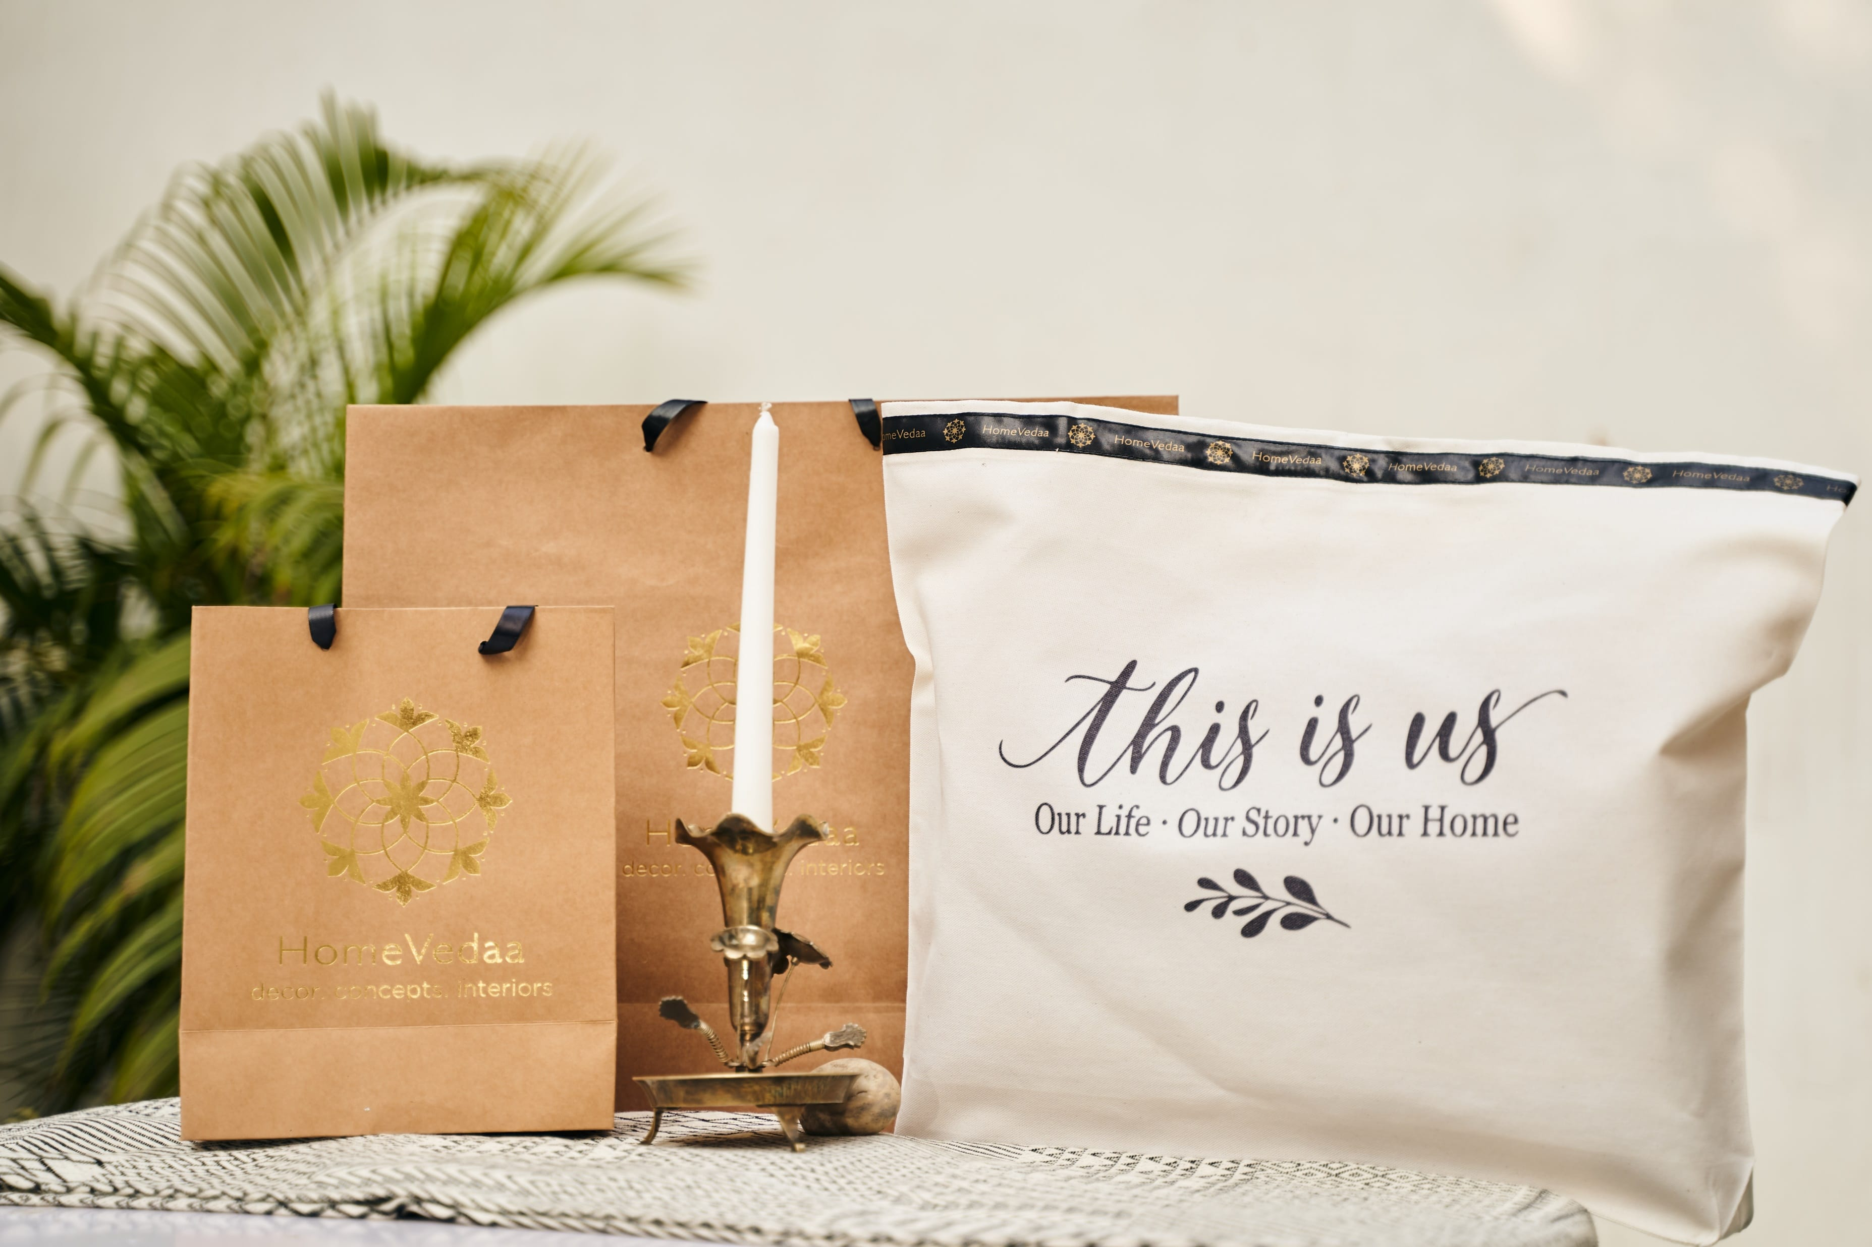
Gifting something you love . . . to the ones you love !
Gifting

Slide 2
HomeVedaa is a platform bringing together finely crafted pieces and home accessories. Each product lovingly crafted with attention to detail, lending that special touch of beauty and luxury. We do not believe in compromising on quality, ethical sourcing and sustainable packaging standards.
We are a homegrown brand founded in the year 2019.
Our Core Values – Transparency and connect with our customers, encouraging and empowering them to make conscious lifestyle choices by offering sustainable products across various categories.
Our Mission – Committed to building a vast community of people who believe in ethical, sustainable and aesthetically pleasing purchases which are better for the planet.
“Design, product and our ambience must stimulate our five senses of sight, sound, smell, touch and taste. If something does not invoke an emotional response, then know that it’s time for a change! This is my personal belief.”
Mukta Gill
Founder: HomeVedaa – Home n Lifestyle
Our DNA

Slide 3
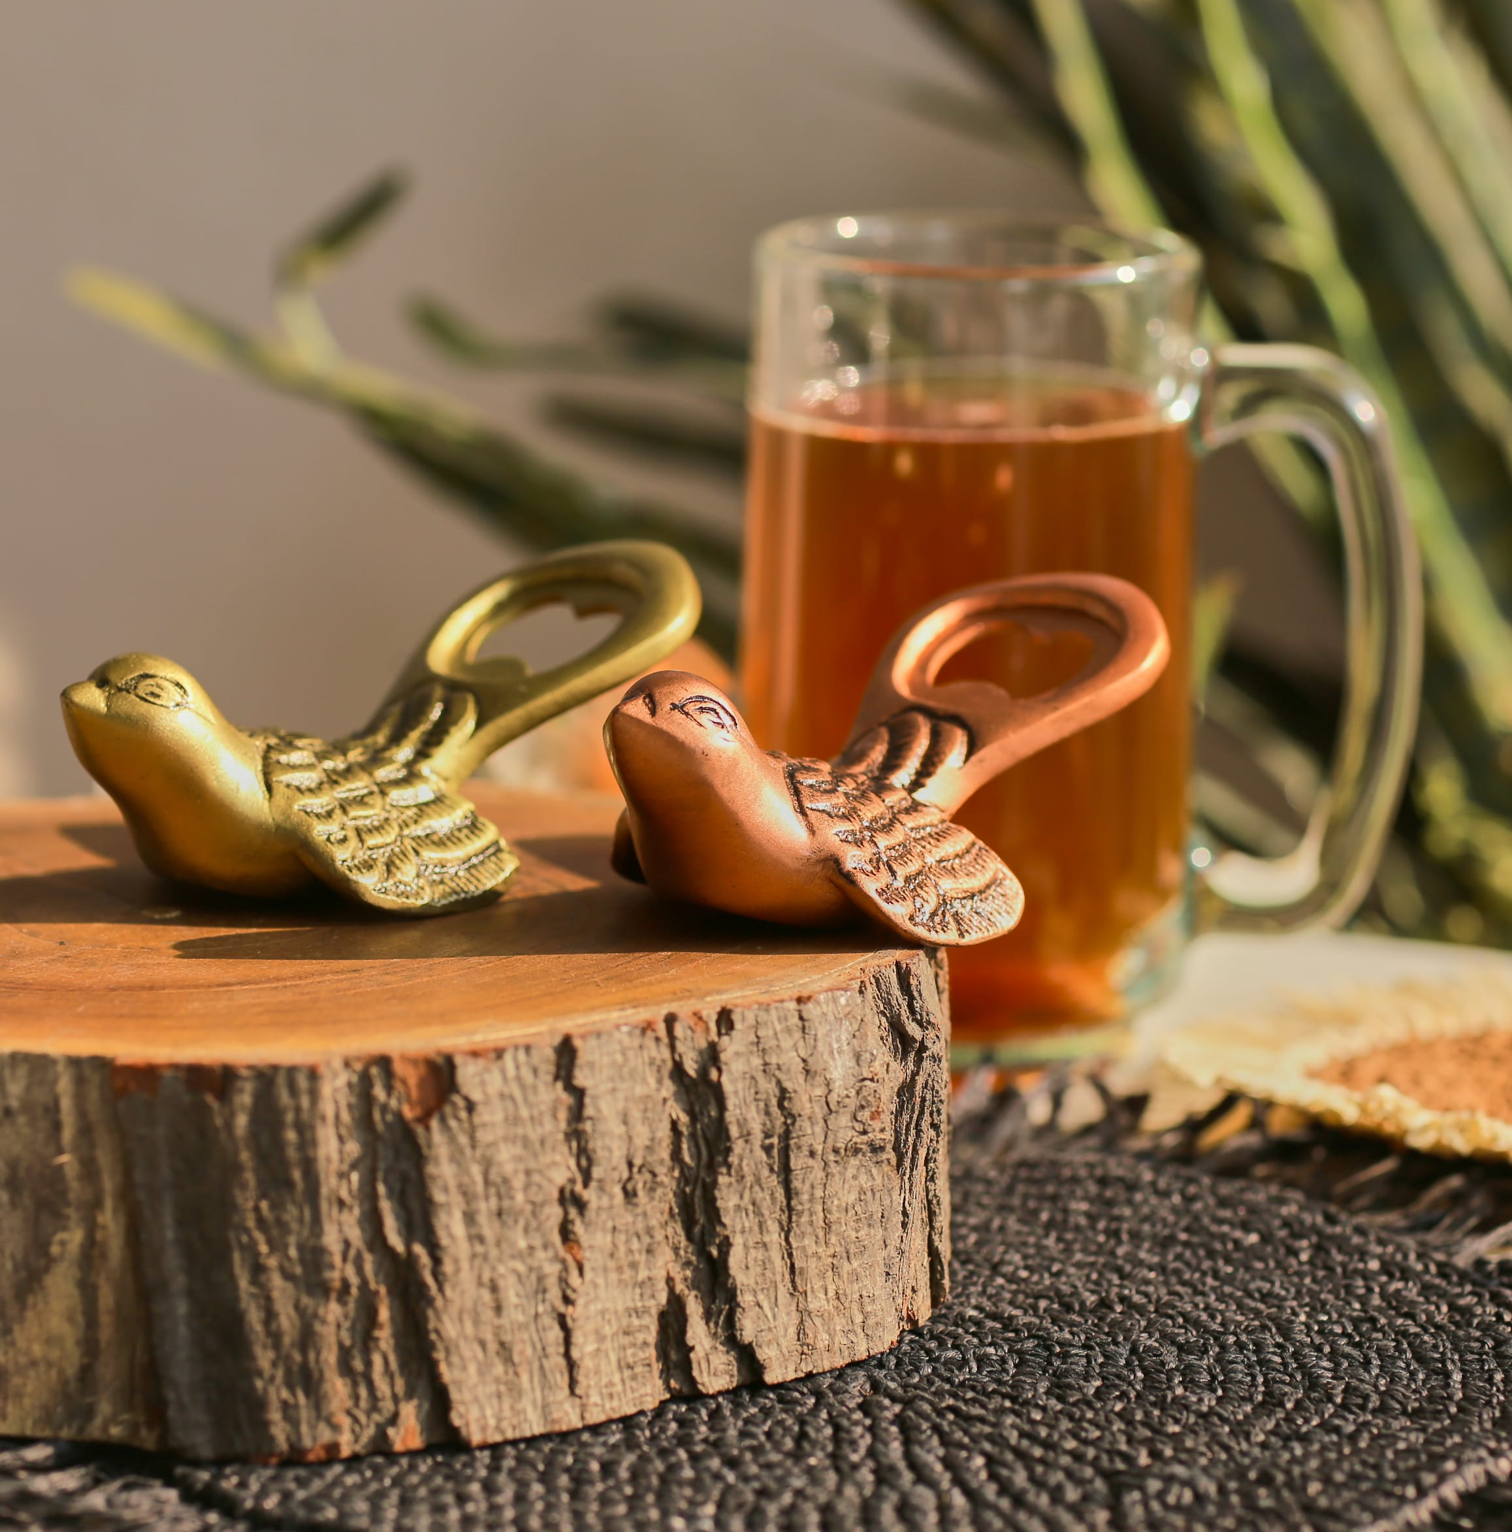
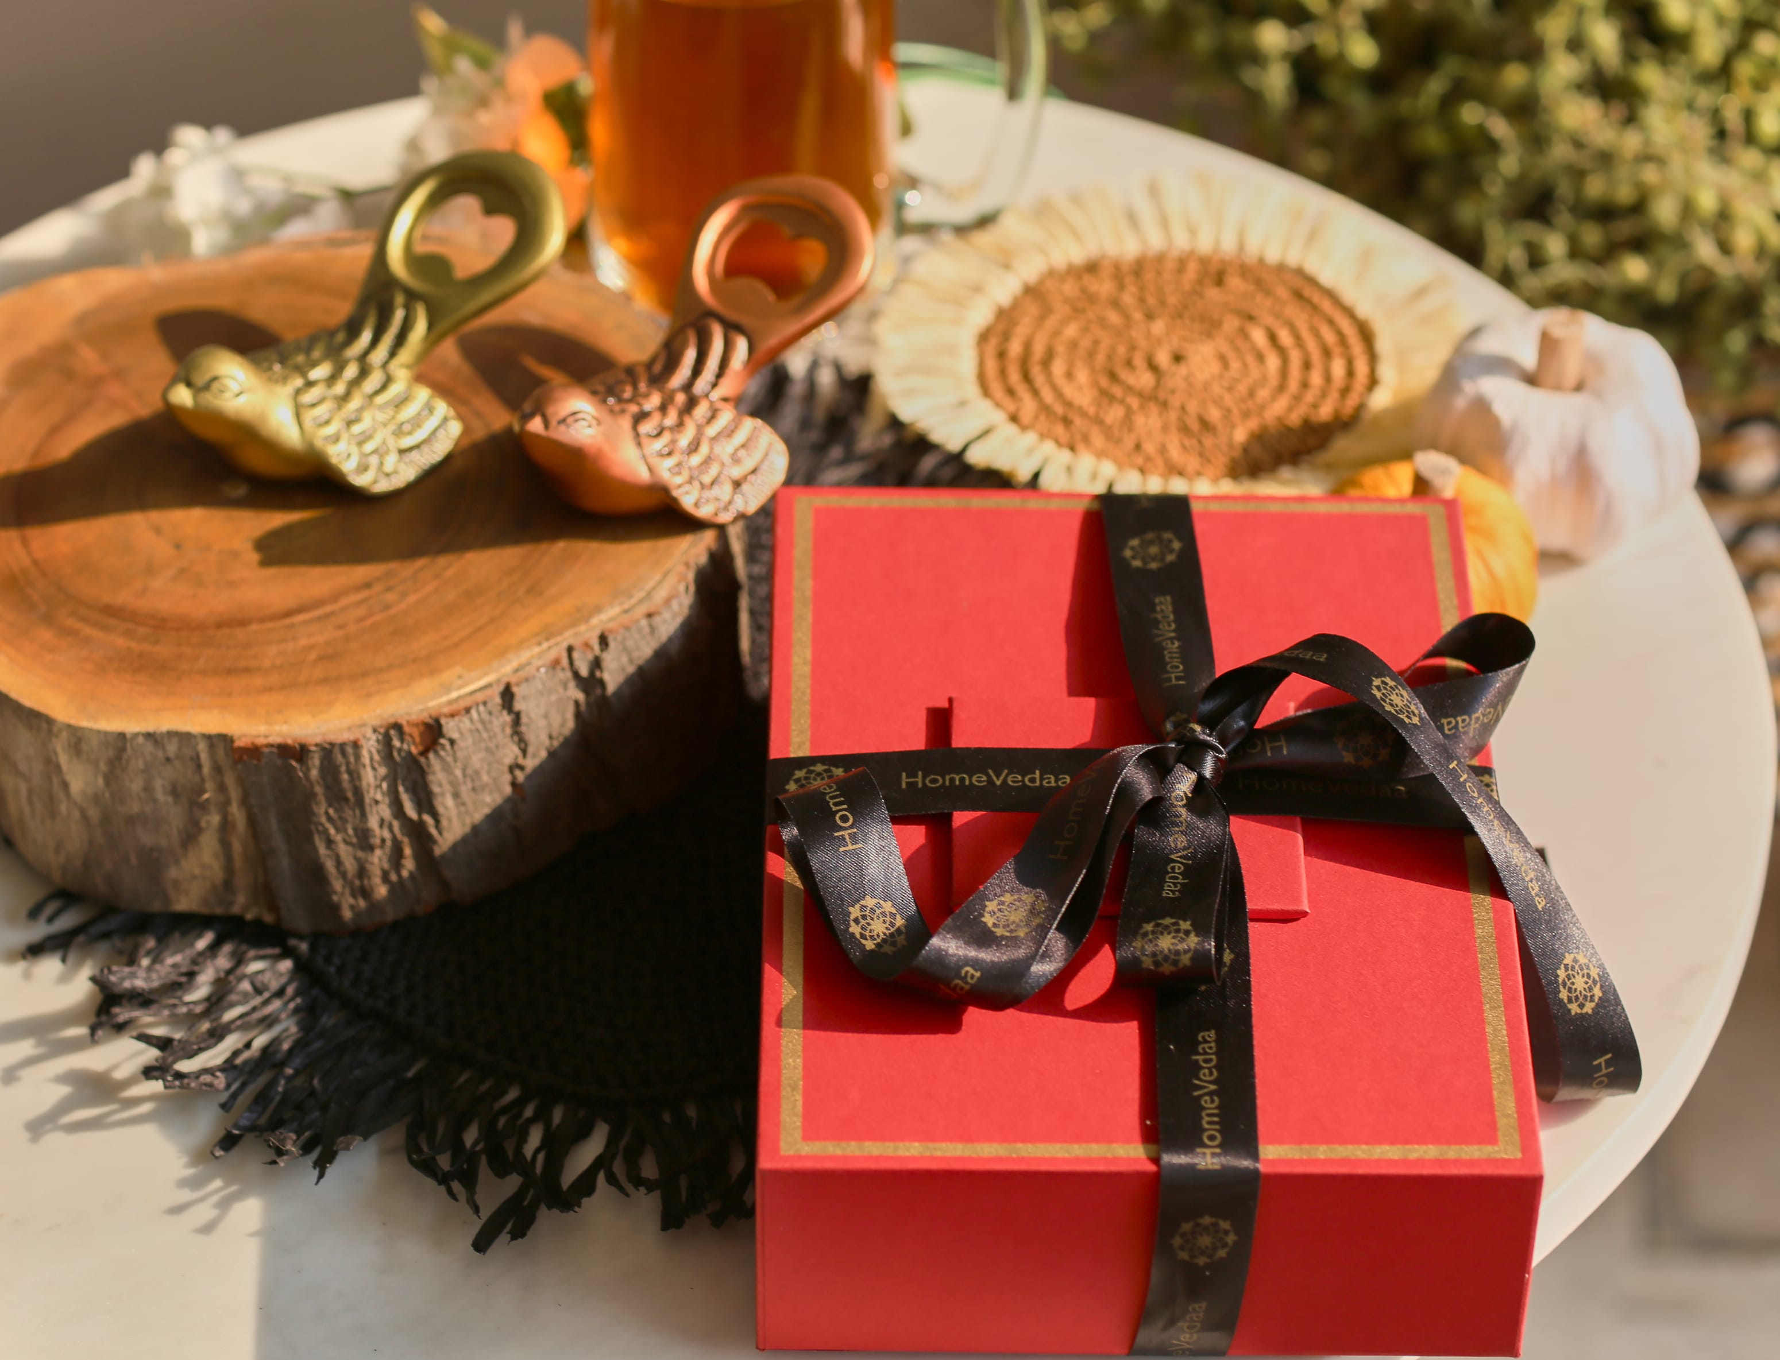
Twitter Opener set of 2 – Inr 1750
Gifting
https://homevedaa.com/product/twitter-opener-set-of-2/

Slide 4
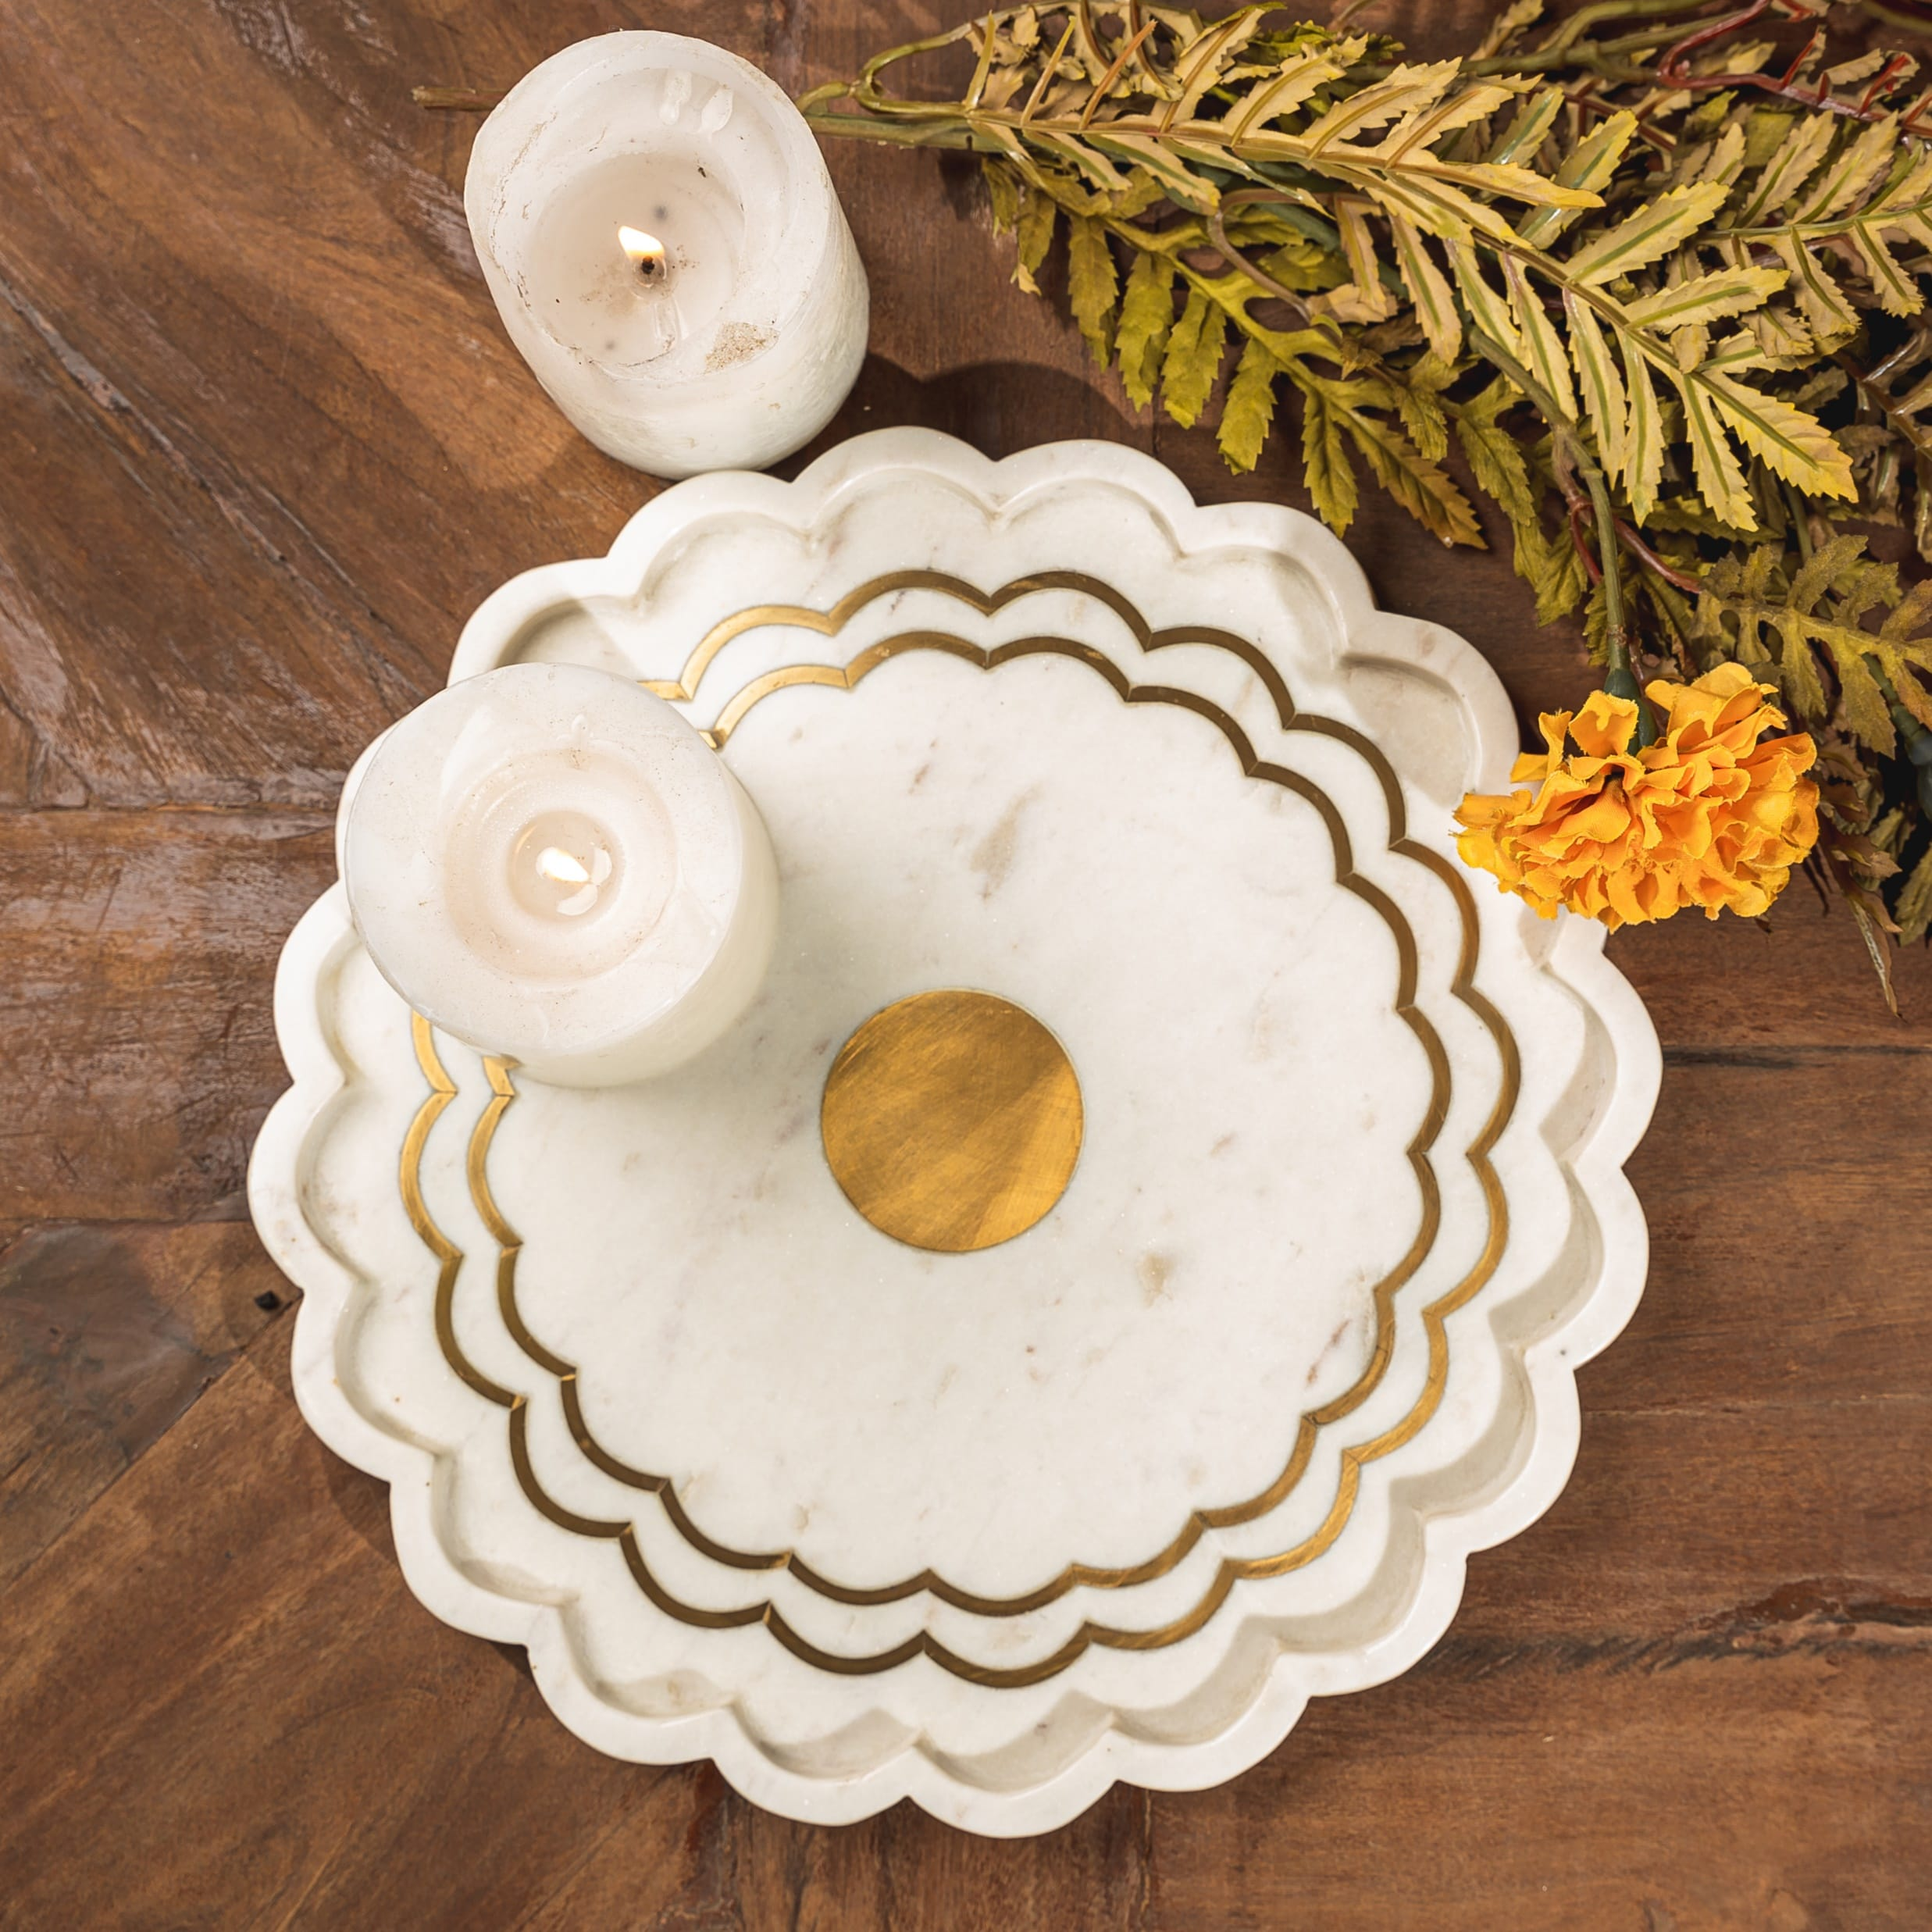
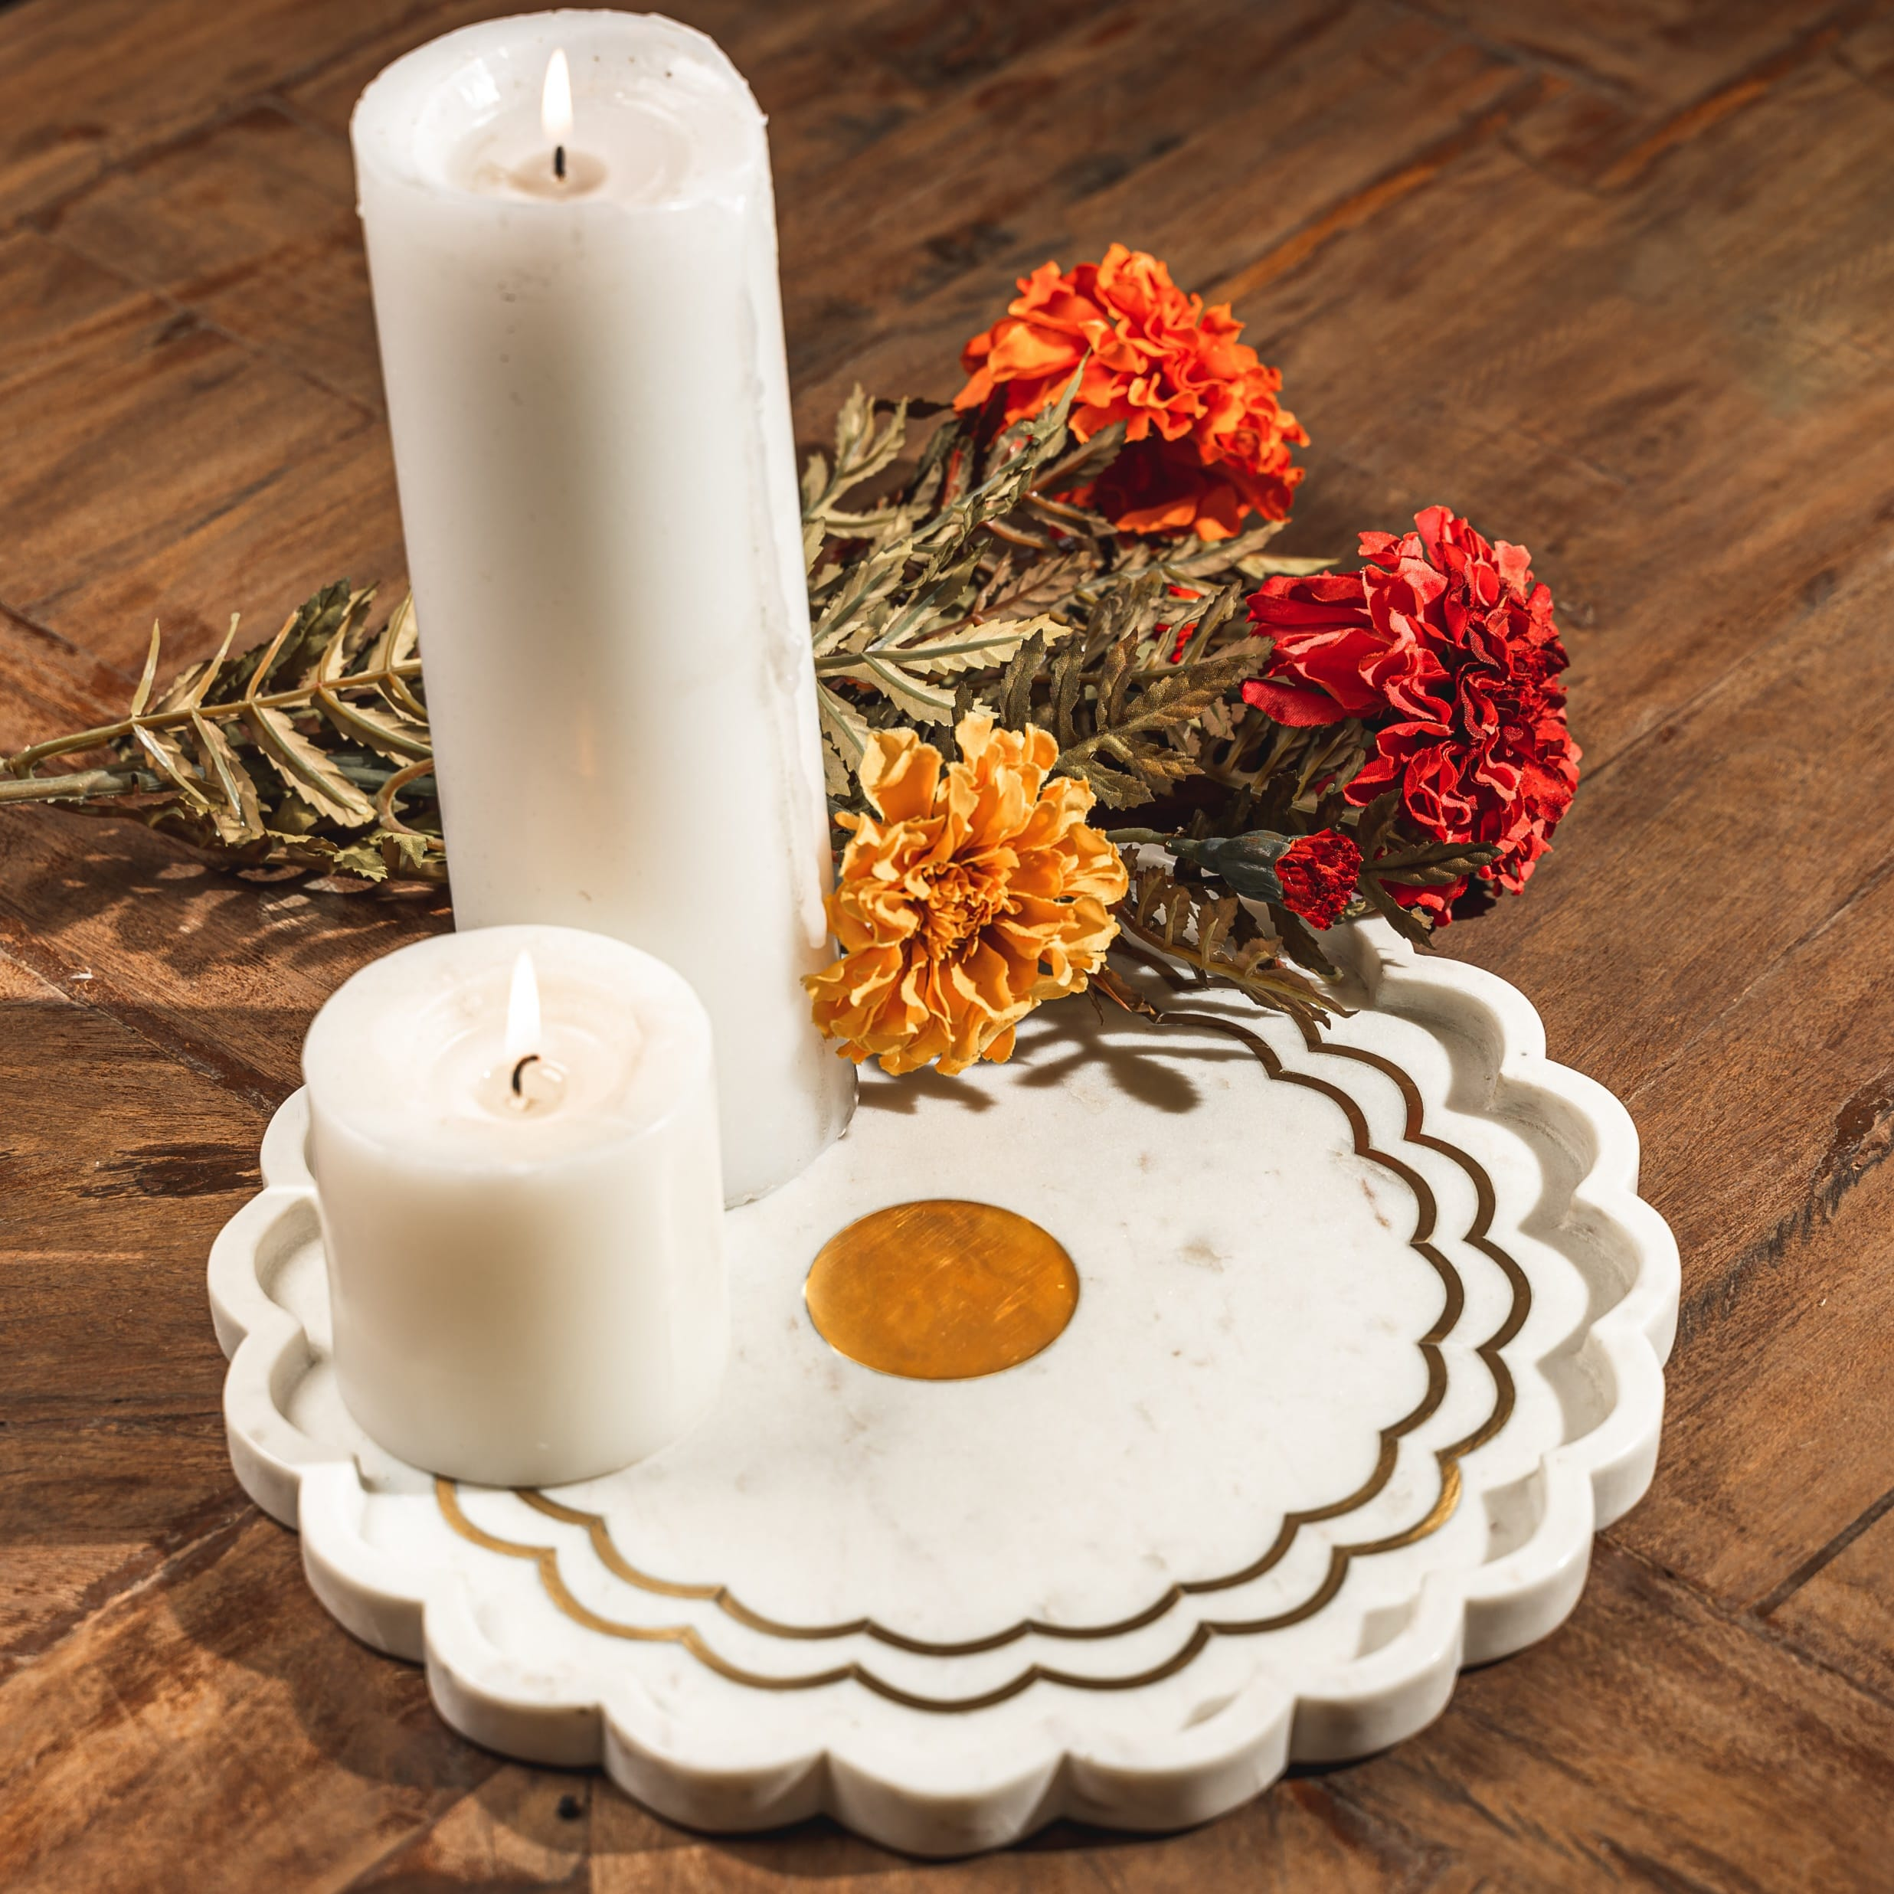
Marigold marble tray with brass inlay – Inr 3750
Gifting
https://homevedaa.com/product/marigold-tray/

Slide 5
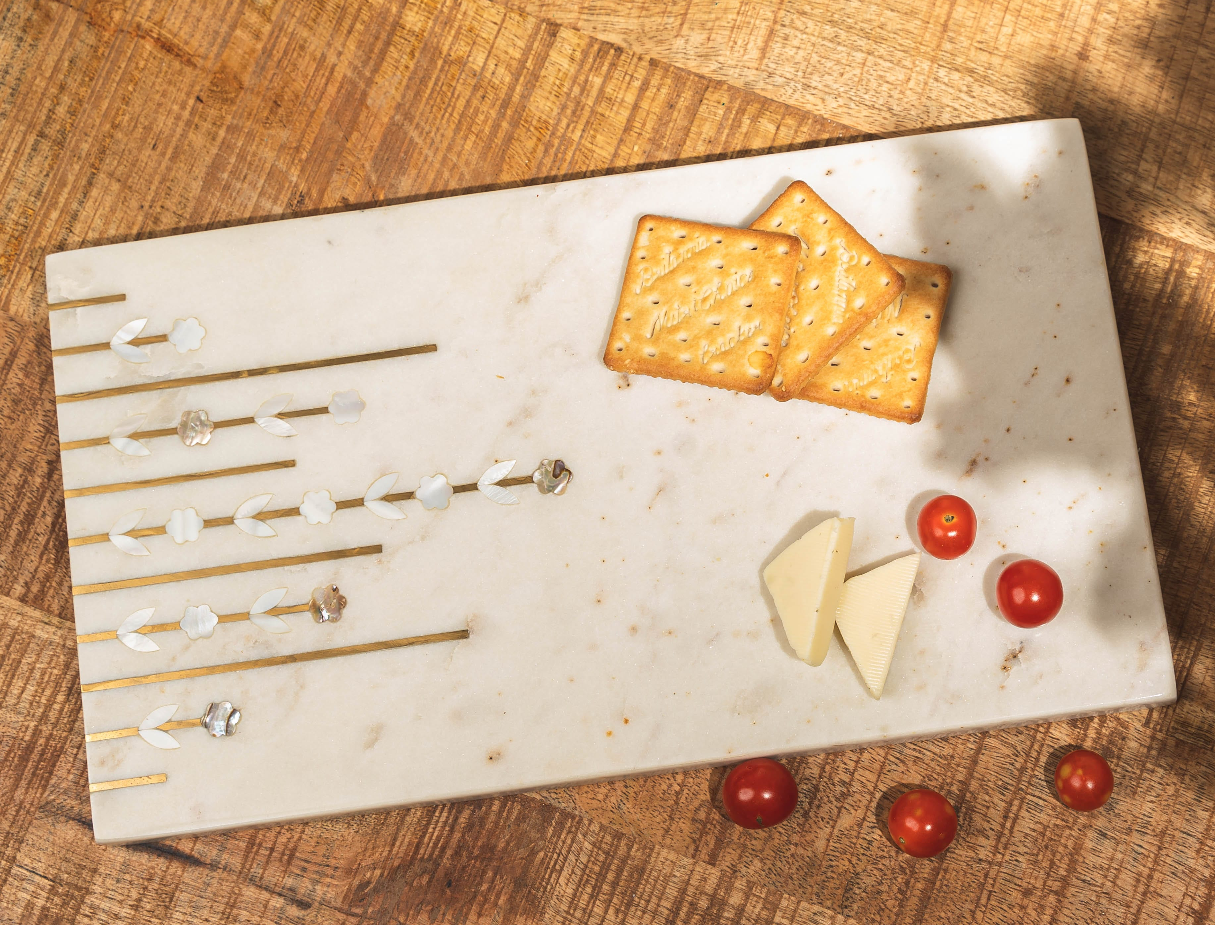
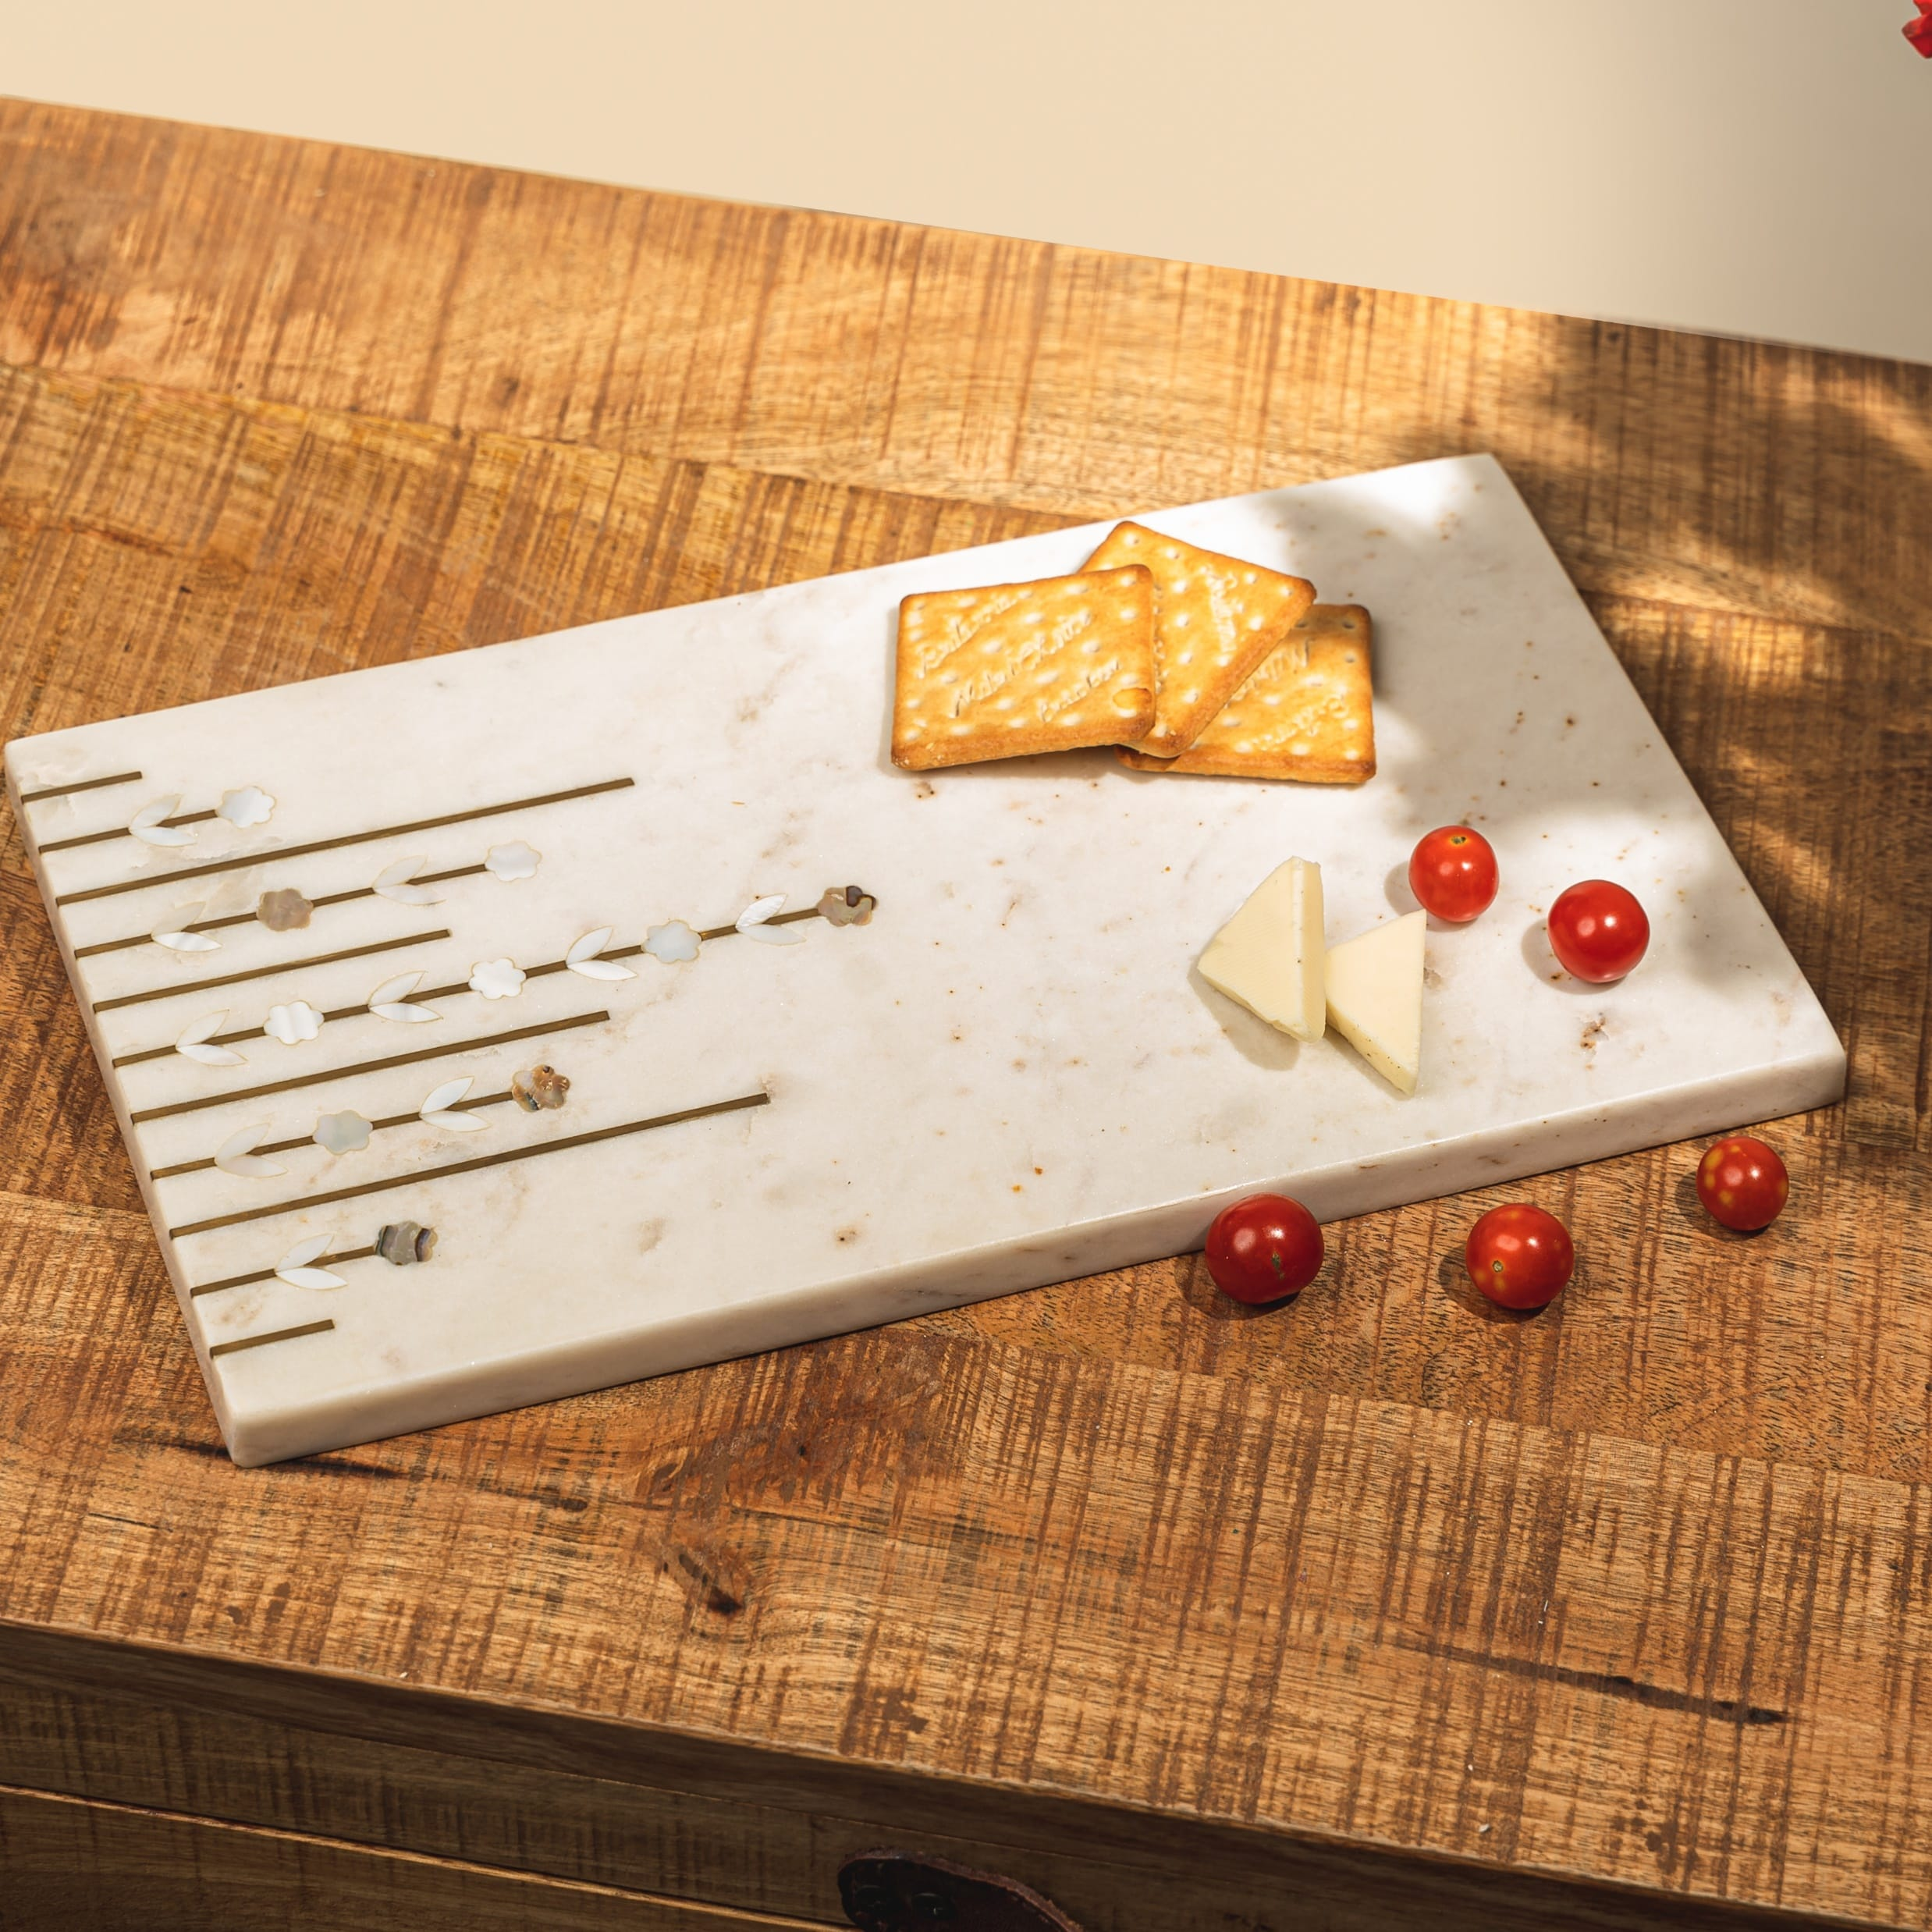
Juniper Marble Platter - inlay design in mother of pearl and brass – INR 3750 – Currently on promotion for Inr 2813 only.
Pair it with a set of our Cheese Knives and you are all set with a gorgeous gift !
Gifting
https://homevedaa.com/product/juniper-platter/

Slide 6
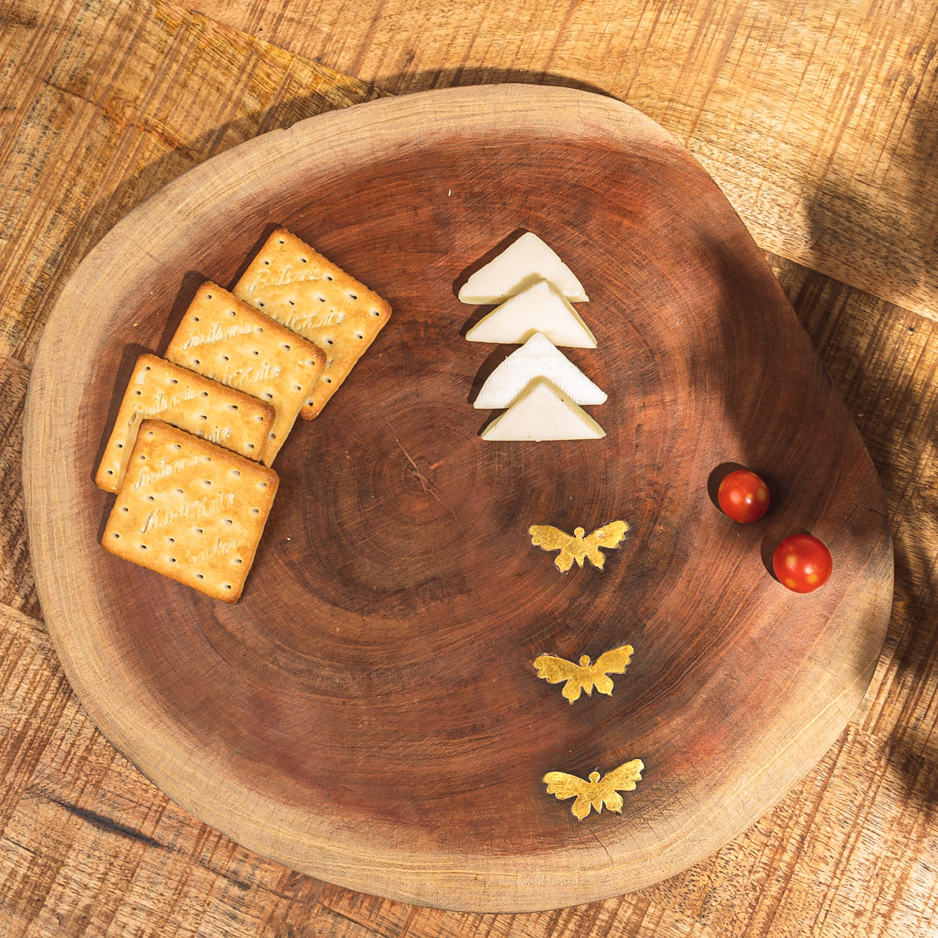
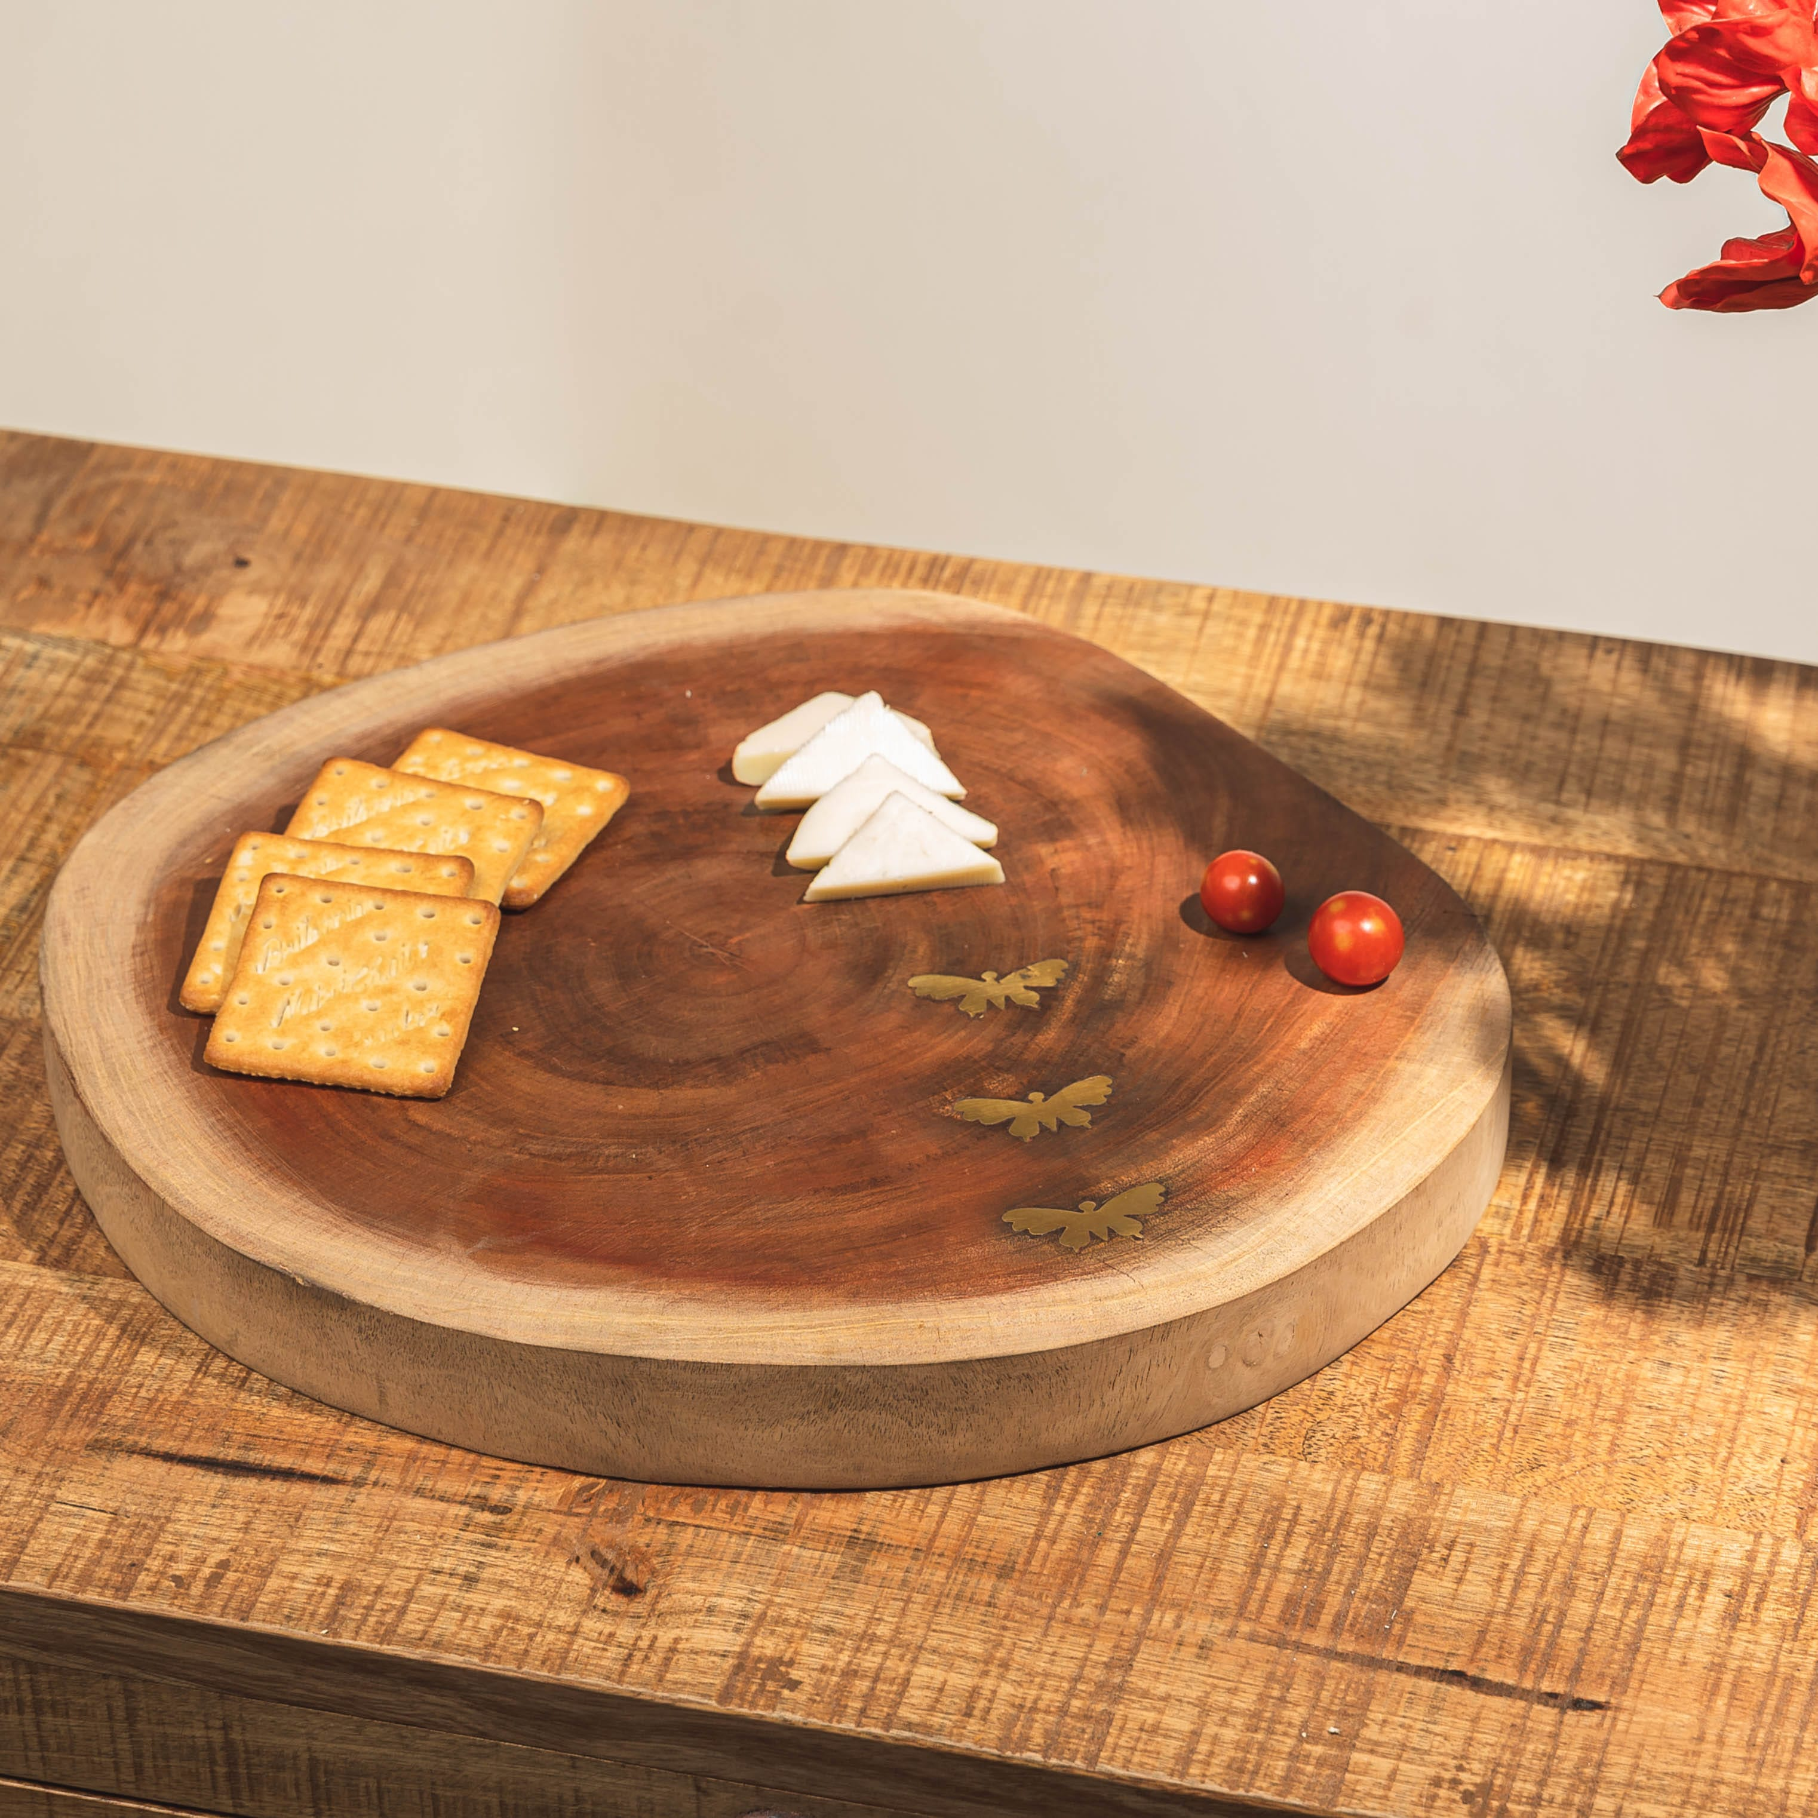
Butterfly Platter – crafted from a solid wooden log with butterflies in brass inlay – INR 2650
Currently on promotion for Inr 1855 only. Pair it with a set of our cheese knives !
Gifting
https://homevedaa.com/product/butterfly-platter/

Slide 7
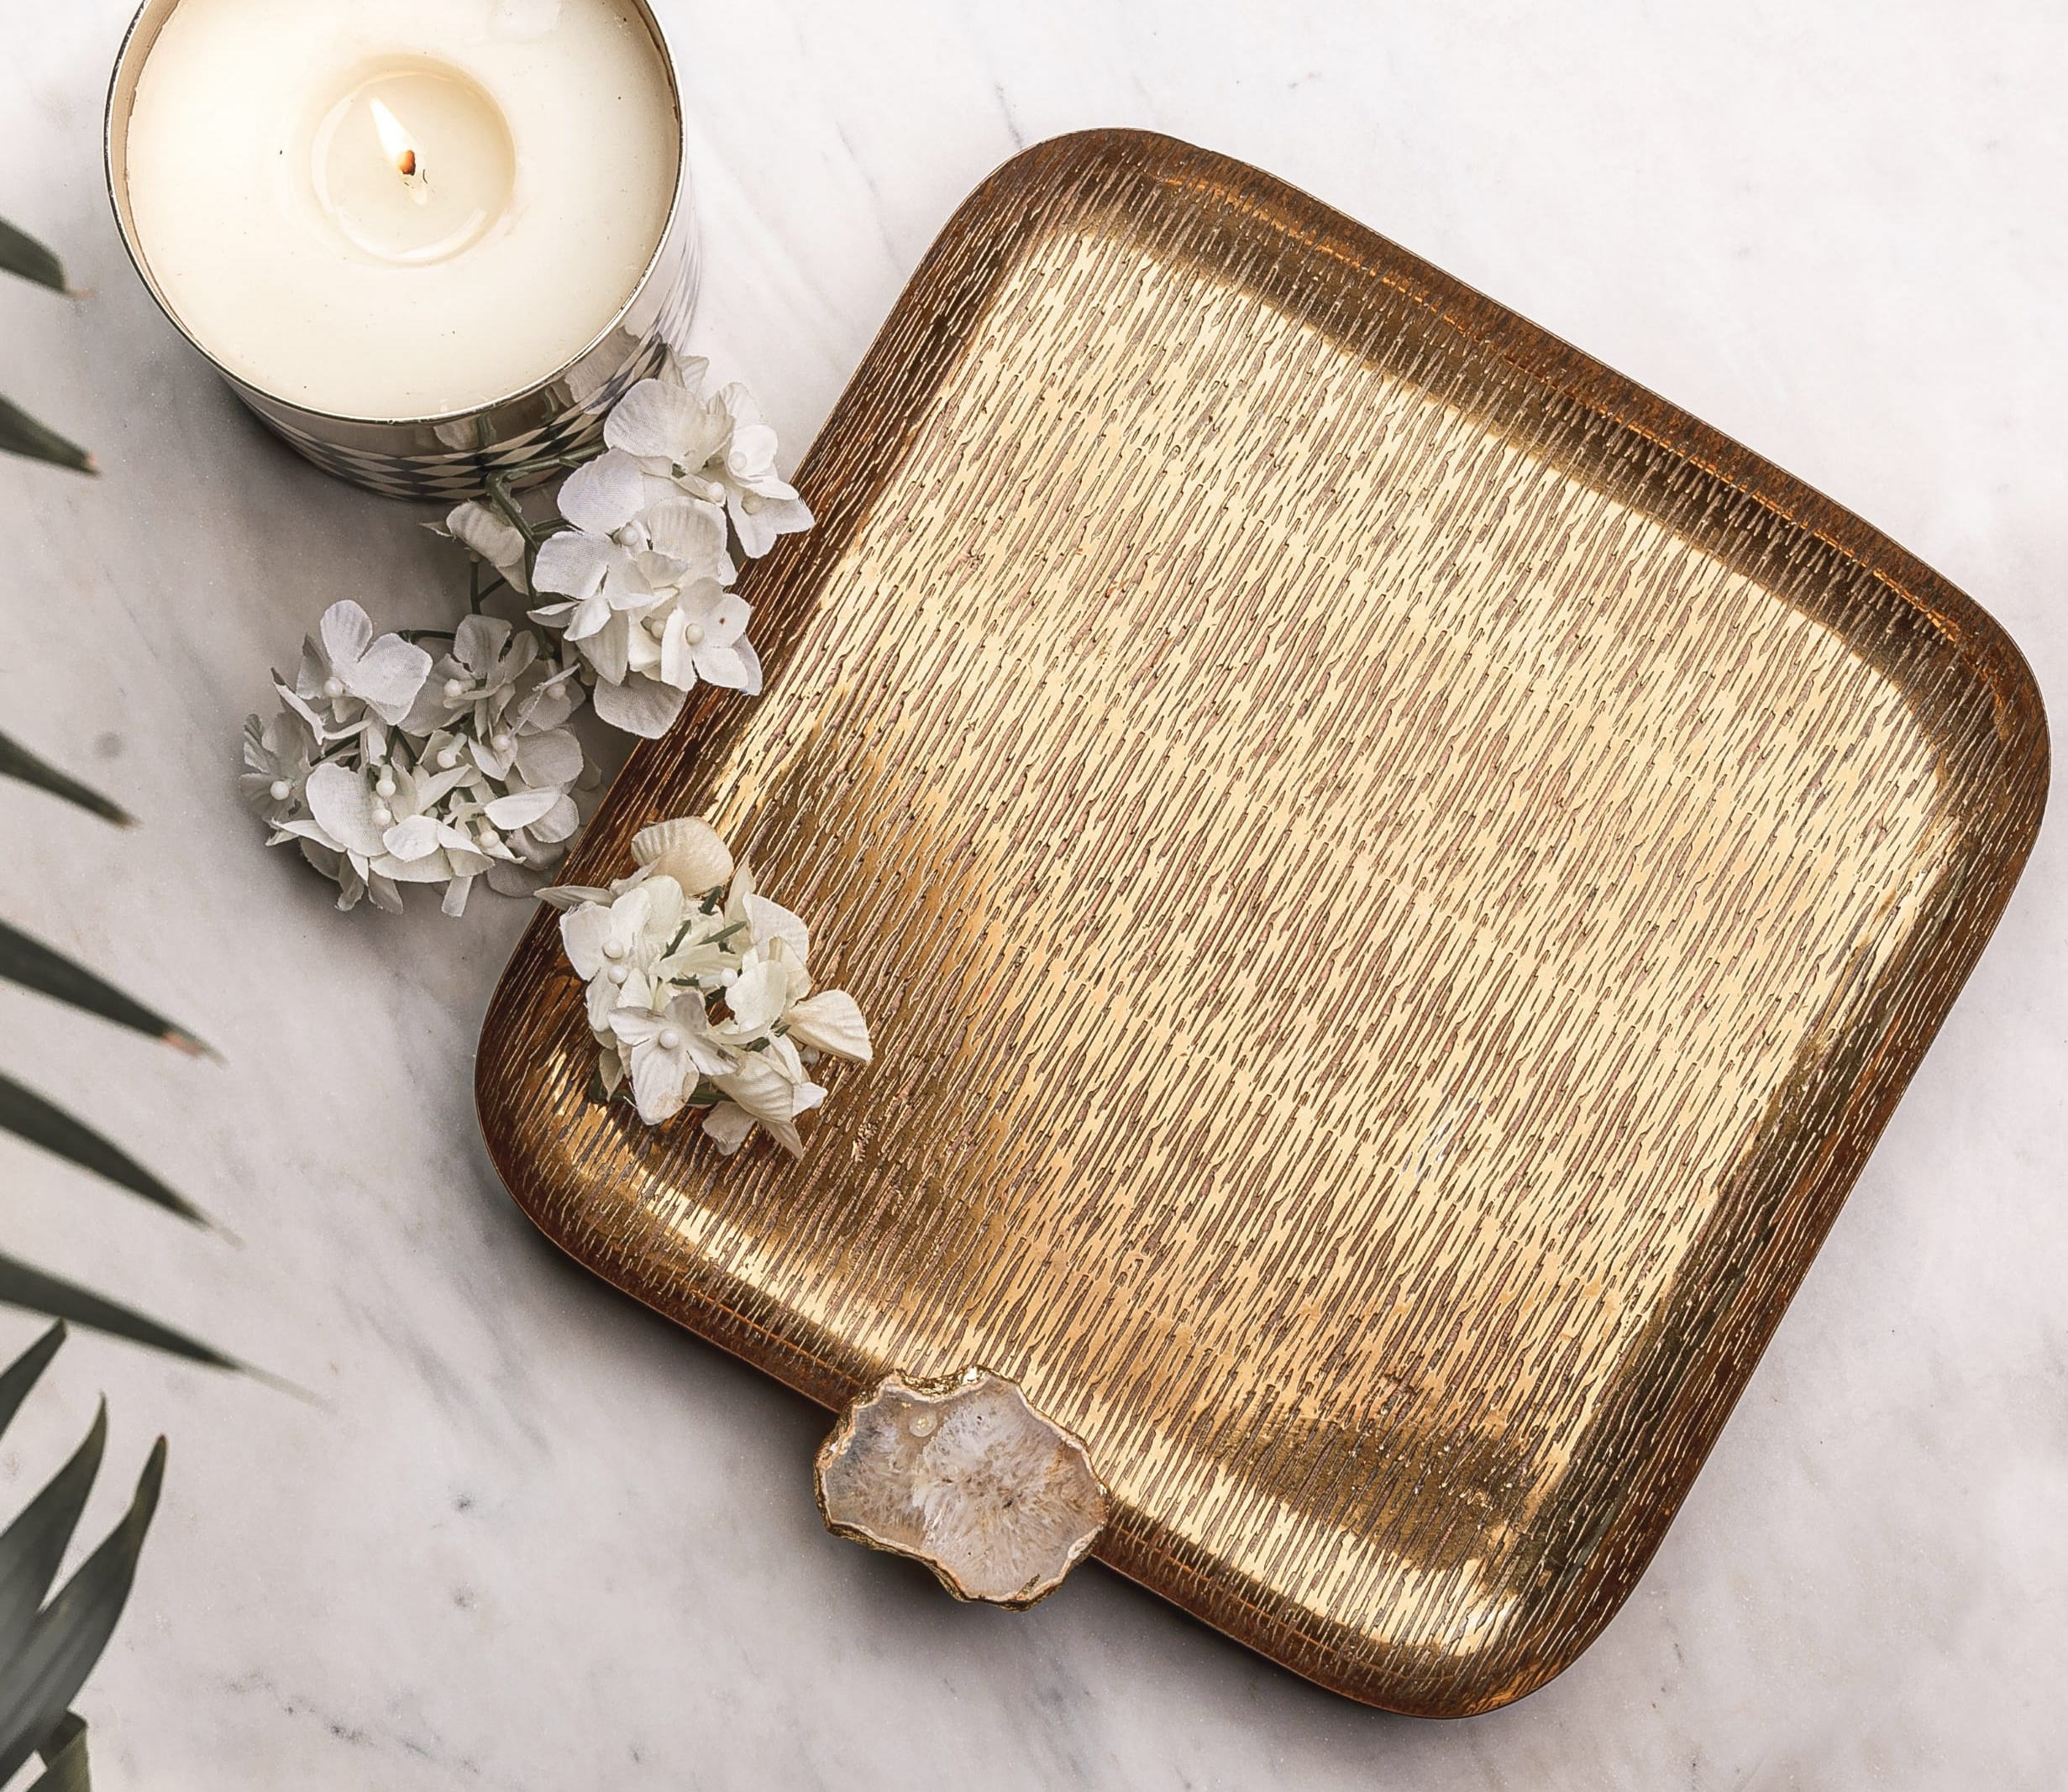
Parissa Platter - pure brass platter with etching allover adorned with a gold agate stone - INR 2750 . Currently on promotion for Inr 1925 only !
Gifting
https://homevedaa.com/product/parissa-platter/

Slide 8
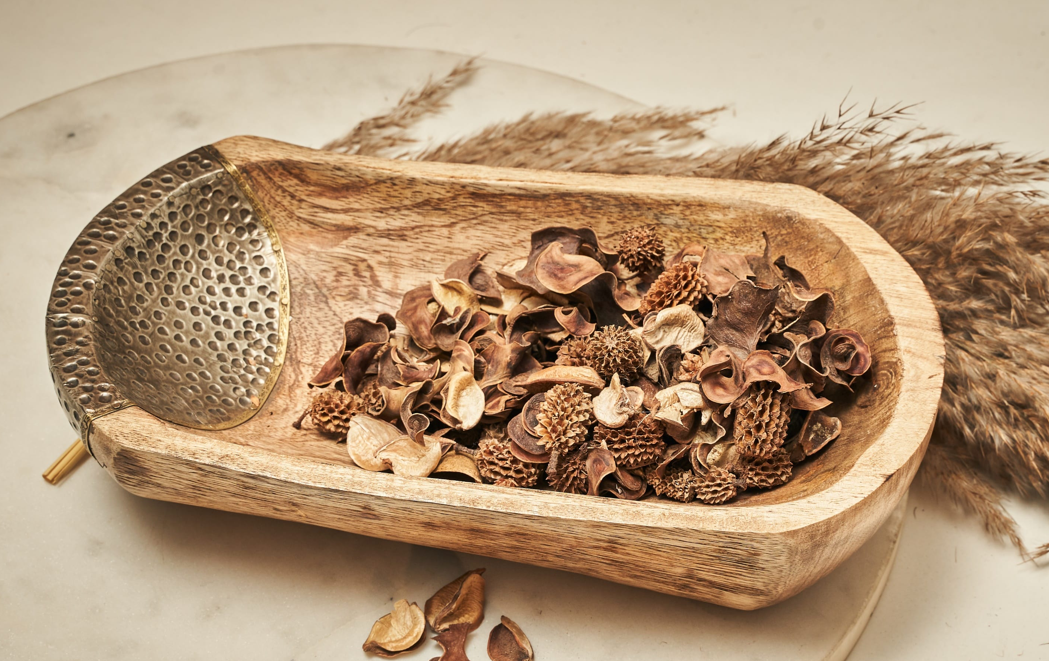
Meadow Wooden Bowl – Inr 2350
Gifting
https://homevedaa.com/product/meadow-wooden-bowl/

Slide 9
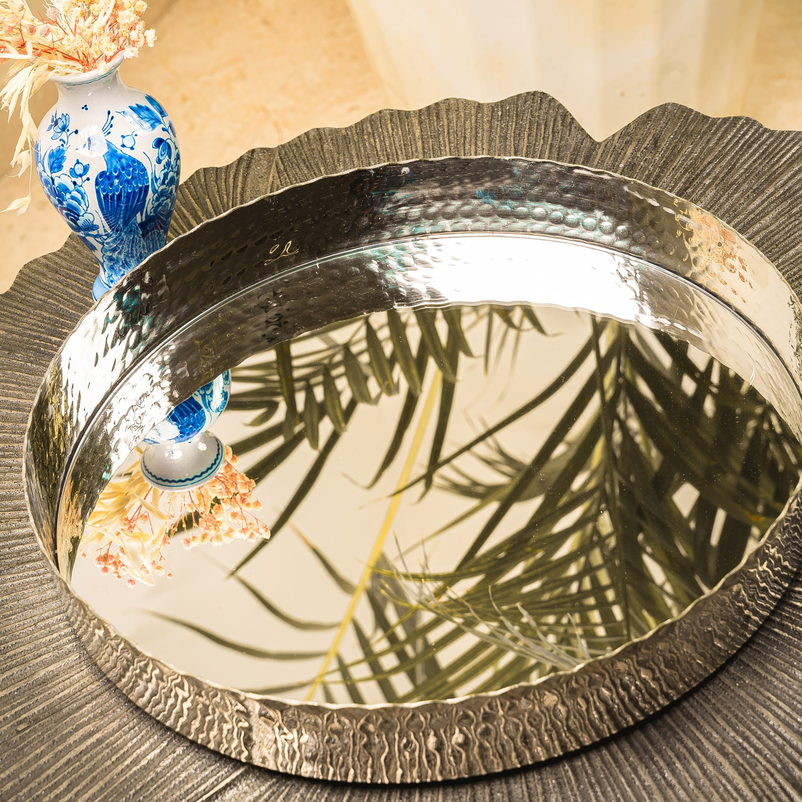
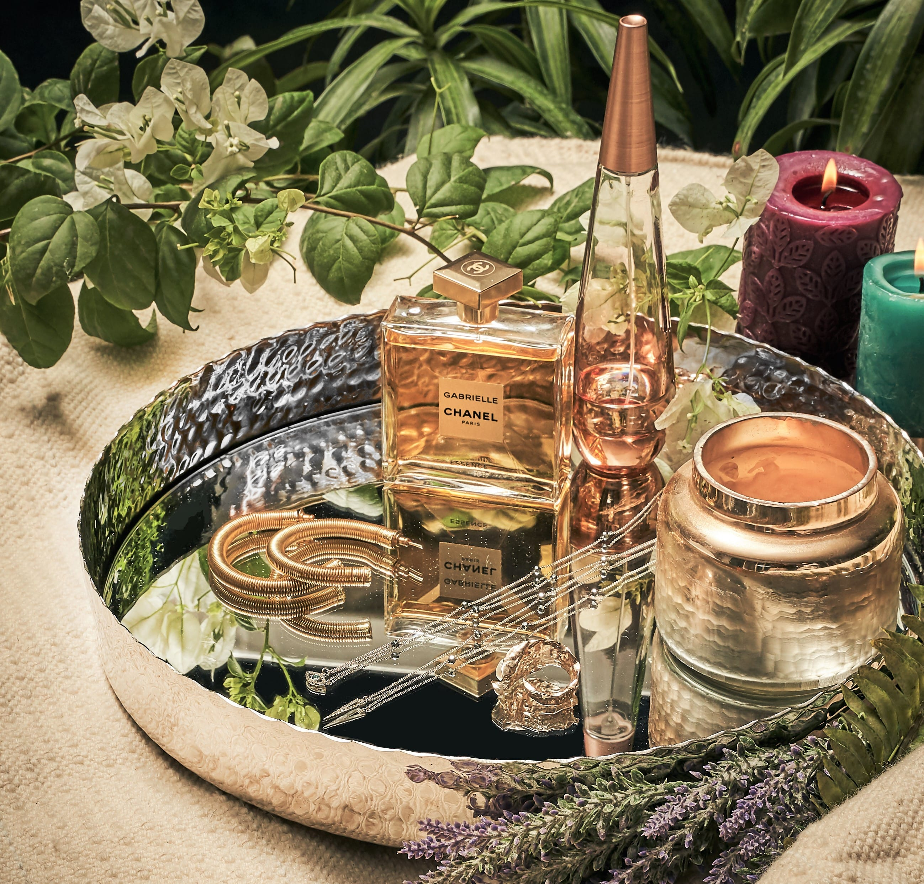
Tia Mirror Tray – Inr 2350
Gifting
https://homevedaa.com/product/tia-mirror-tray/

Slide 10
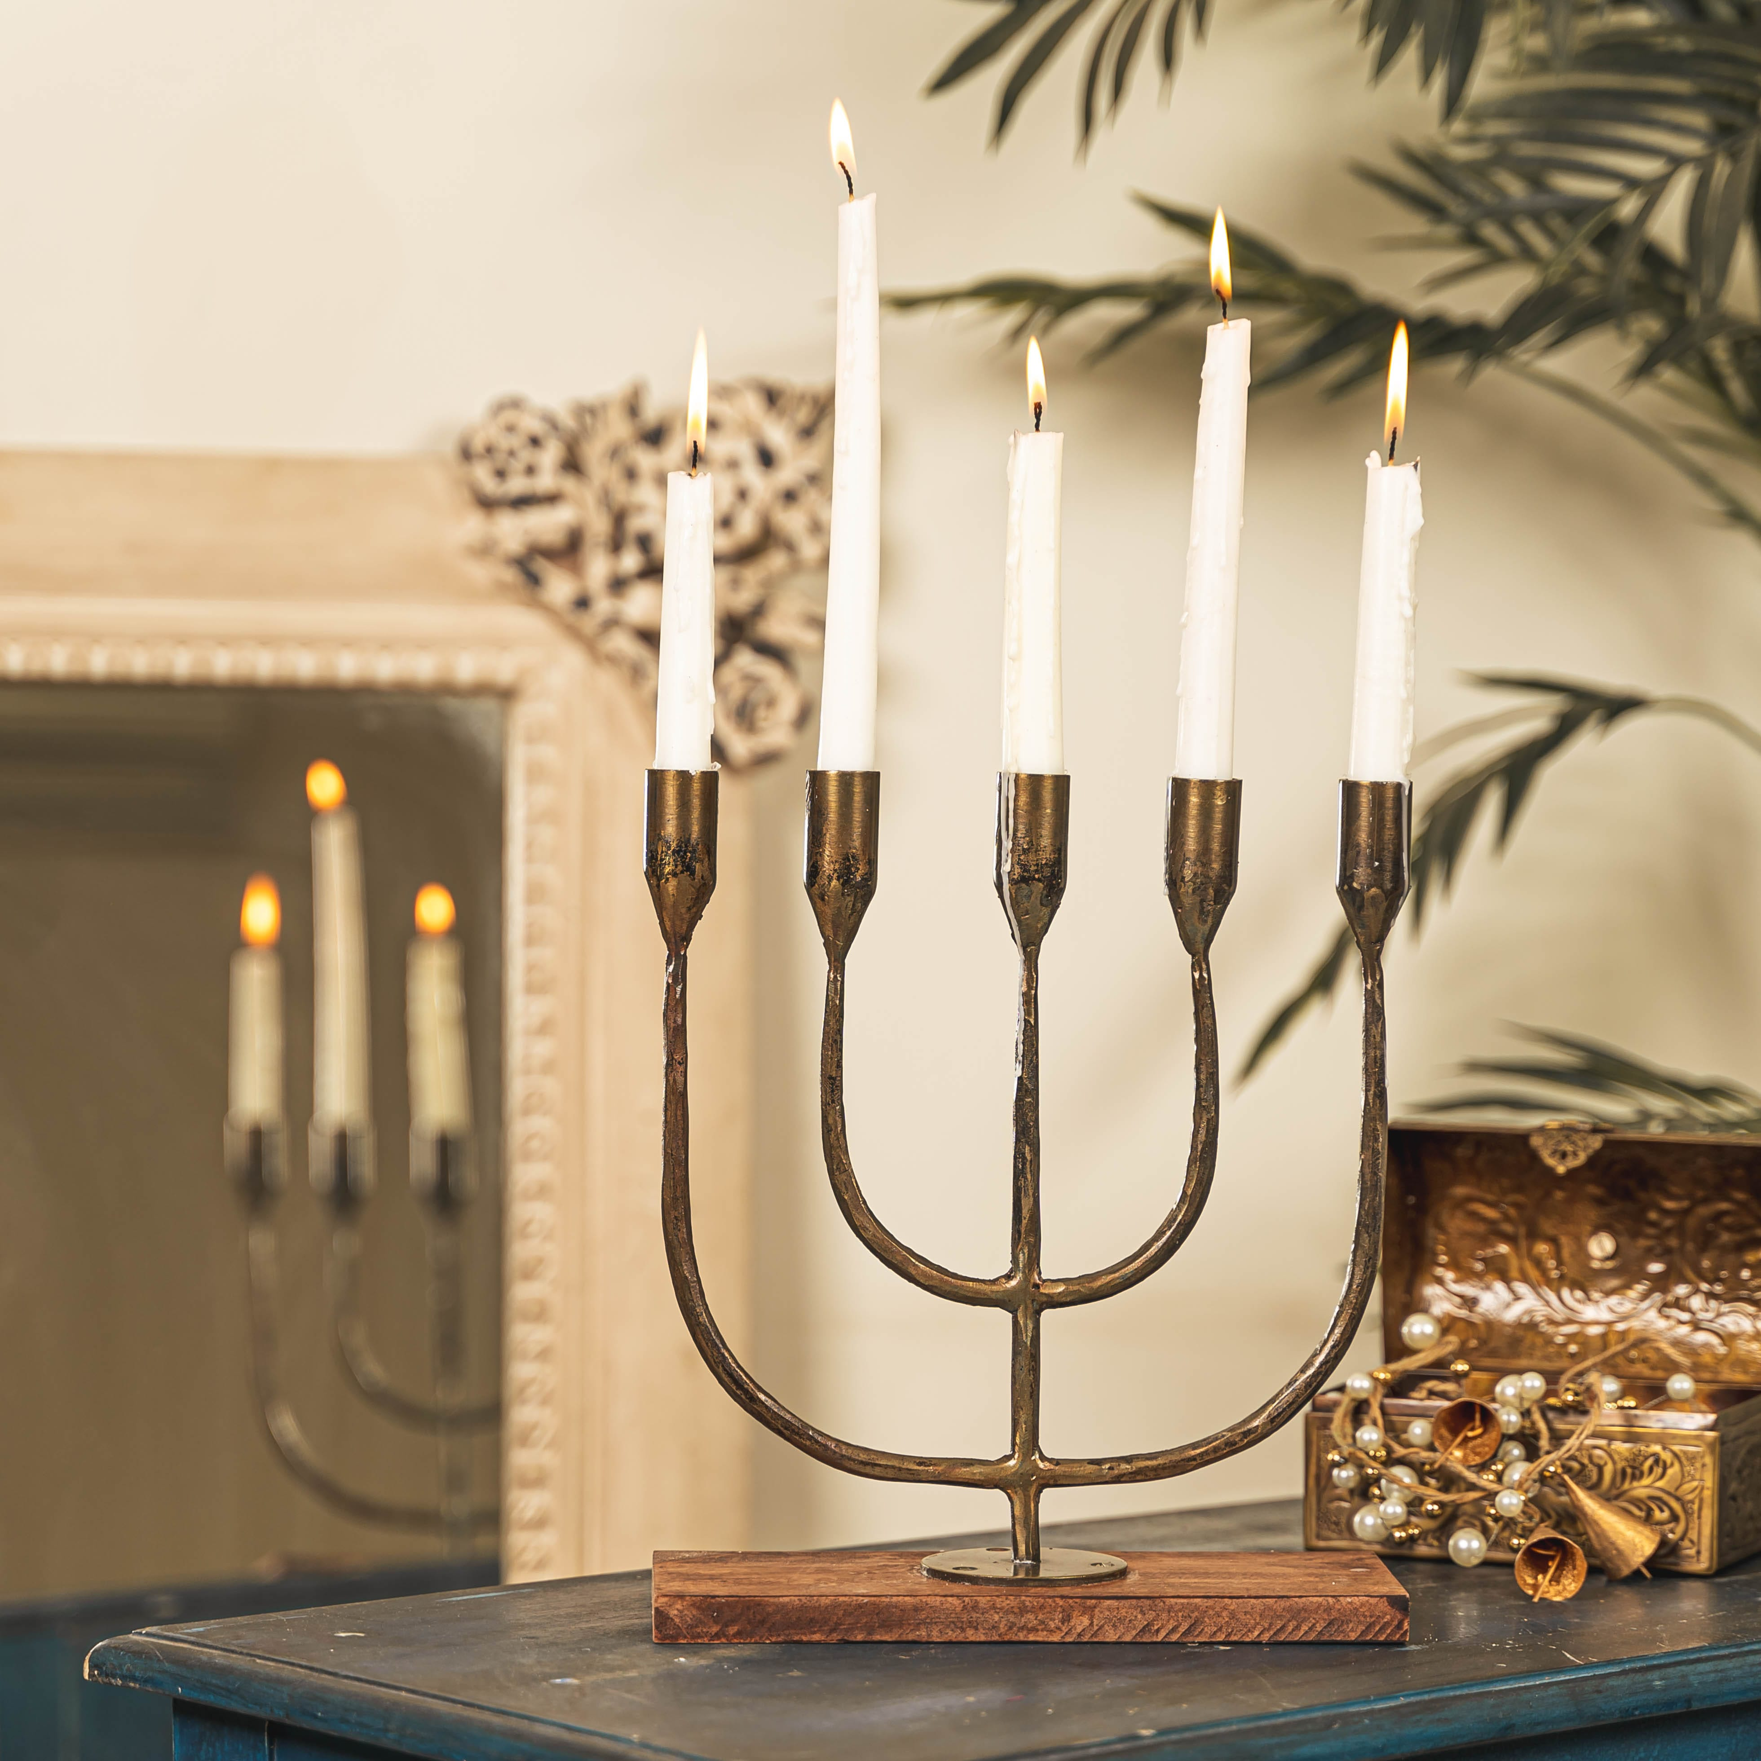
Maya Candelabra – candlestand in hammered metal with wooden base - Inr 2250
Gifting
https://homevedaa.com/product/maya-candelabra/

Slide 11
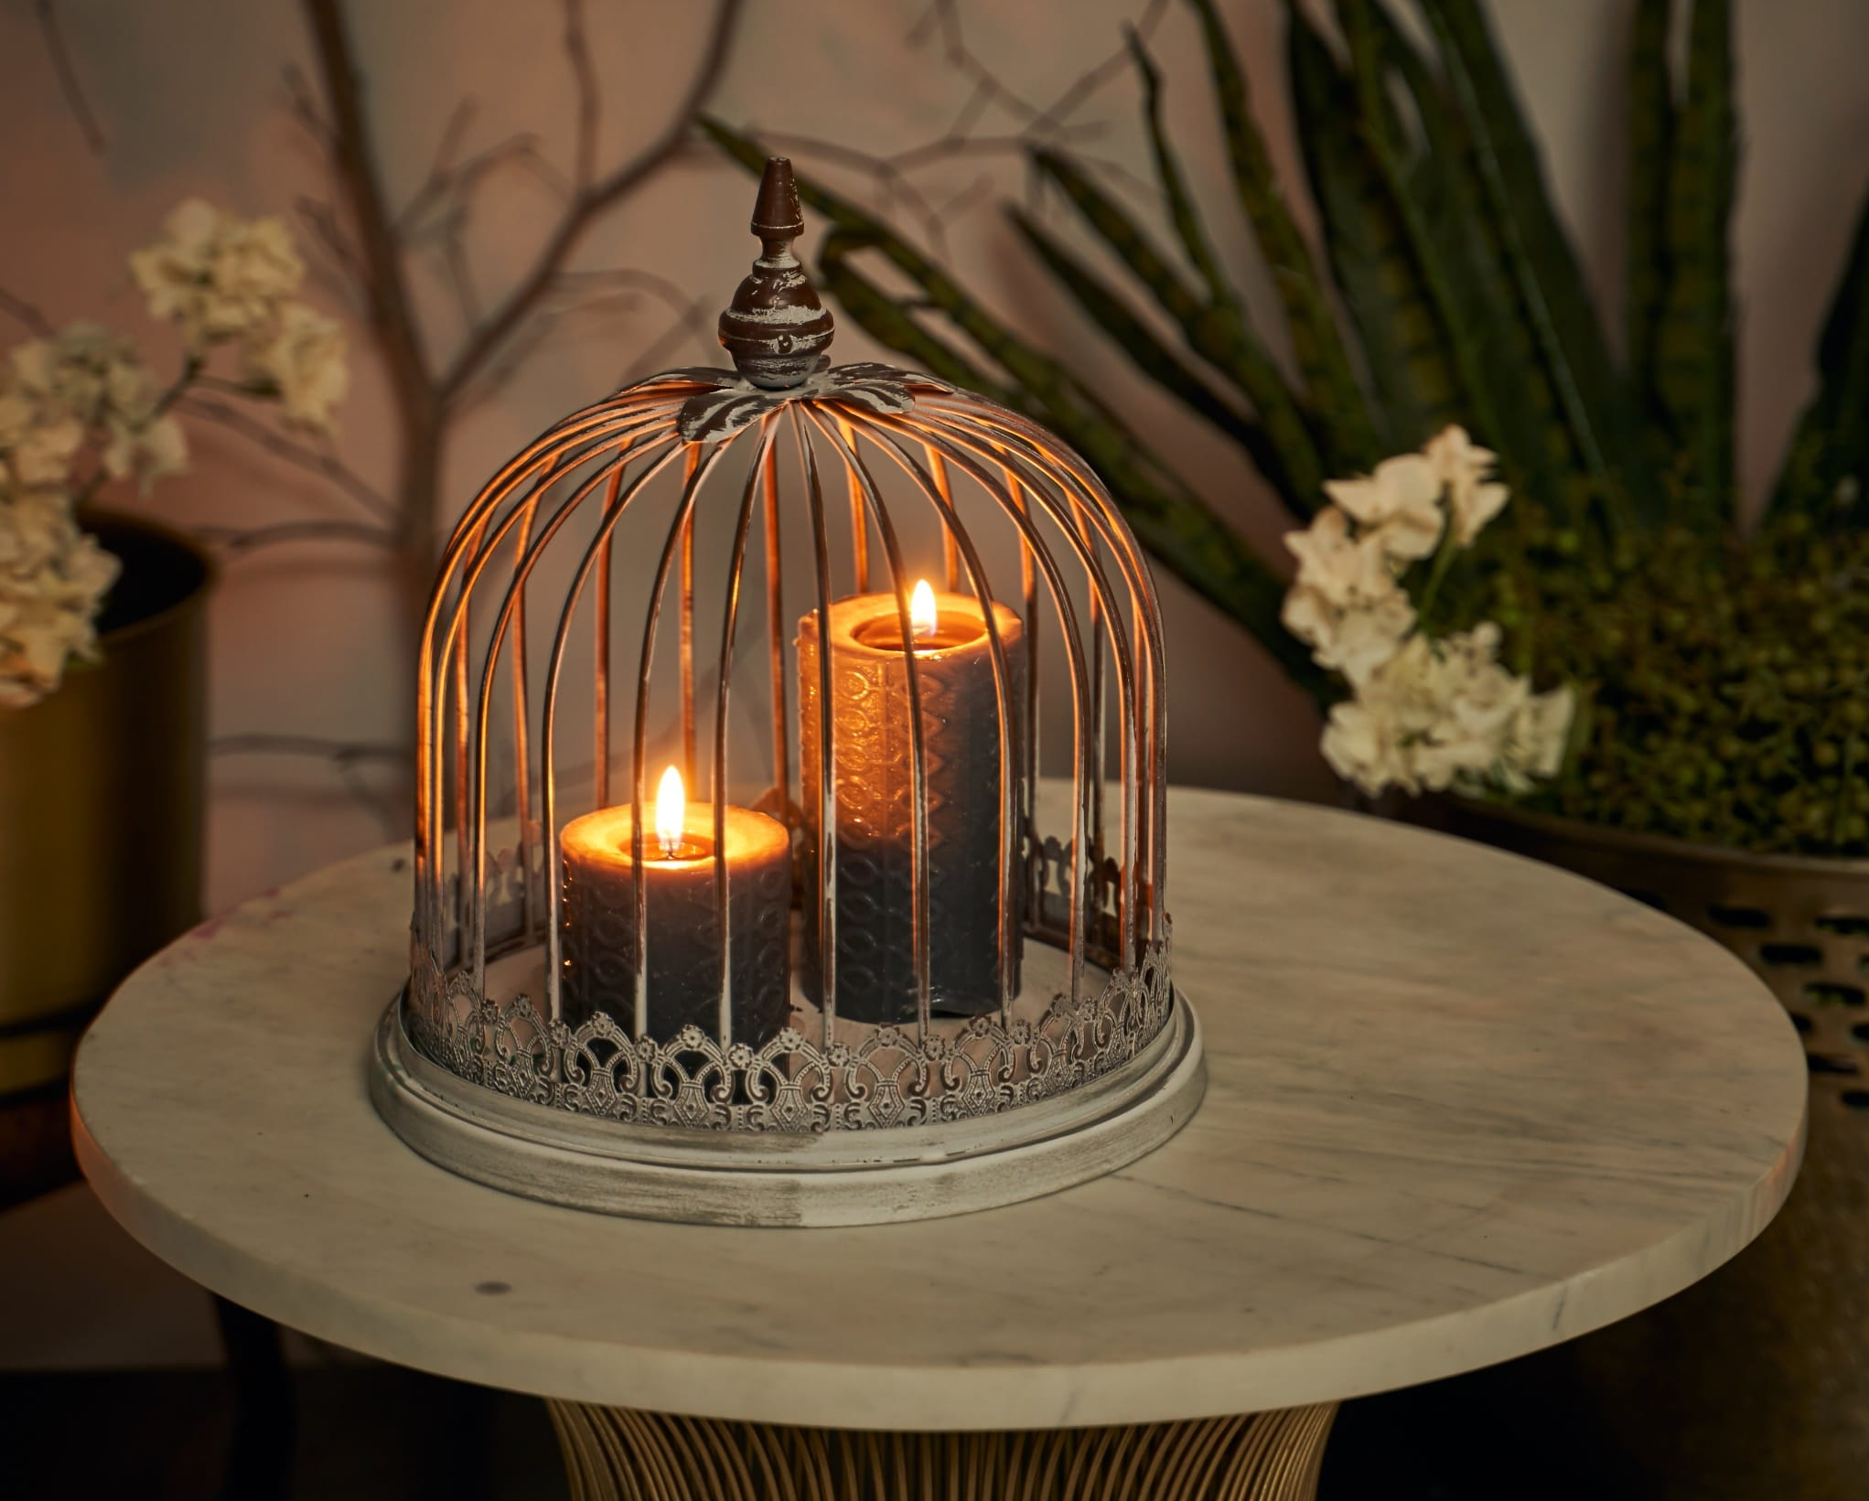
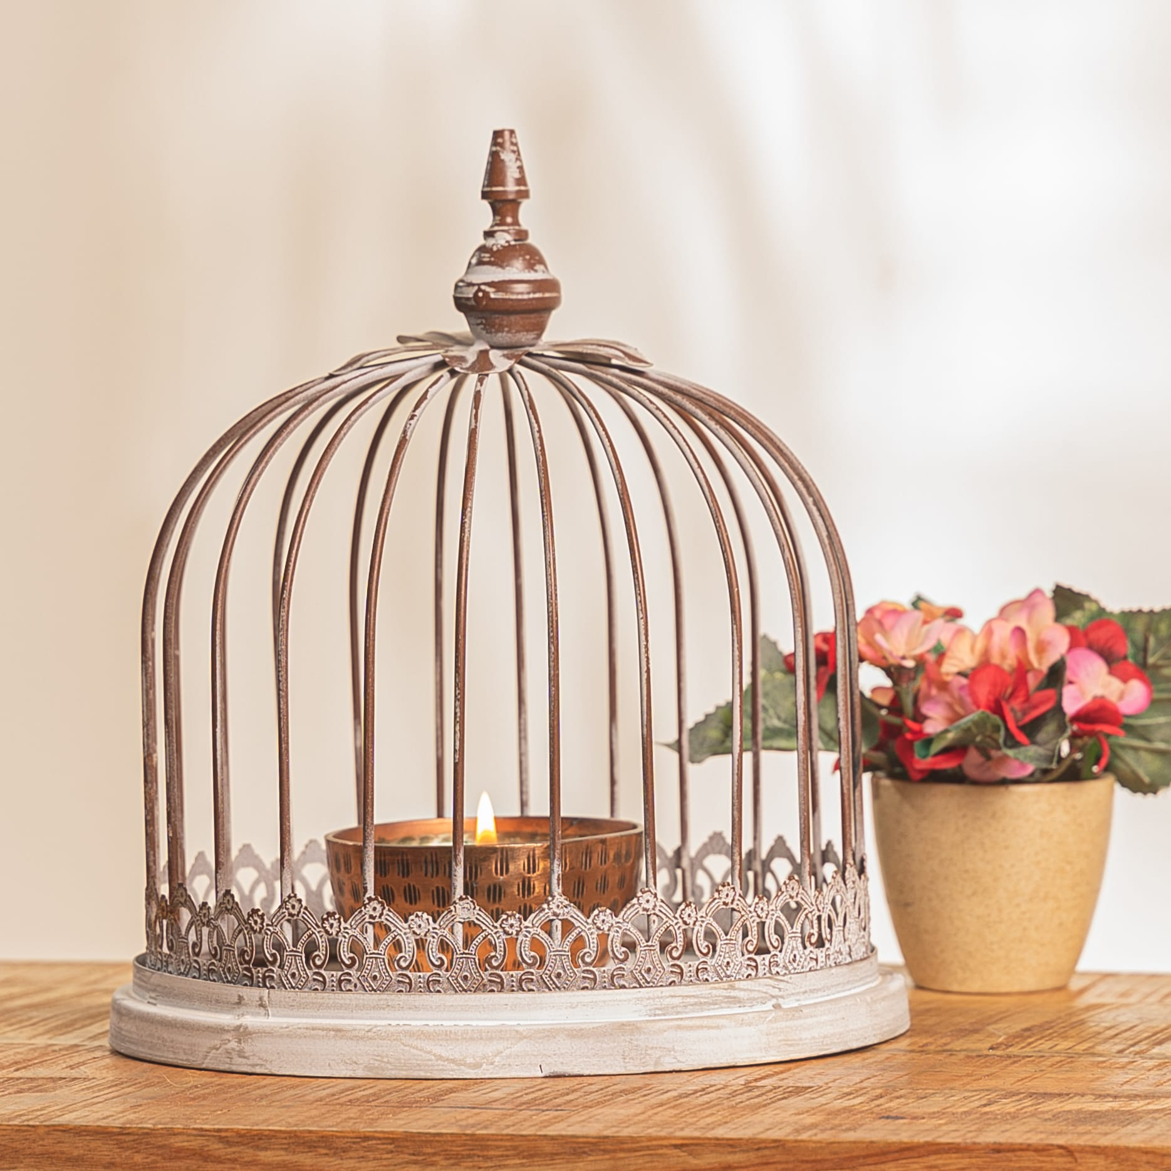
Sophia Candle Holder / Planter pot Holder – Inr 1450
Gifting
https://homevedaa.com/product/sophia-candle-holder/

Slide 12
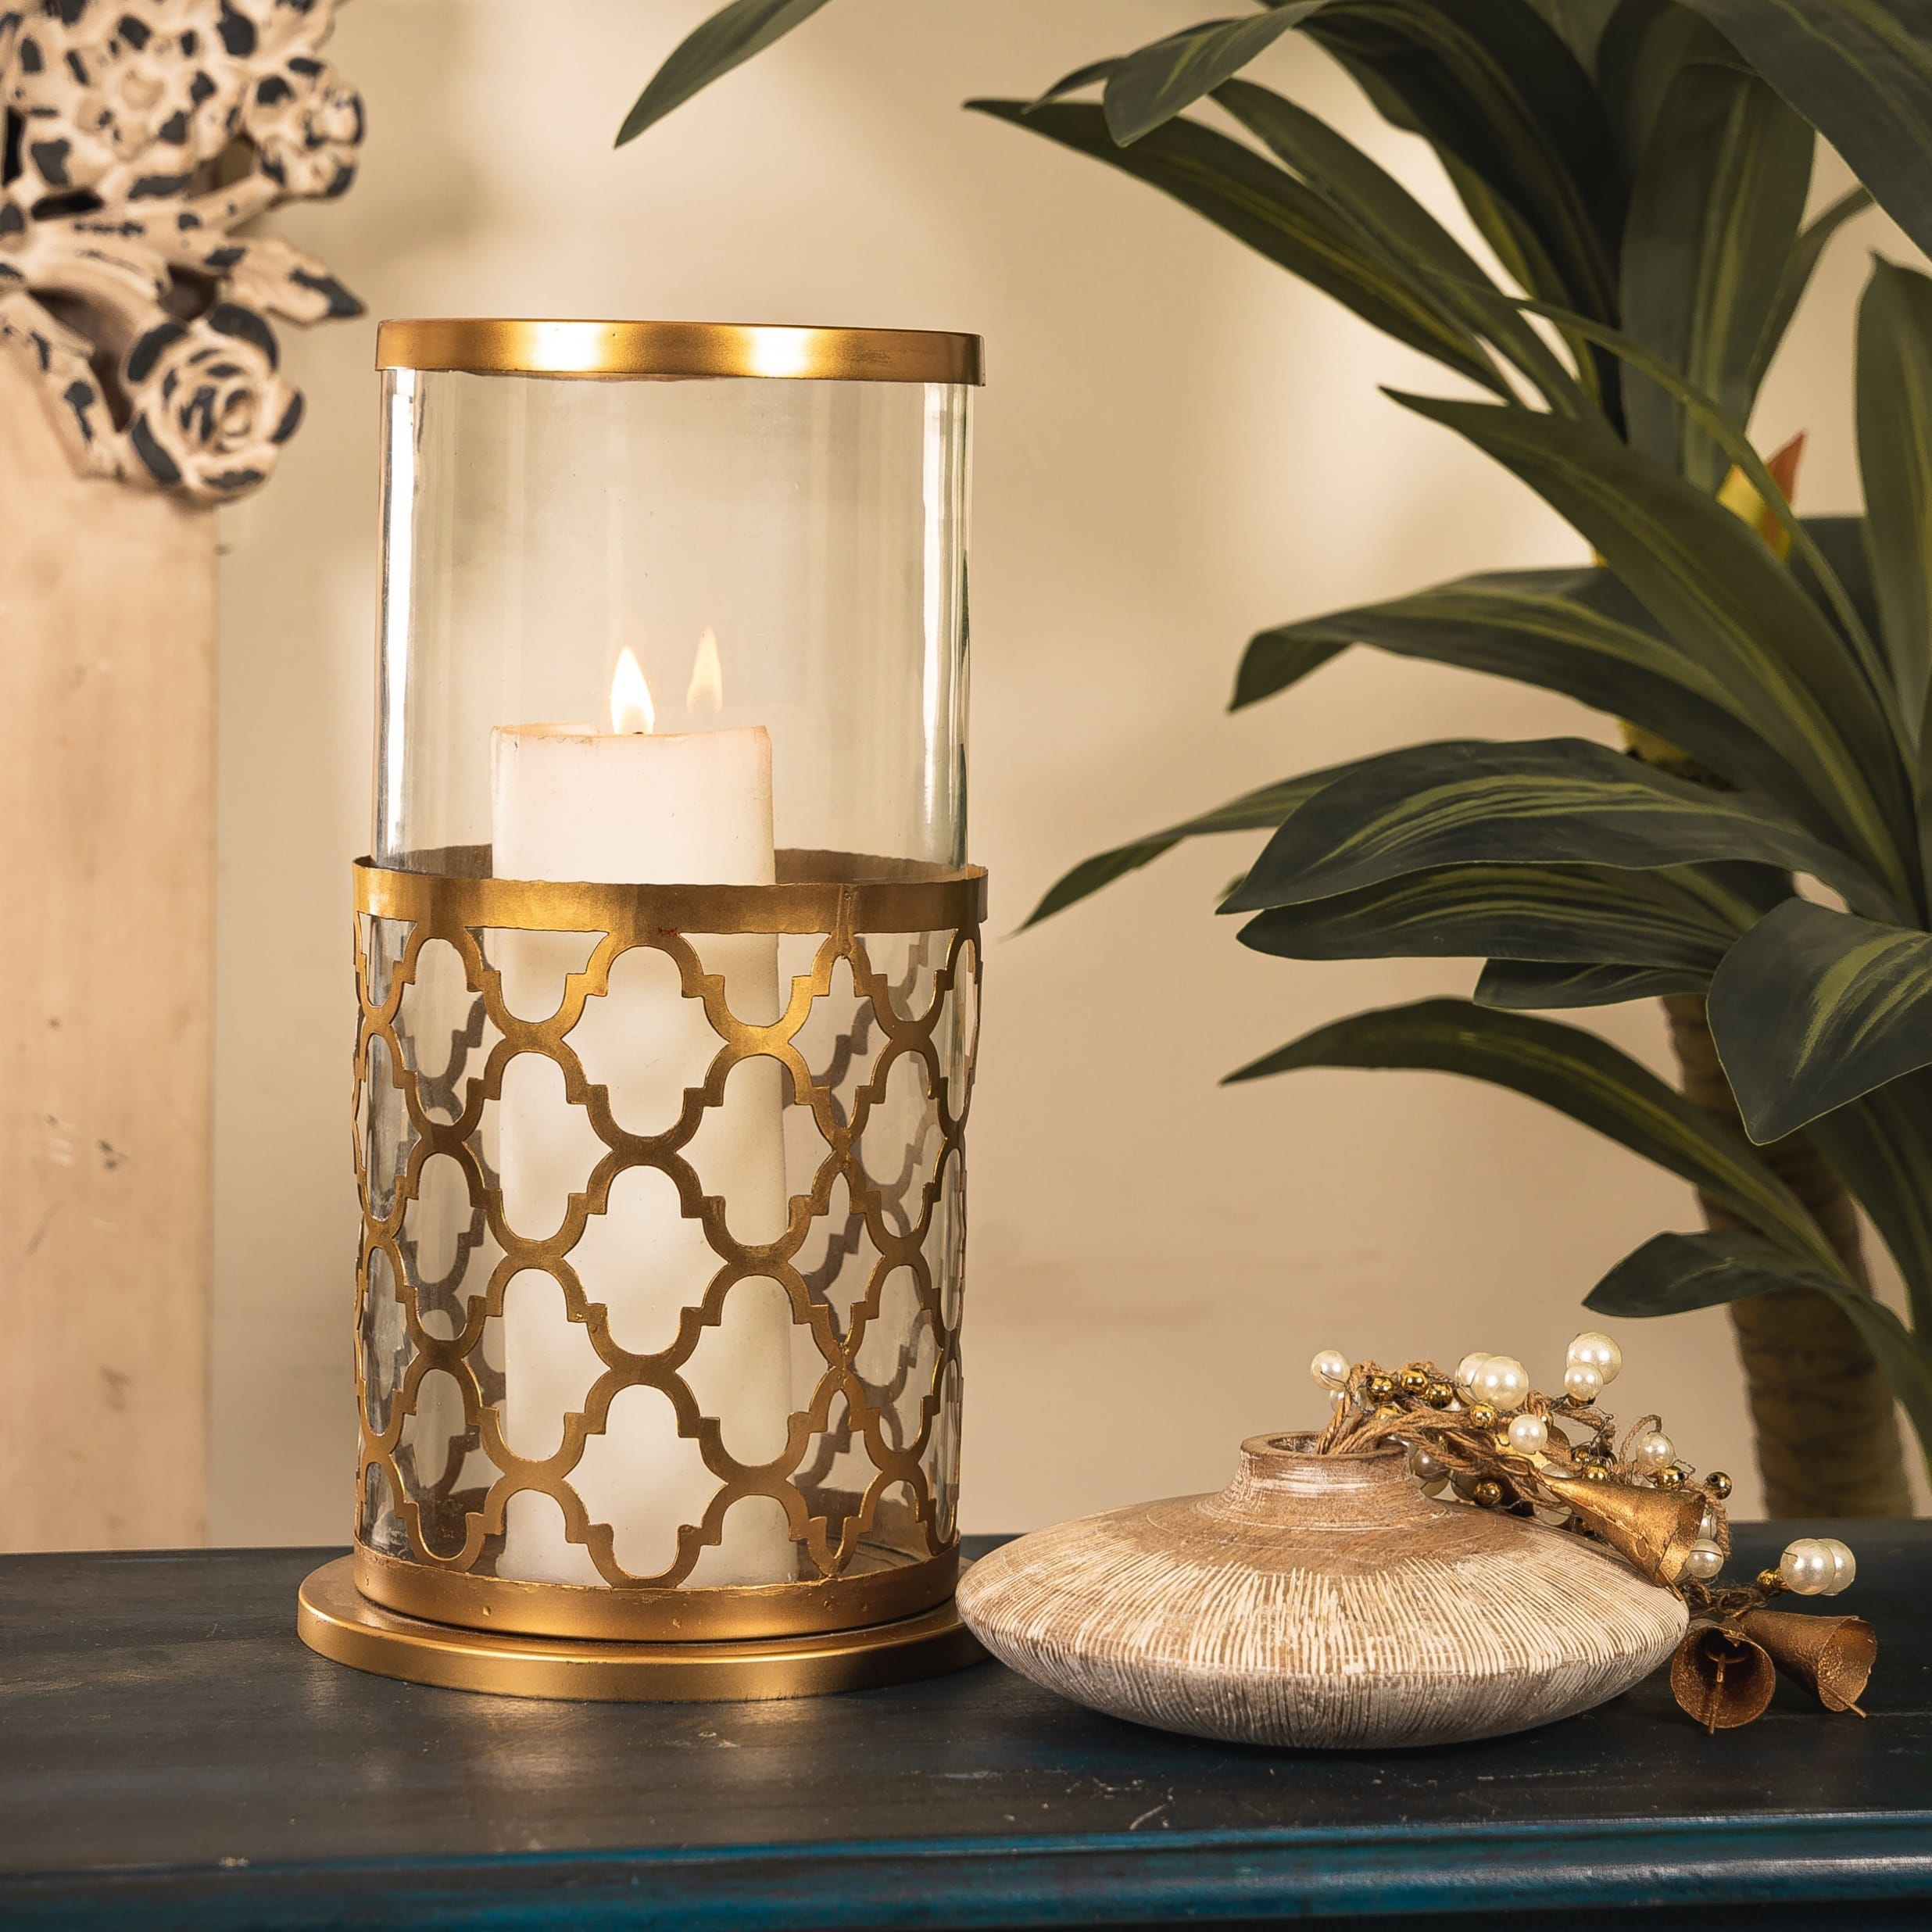
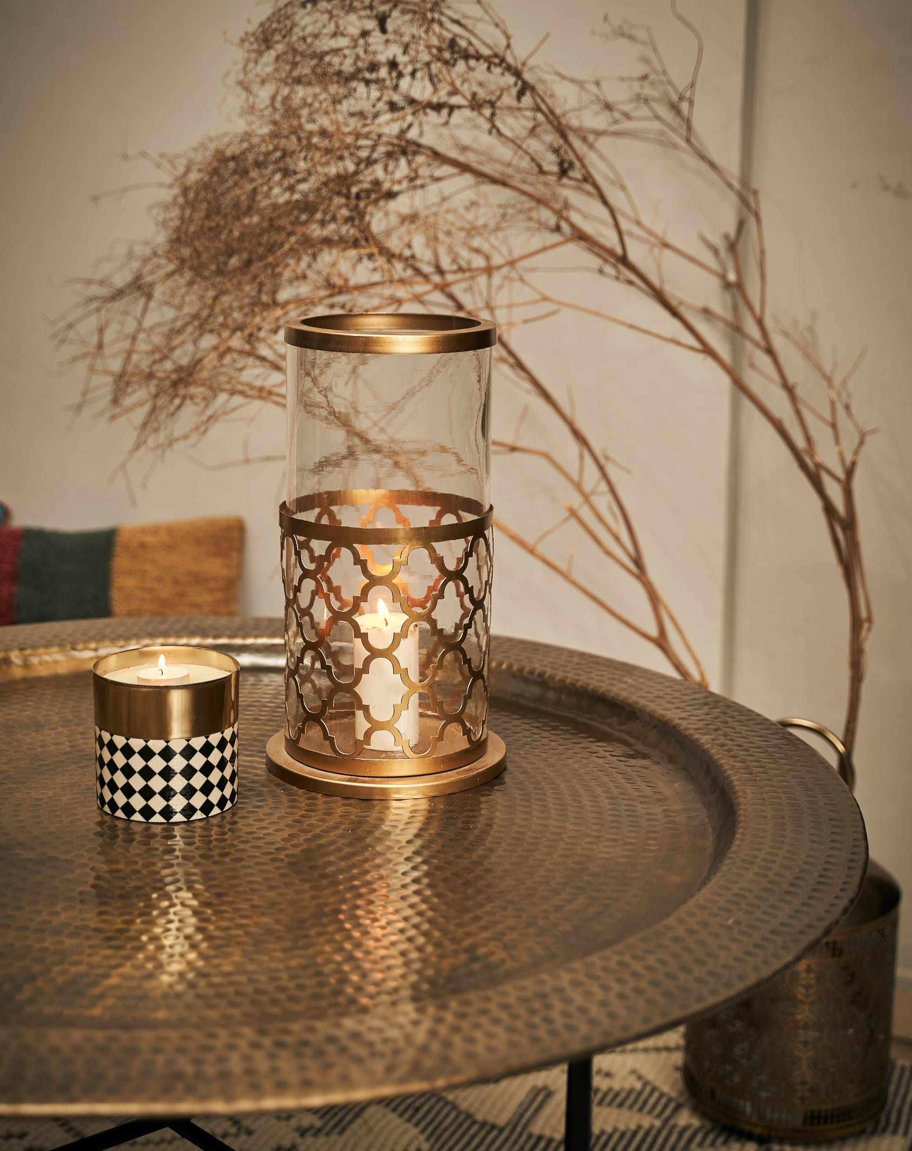
Zara Hurricane – INR 2950
Gifting
https://homevedaa.com/product/zara-hurricane/

Slide 13
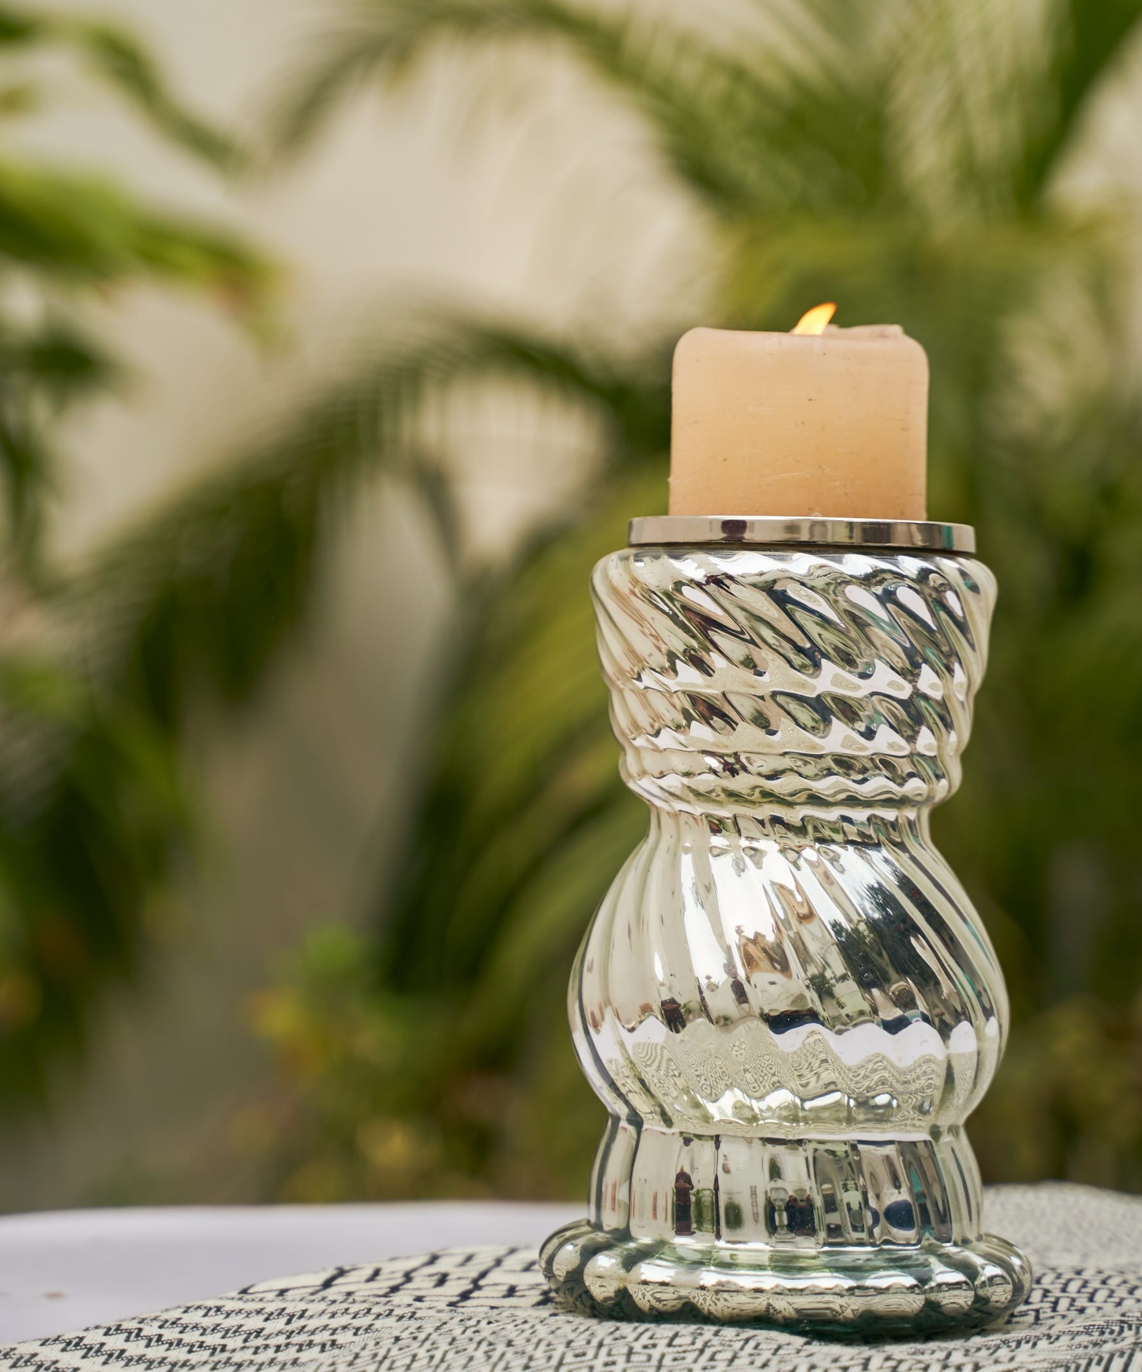
Twirl Candle Holder - Inr 2200
Gifting
https://homevedaa.com/product/twirl-candle-holder/

Slide 14
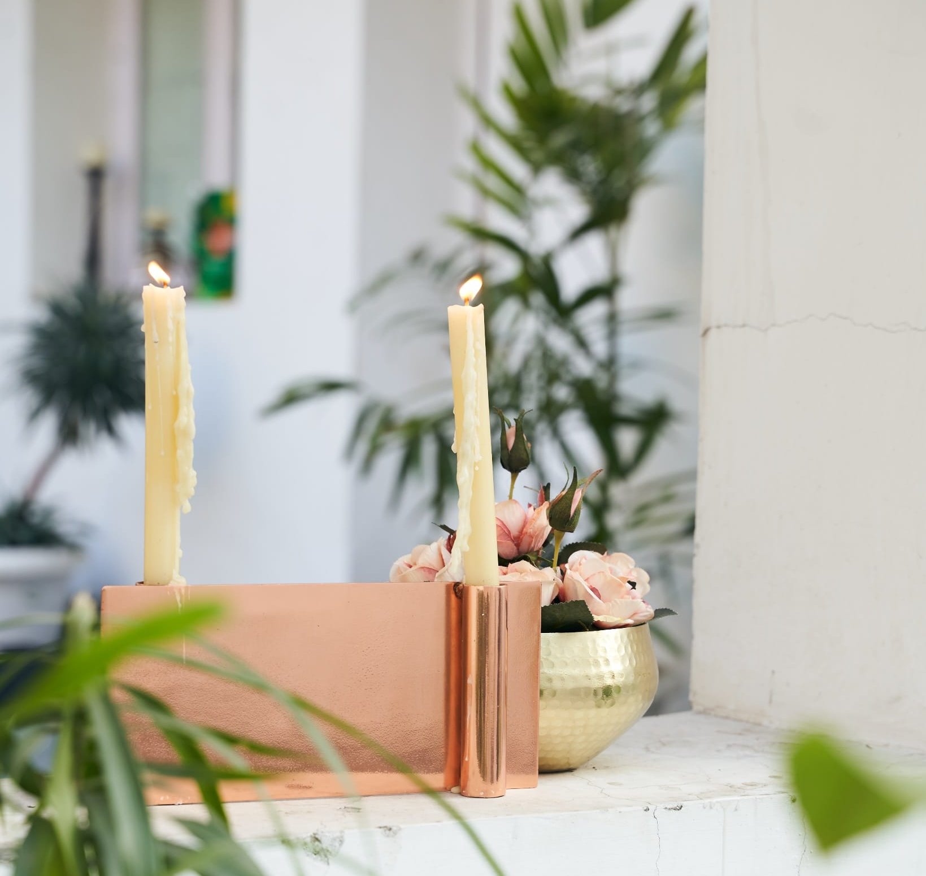
Twin Candle Holder – Inr 1800
Gifting
https://homevedaa.com/product/twin-candle-holder/

Slide 15
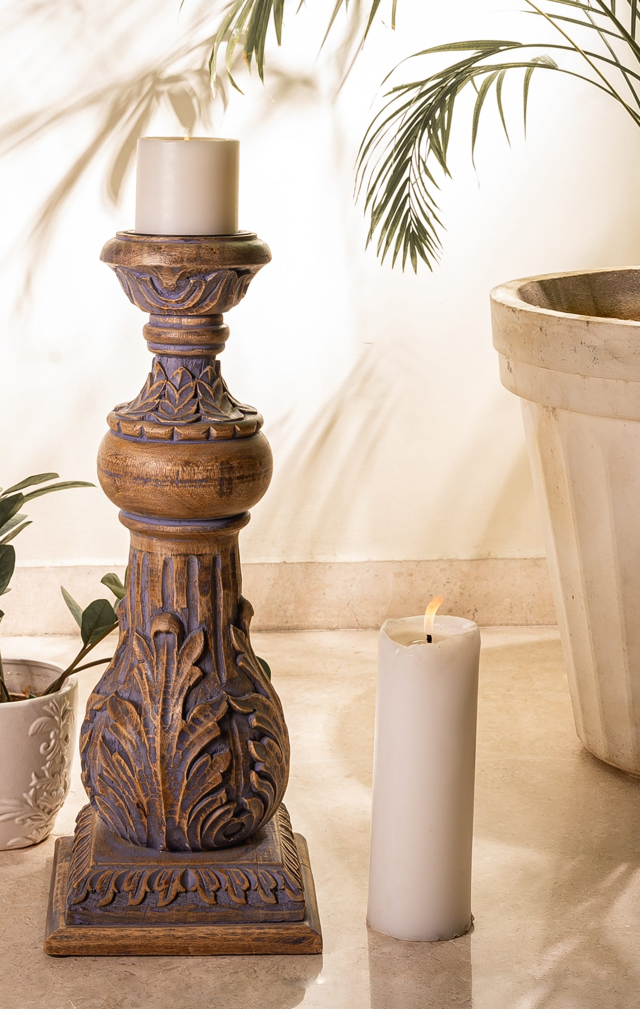
ILA candle Stand – wooden hand carved – INR 3900
Gifting
https://homevedaa.com/product/ila-candle-holder/

Slide 16
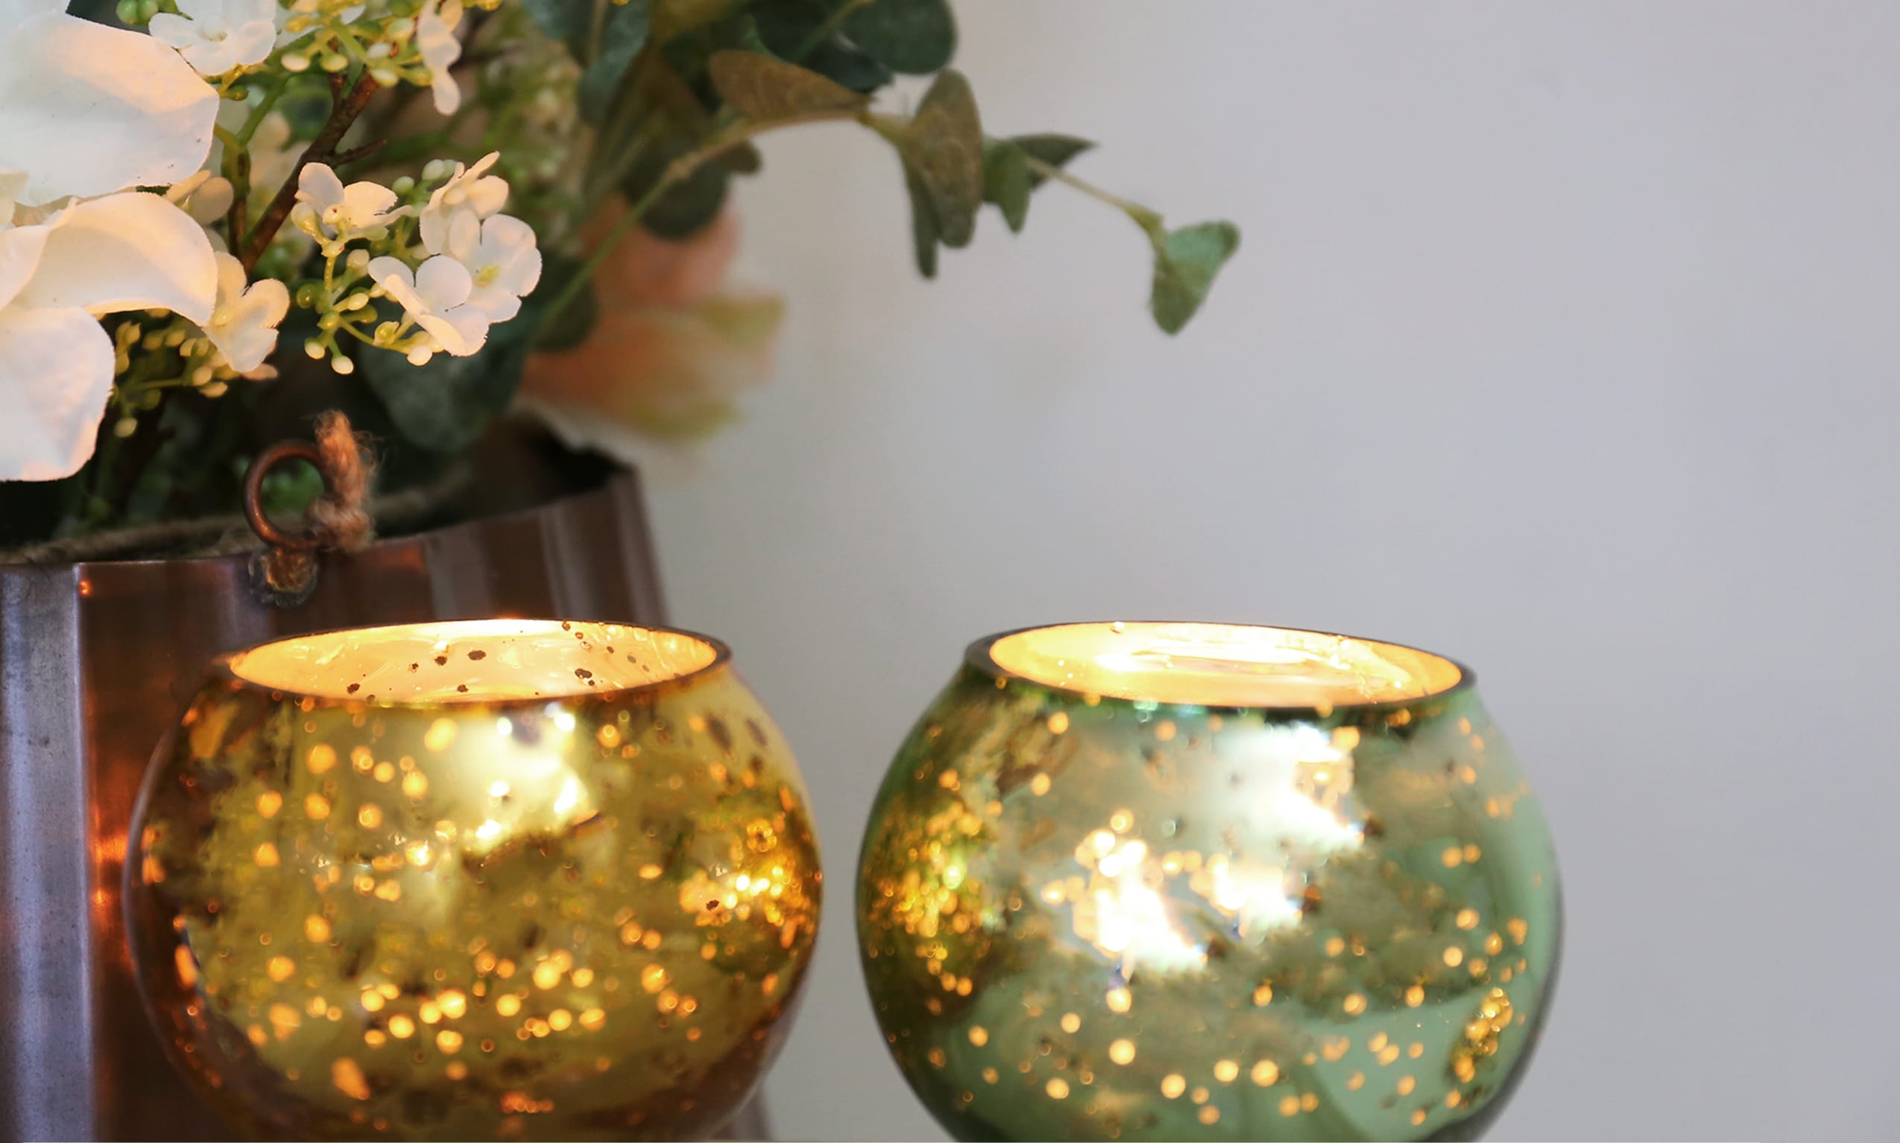
Glimmer Tea light Holder – set of 4 – Inr 390 for the set
Gifting
https://homevedaa.com/product/glimmer-tea-light-holder/

Slide 17
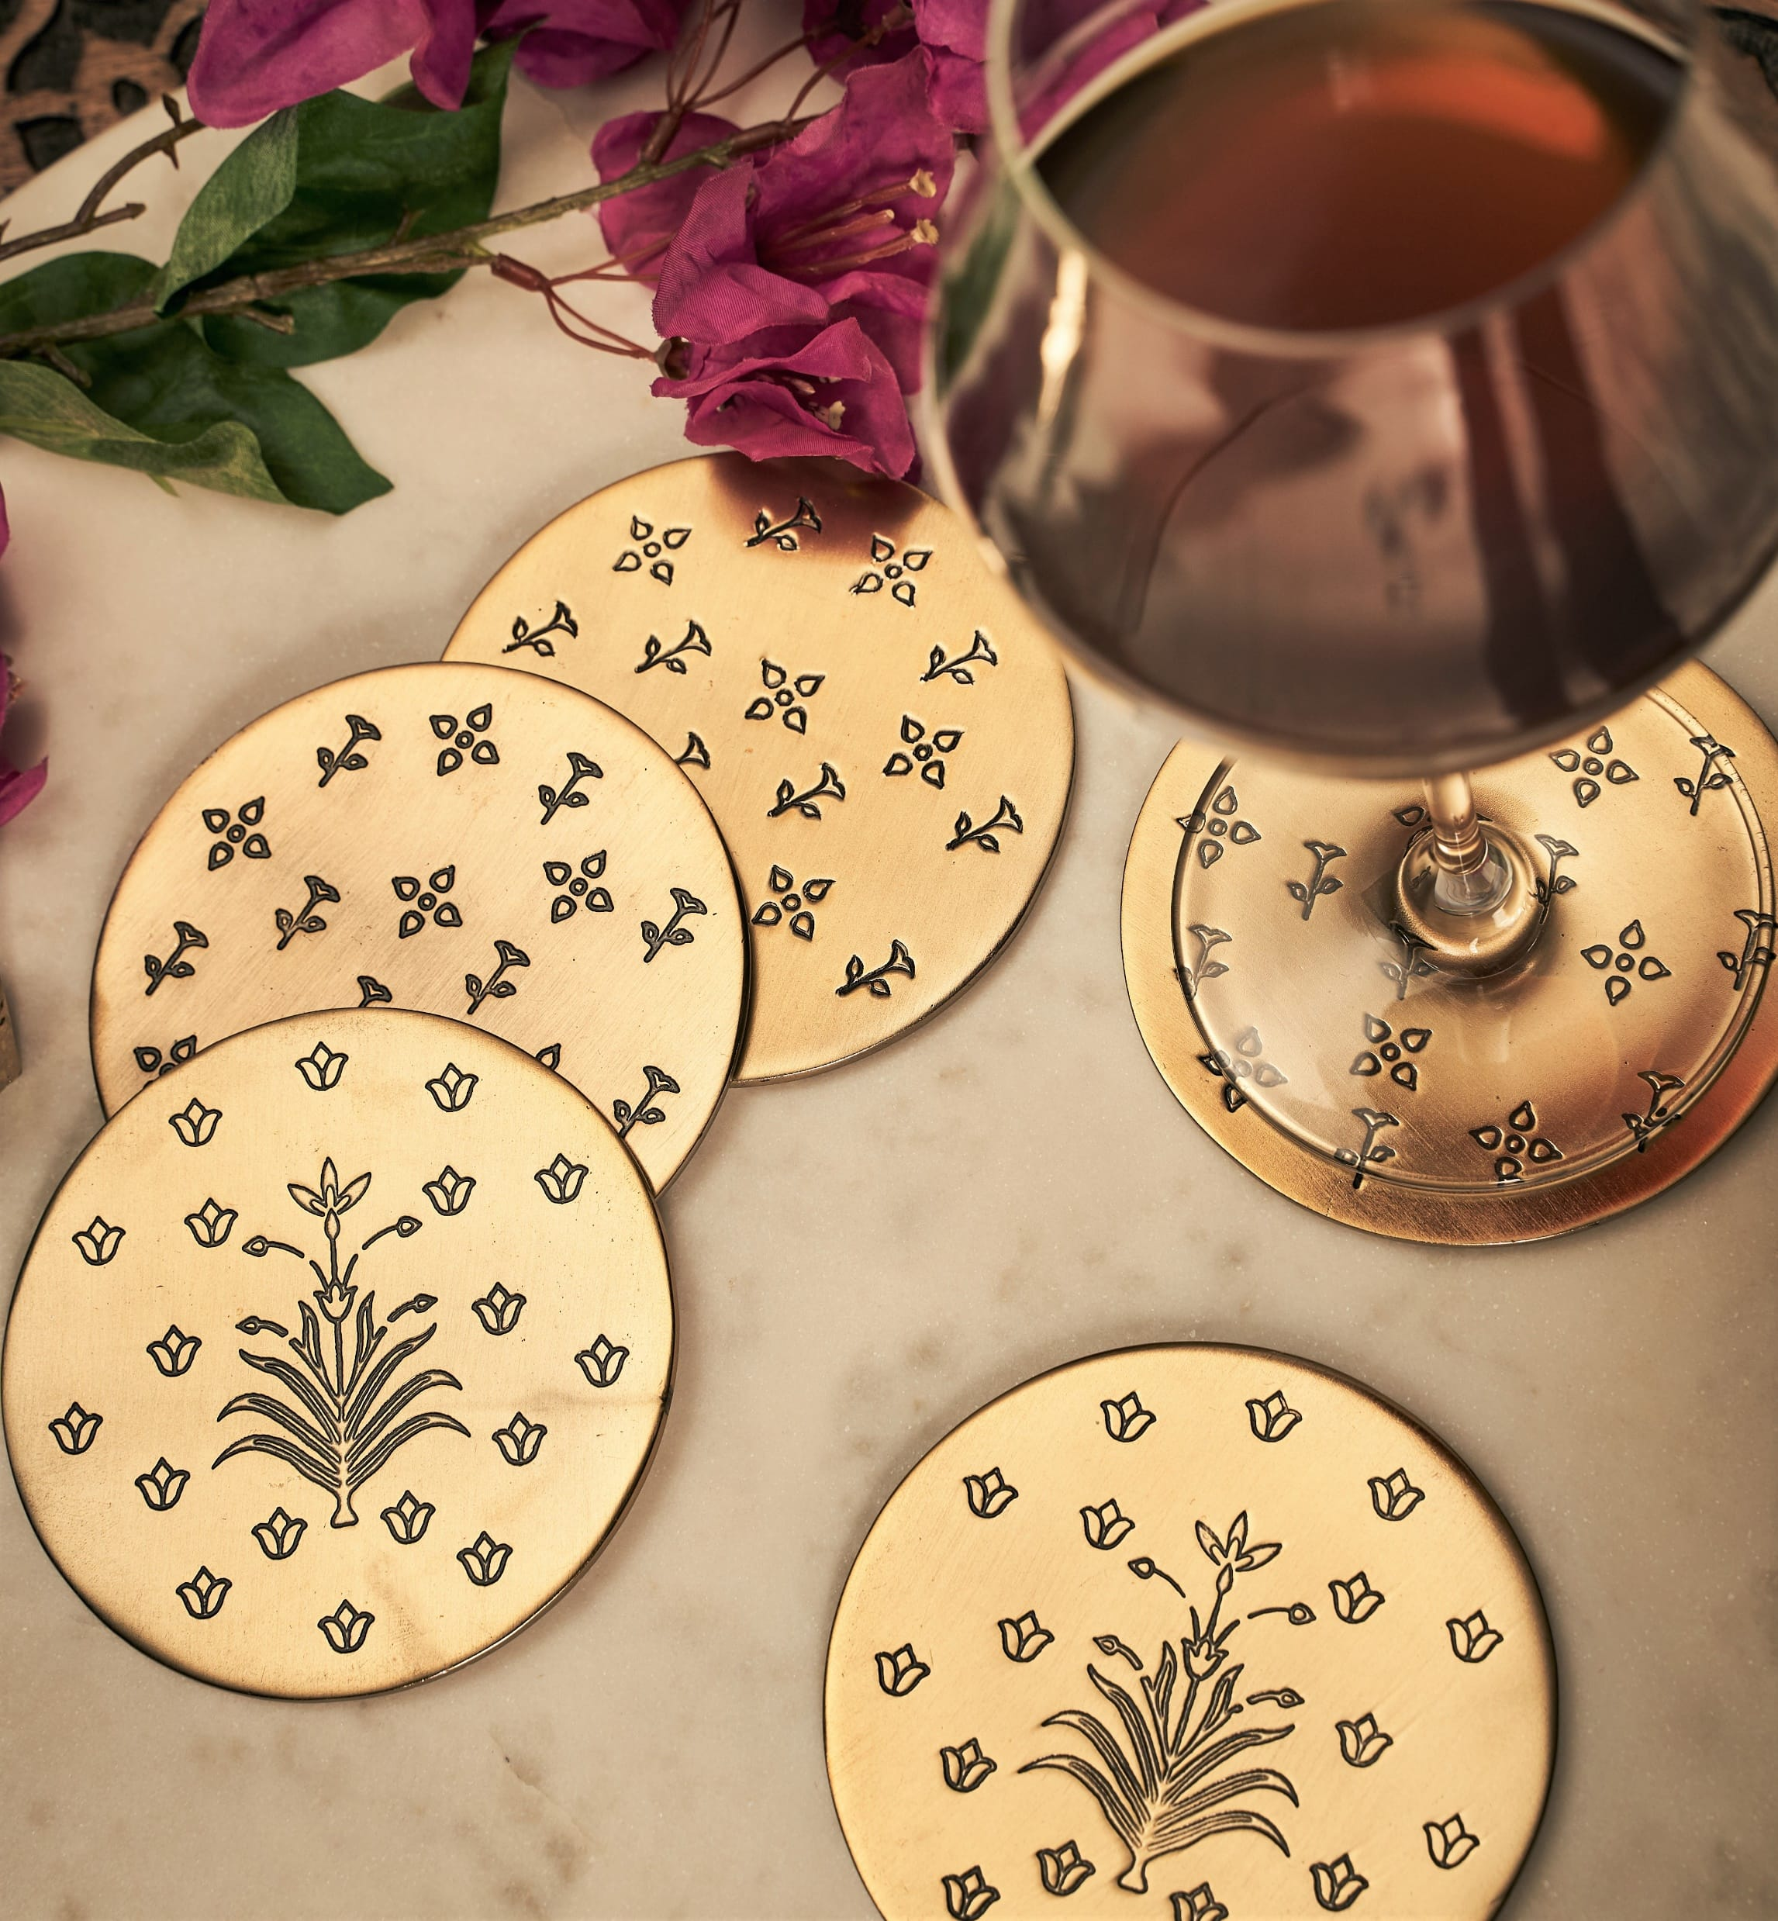
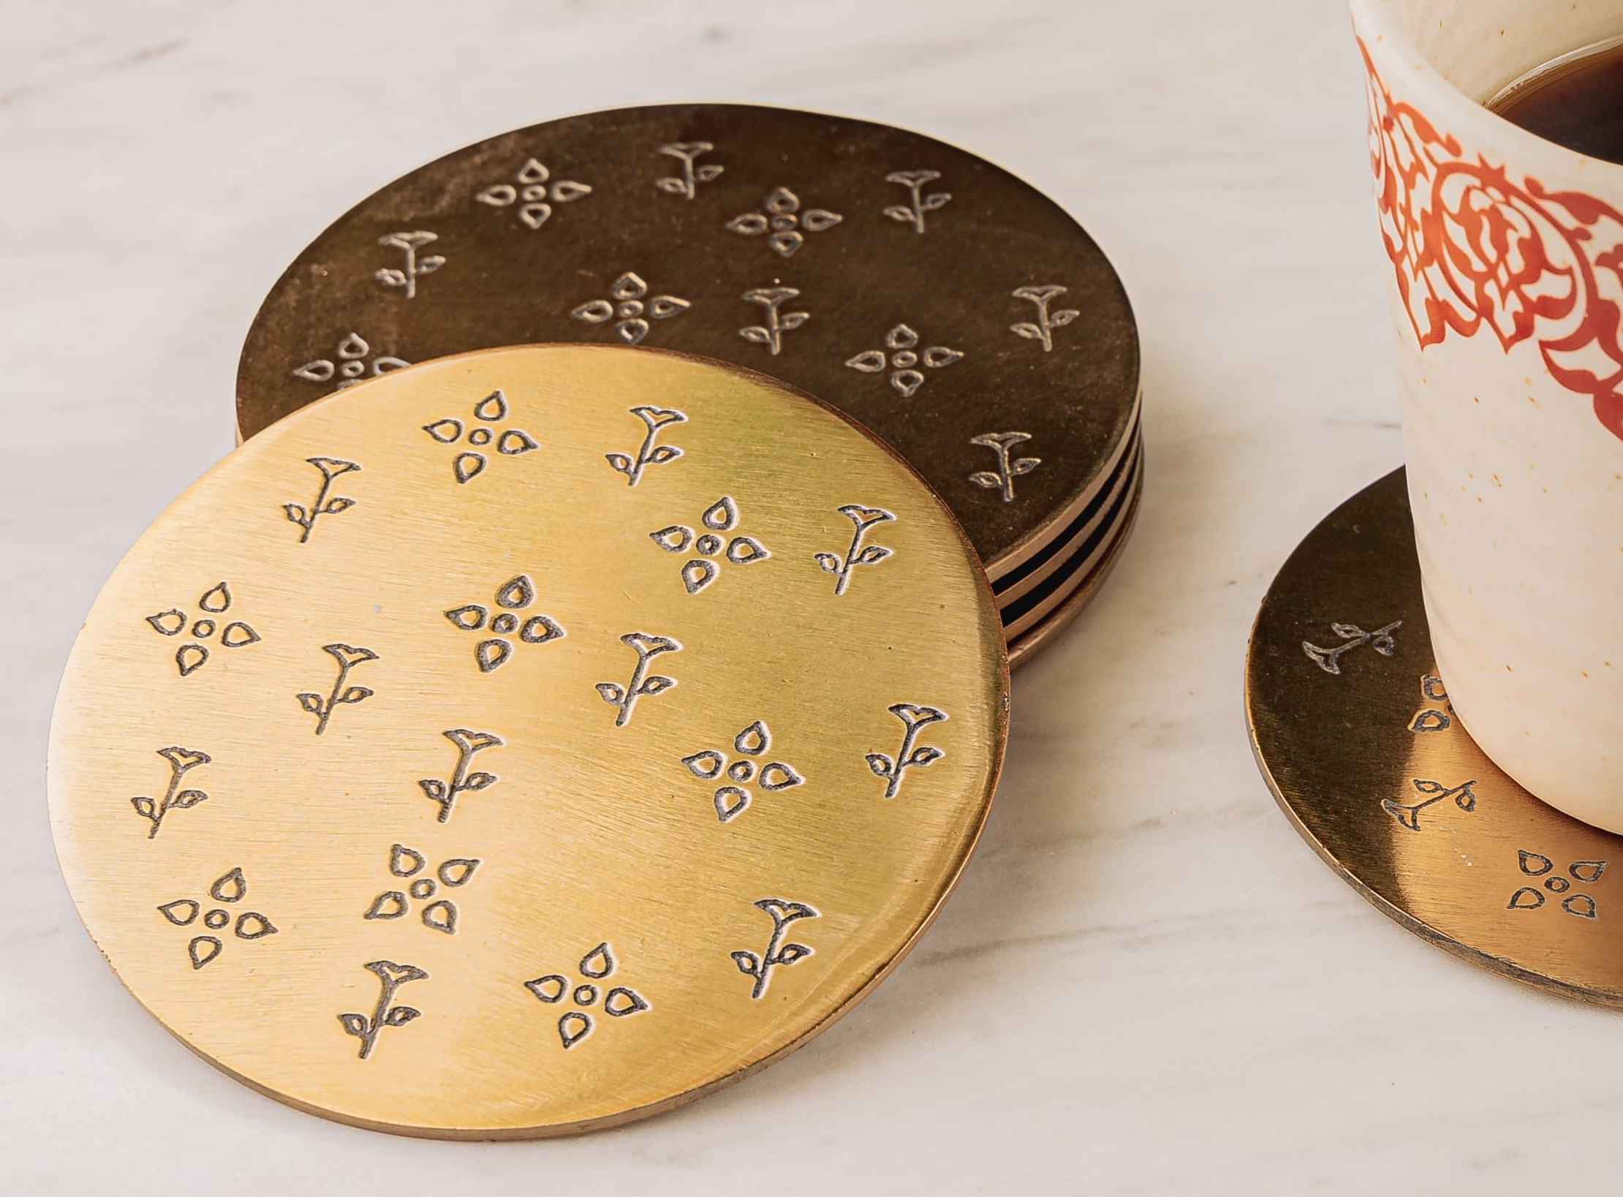
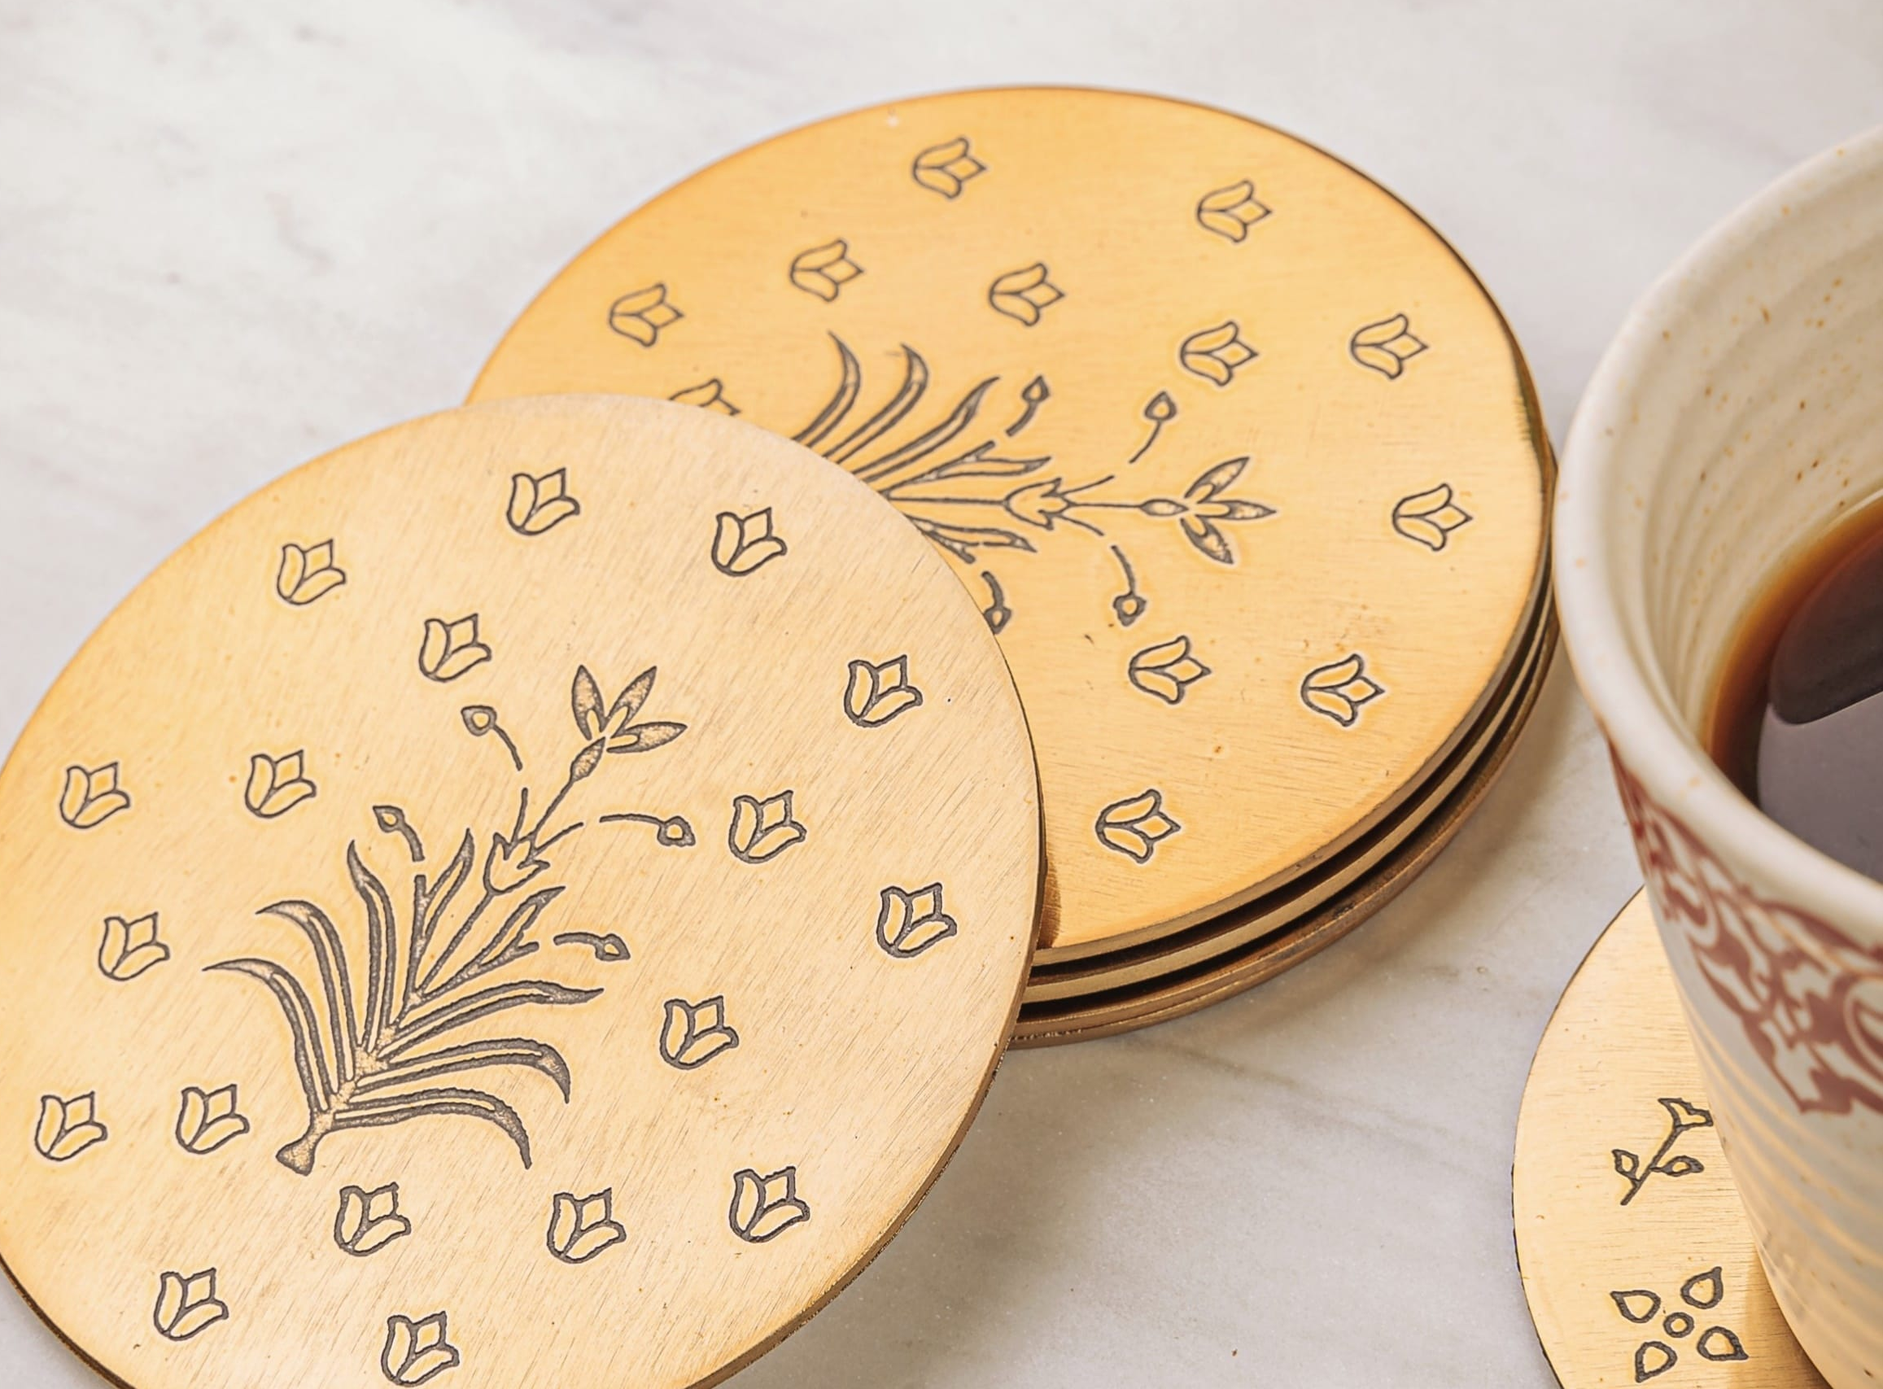
Savannah Coasters – a set of 6 mix match coasters with etched motifs – Inr 2100 for the set of 6
Gifting
https://homevedaa.com/product/savannah-coasters-set-of-6-coming-soon/

Slide 18
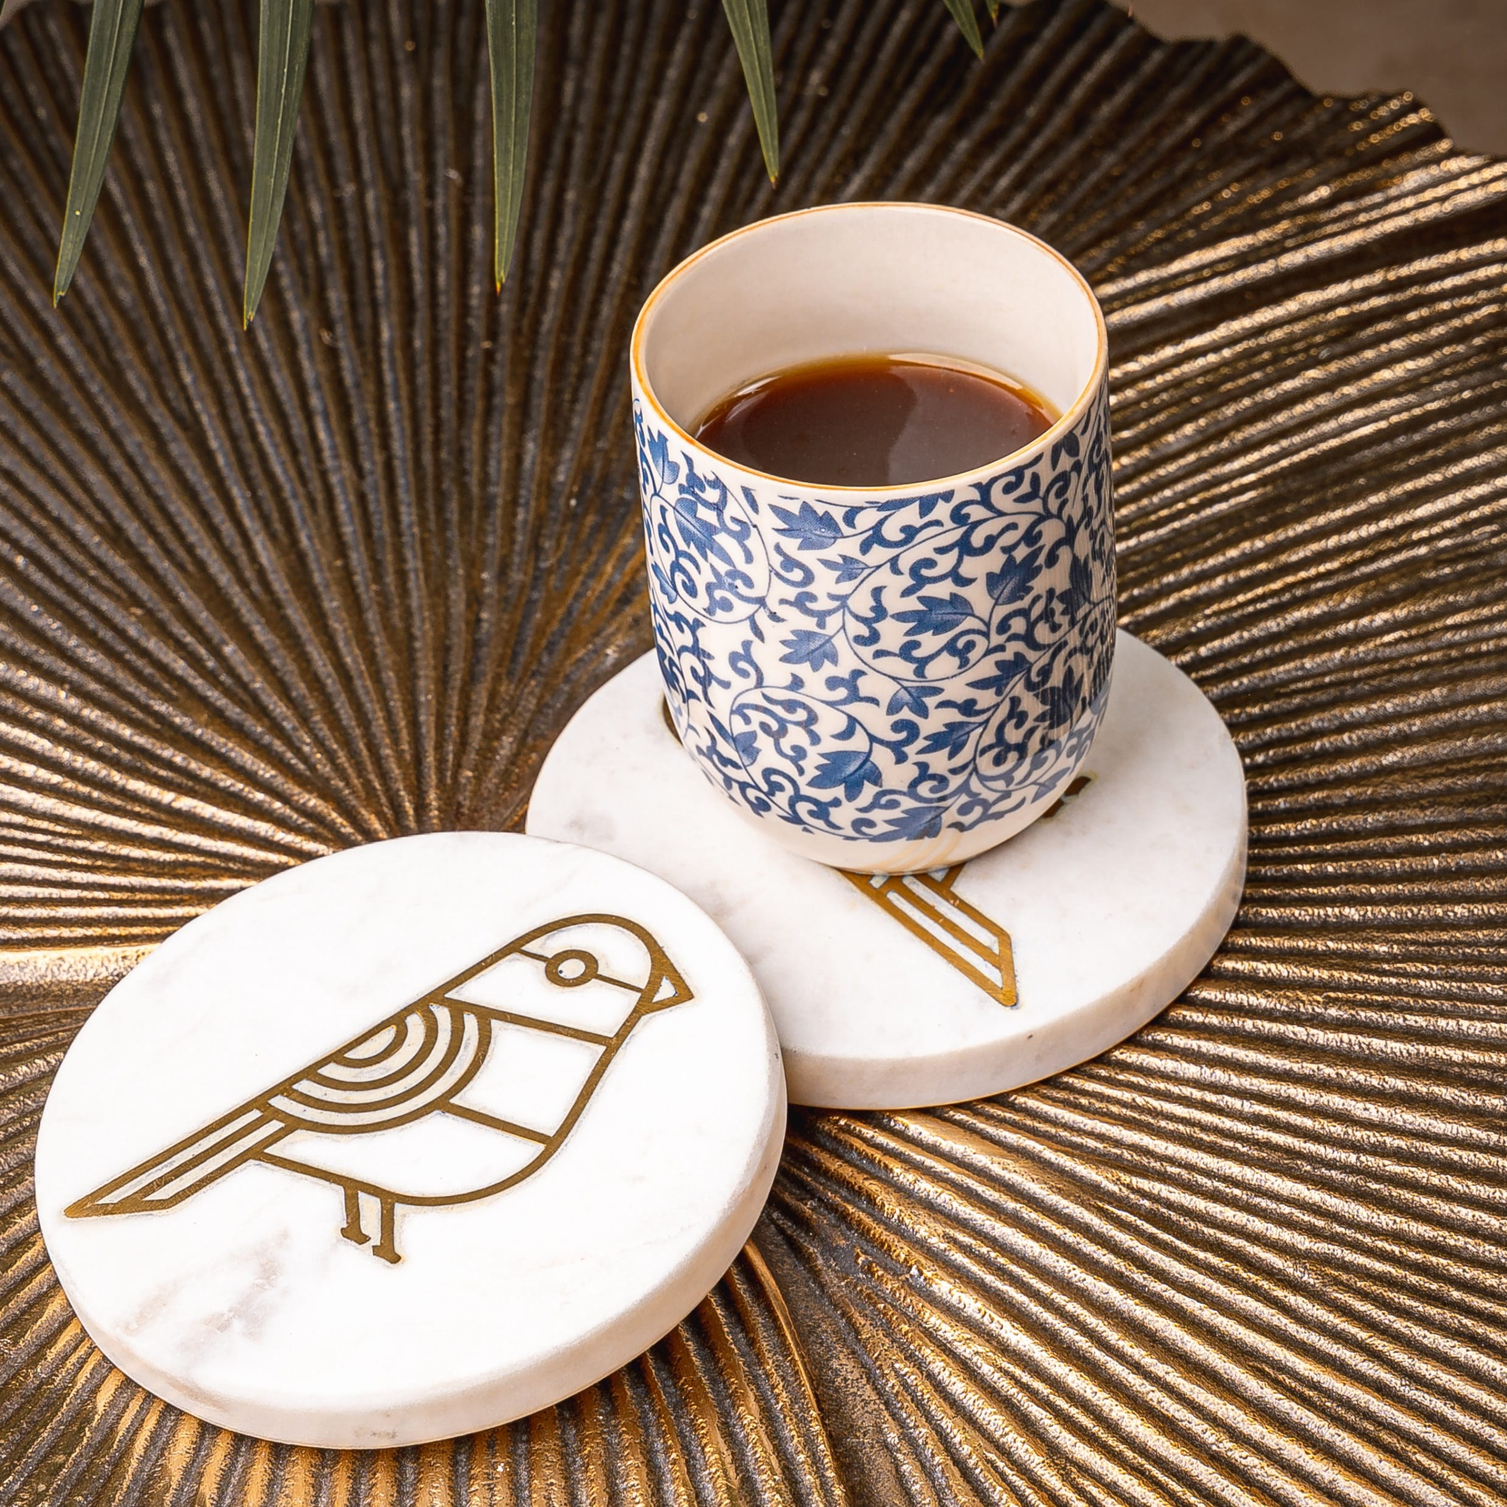
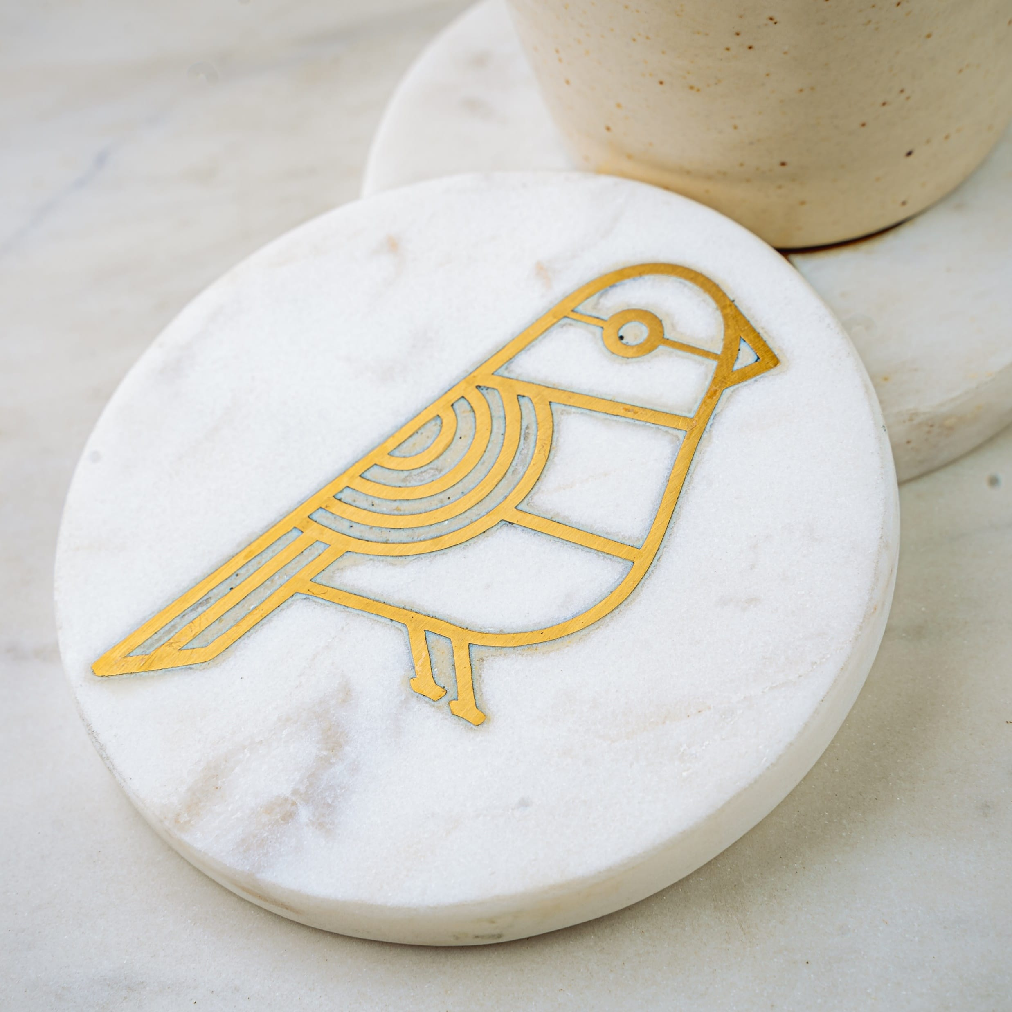
Birdy Marble Coasters - set of 2 with bird inlay in brass – Inr 1550 for set of 2.
Gifting
https://homevedaa.com/product/birdy-coaster/

Slide 19
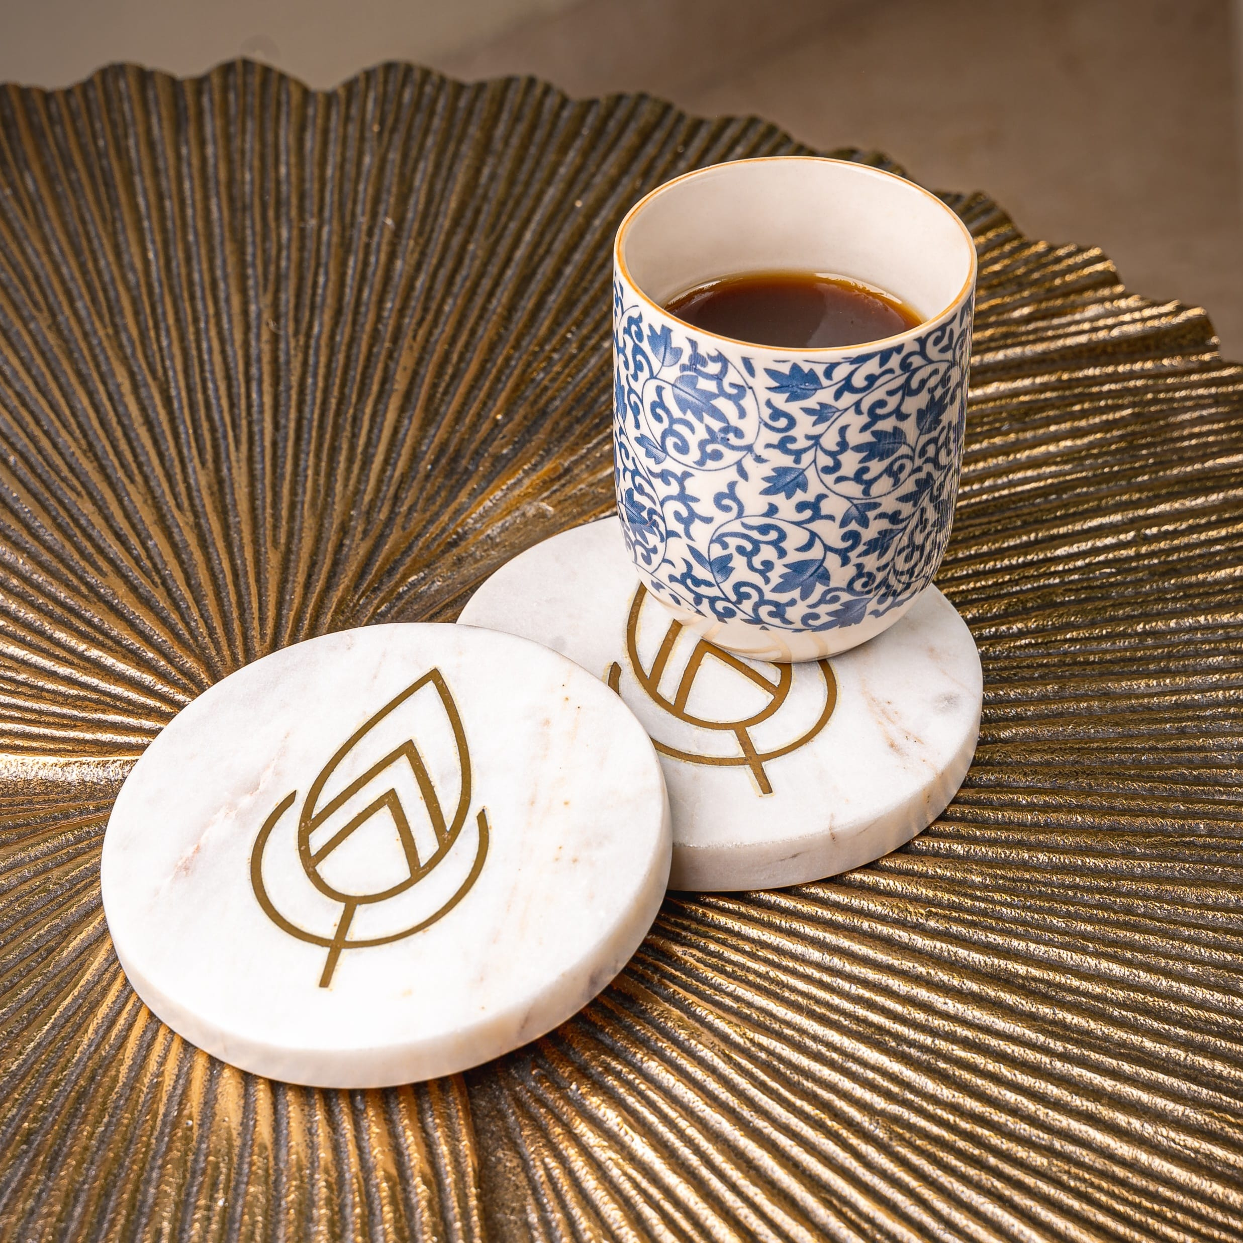
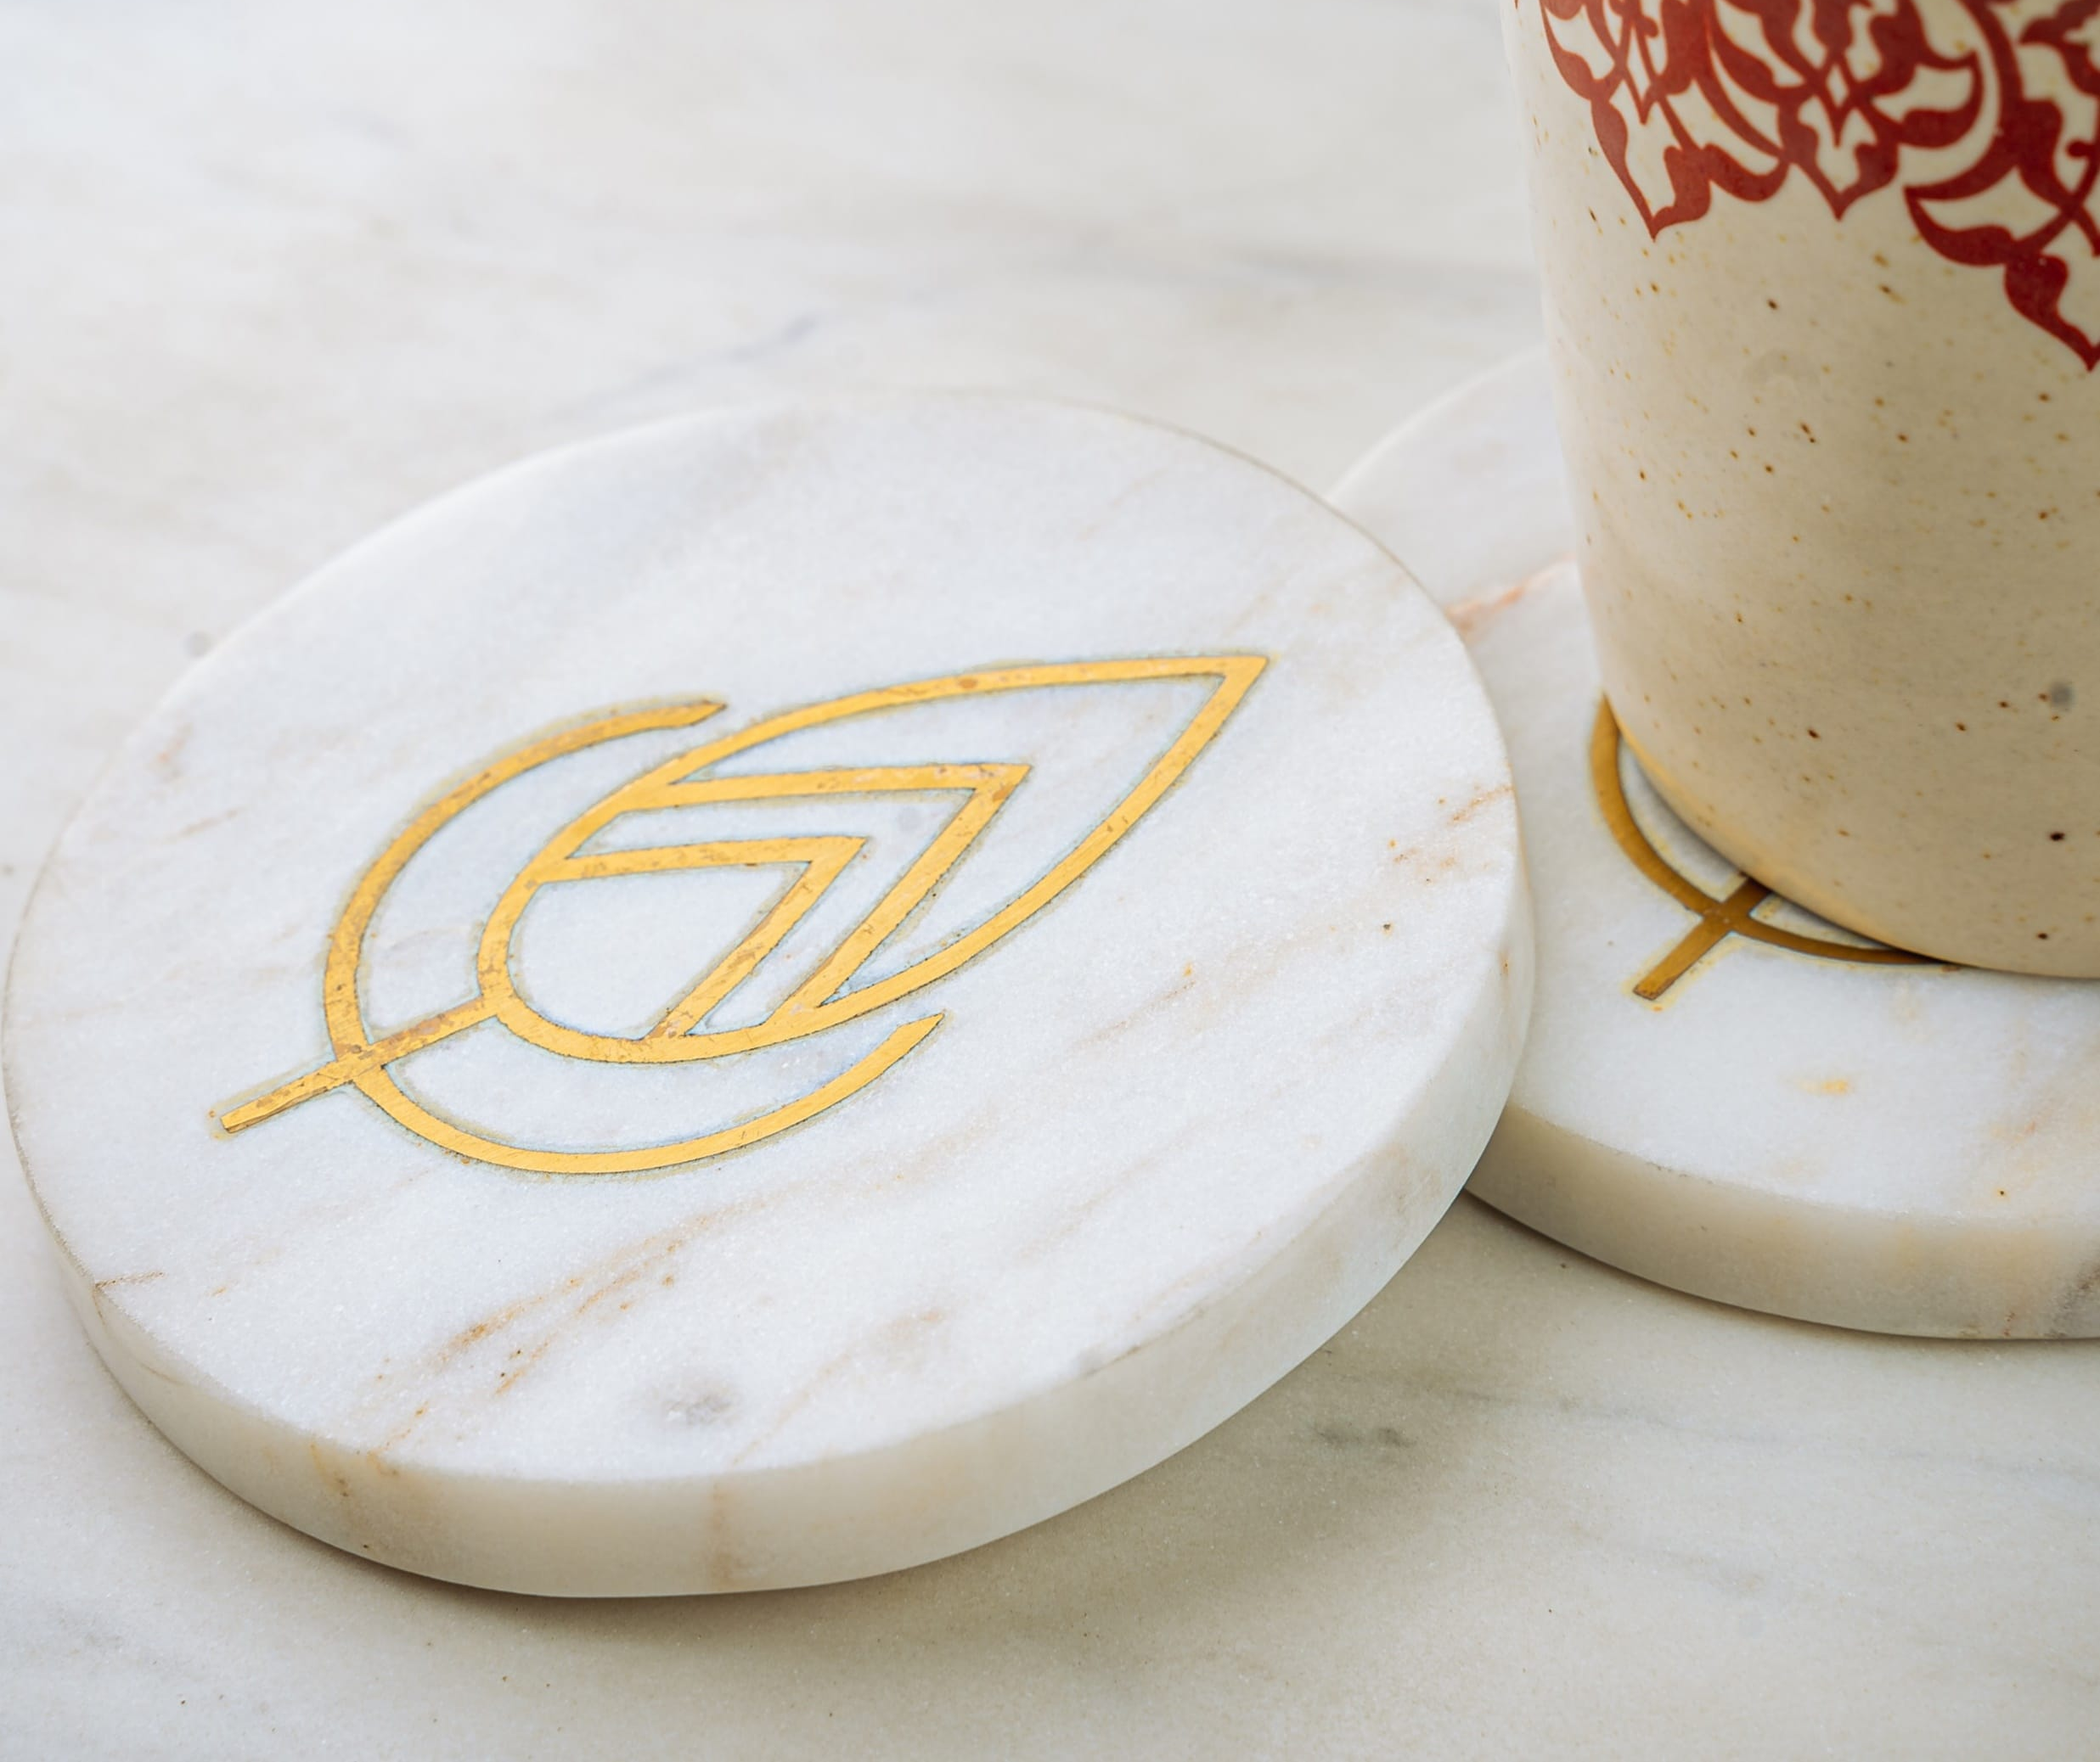
Leaf Marble Coasters - set of 2 with leaf inlay in brass – Inr 1550 for set of 2.
Gifting
https://homevedaa.com/product/leaf-coaster/

Slide 20
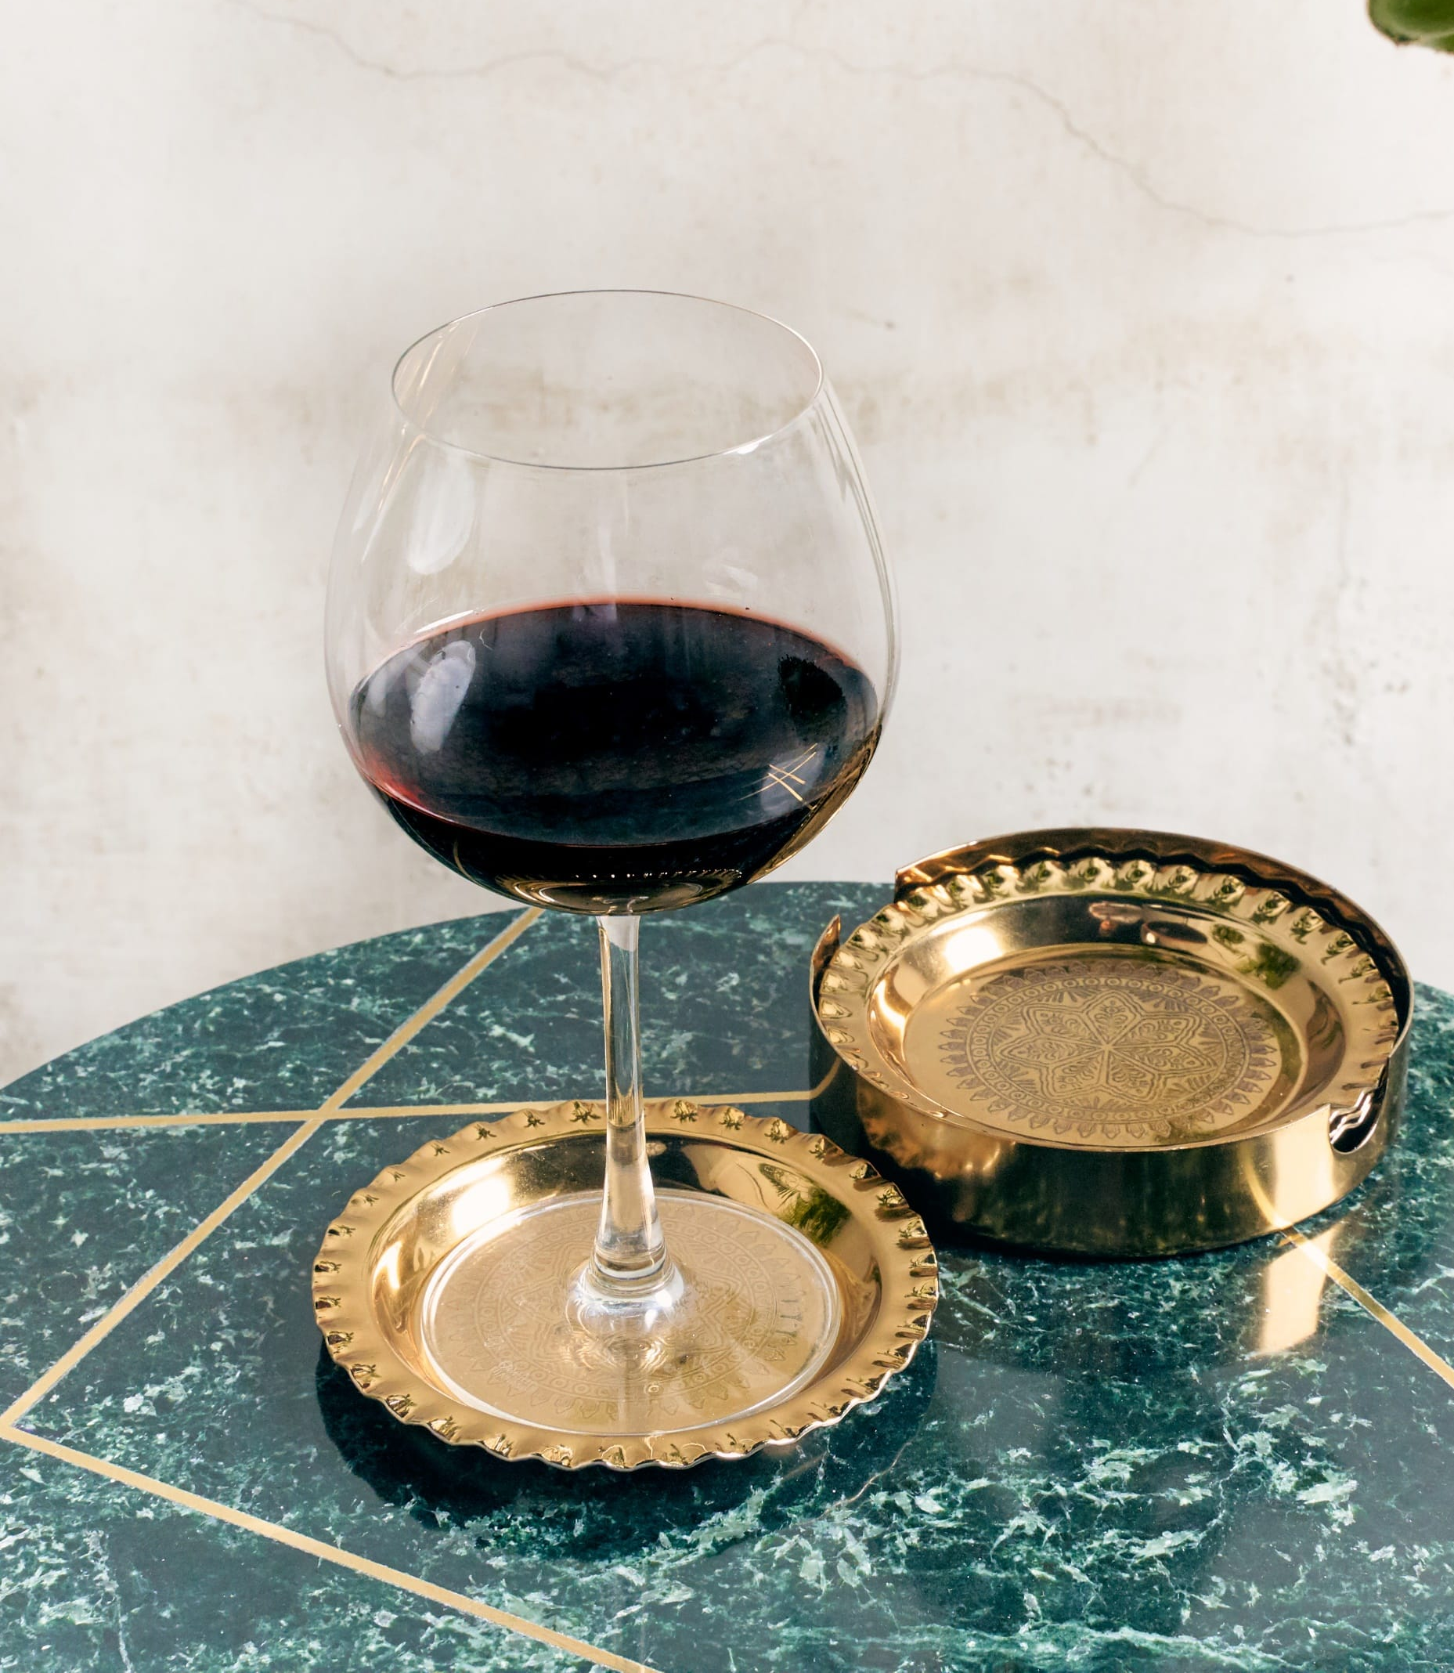
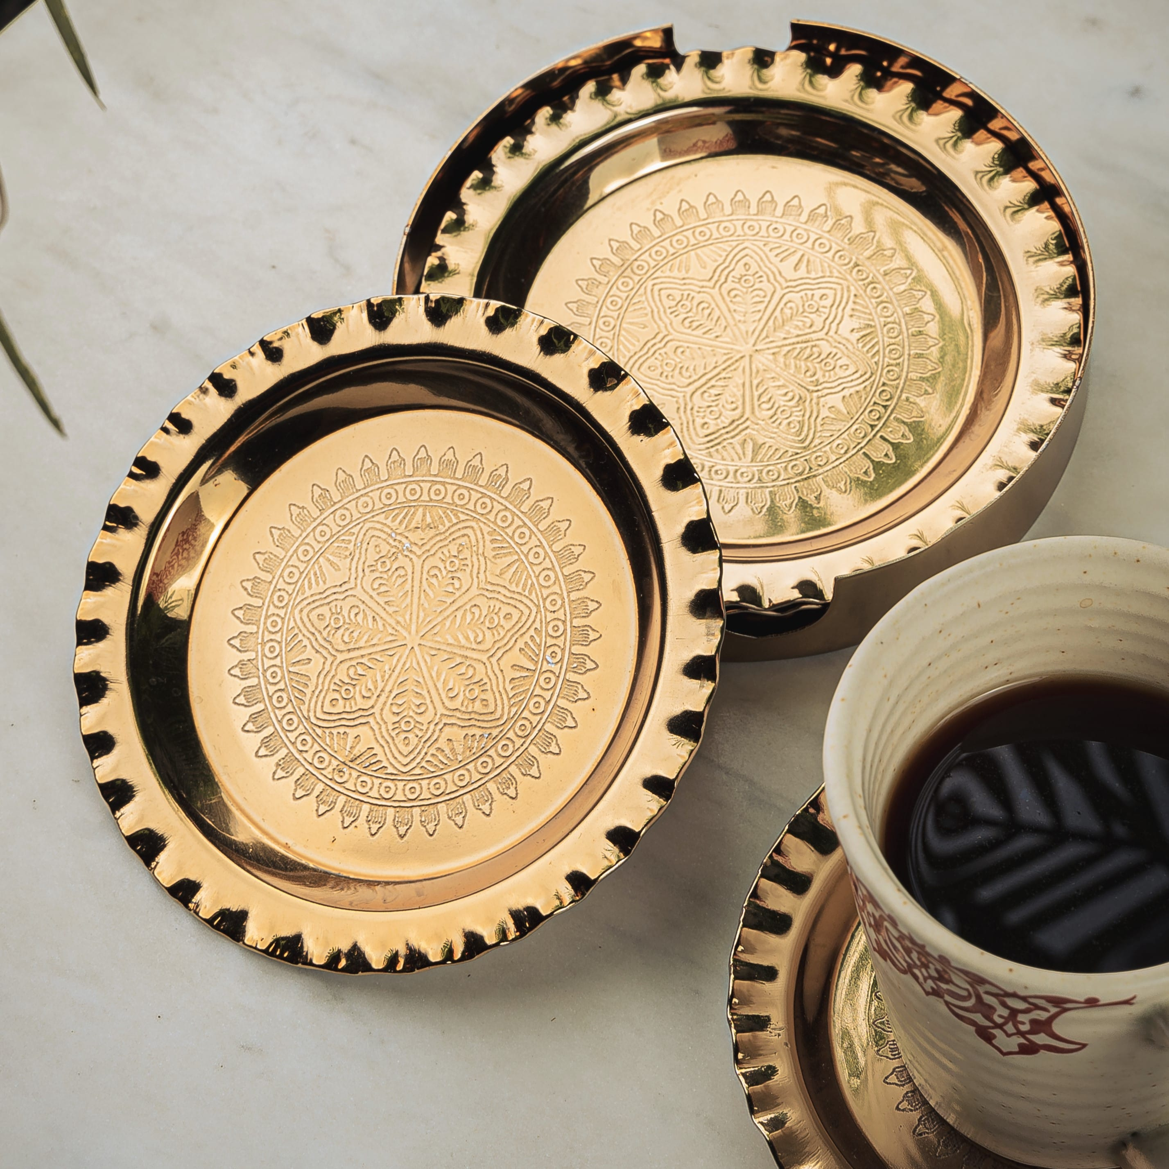
Padma Coaster set of 4 with a coaster holder – Inr 1950 for set of 4
Gifting
https://homevedaa.com/product/padma-coaster/

Slide 21
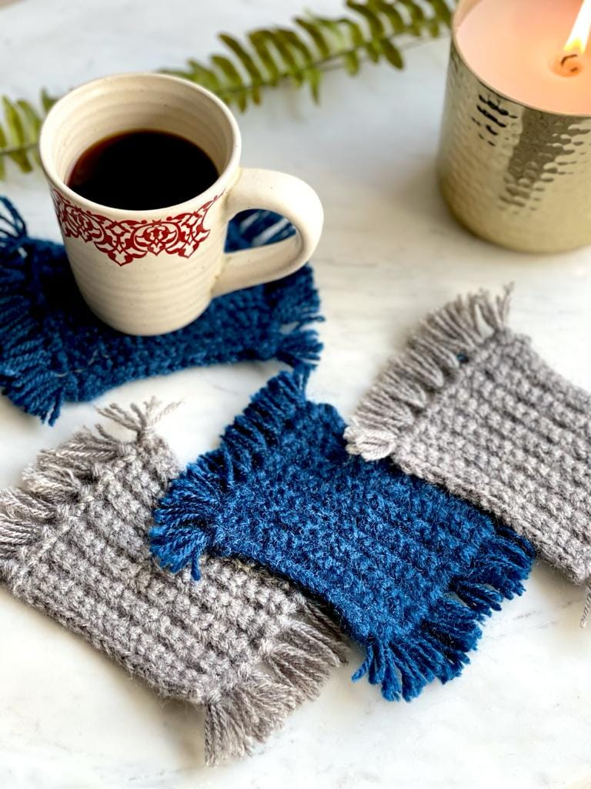
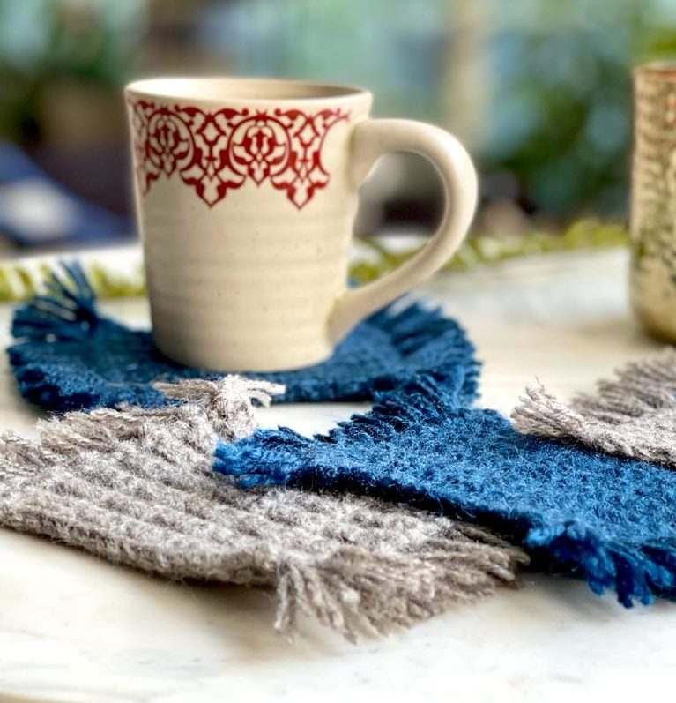
Mug Rugs set of 4 – handmade crochet coasters - Inr 950 for set of 4
Exclusive – A Team Vedhika Initiative !
Gifting
https://homevedaa.com/product/mug-rugs-set-of-4/

Slide 22
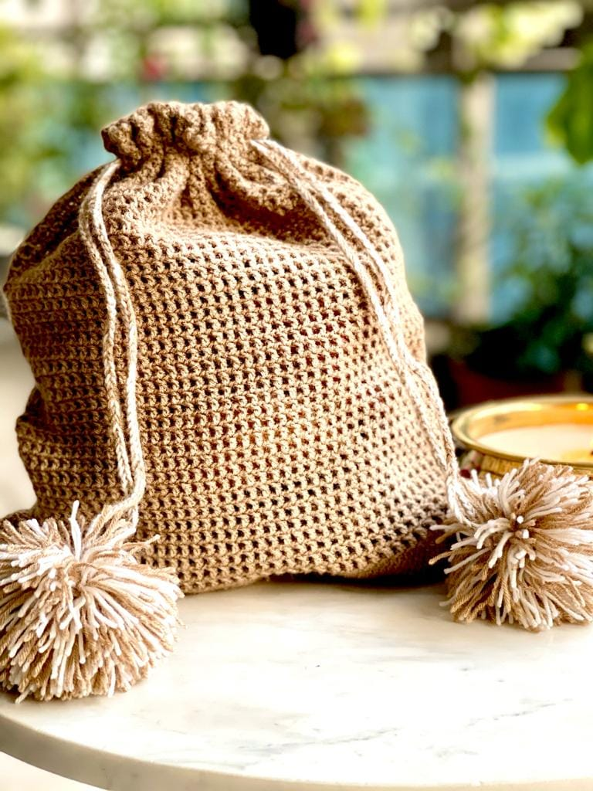
Vedhika Crochet Storage Bag multi purpose – 100% hand crocheted - Inr 950
Exclusive – A Team Vedhika Initiative !
Gifting
https://homevedaa.com/product/hand-knit-bag/

Slide 23
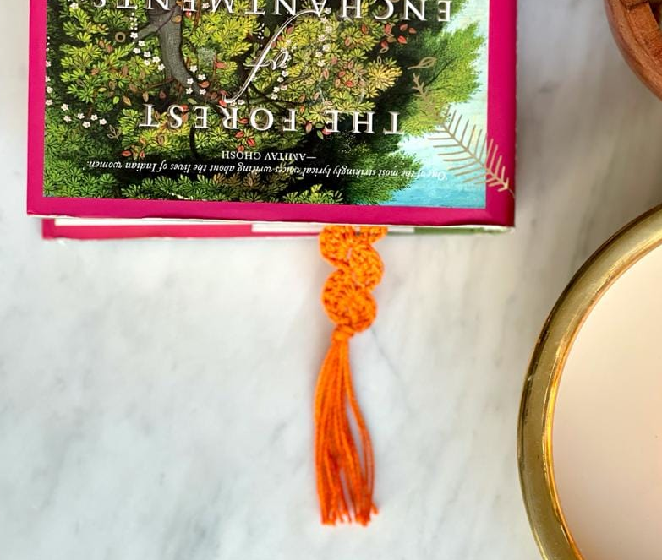
Vedhika bookmark – handmade crochet bookmark in Saffron color – INR 150
Exclusive – A Team Vedhika Initiative !
Gifting
https://homevedaa.com/product/crochet-bookmark/

Slide 24
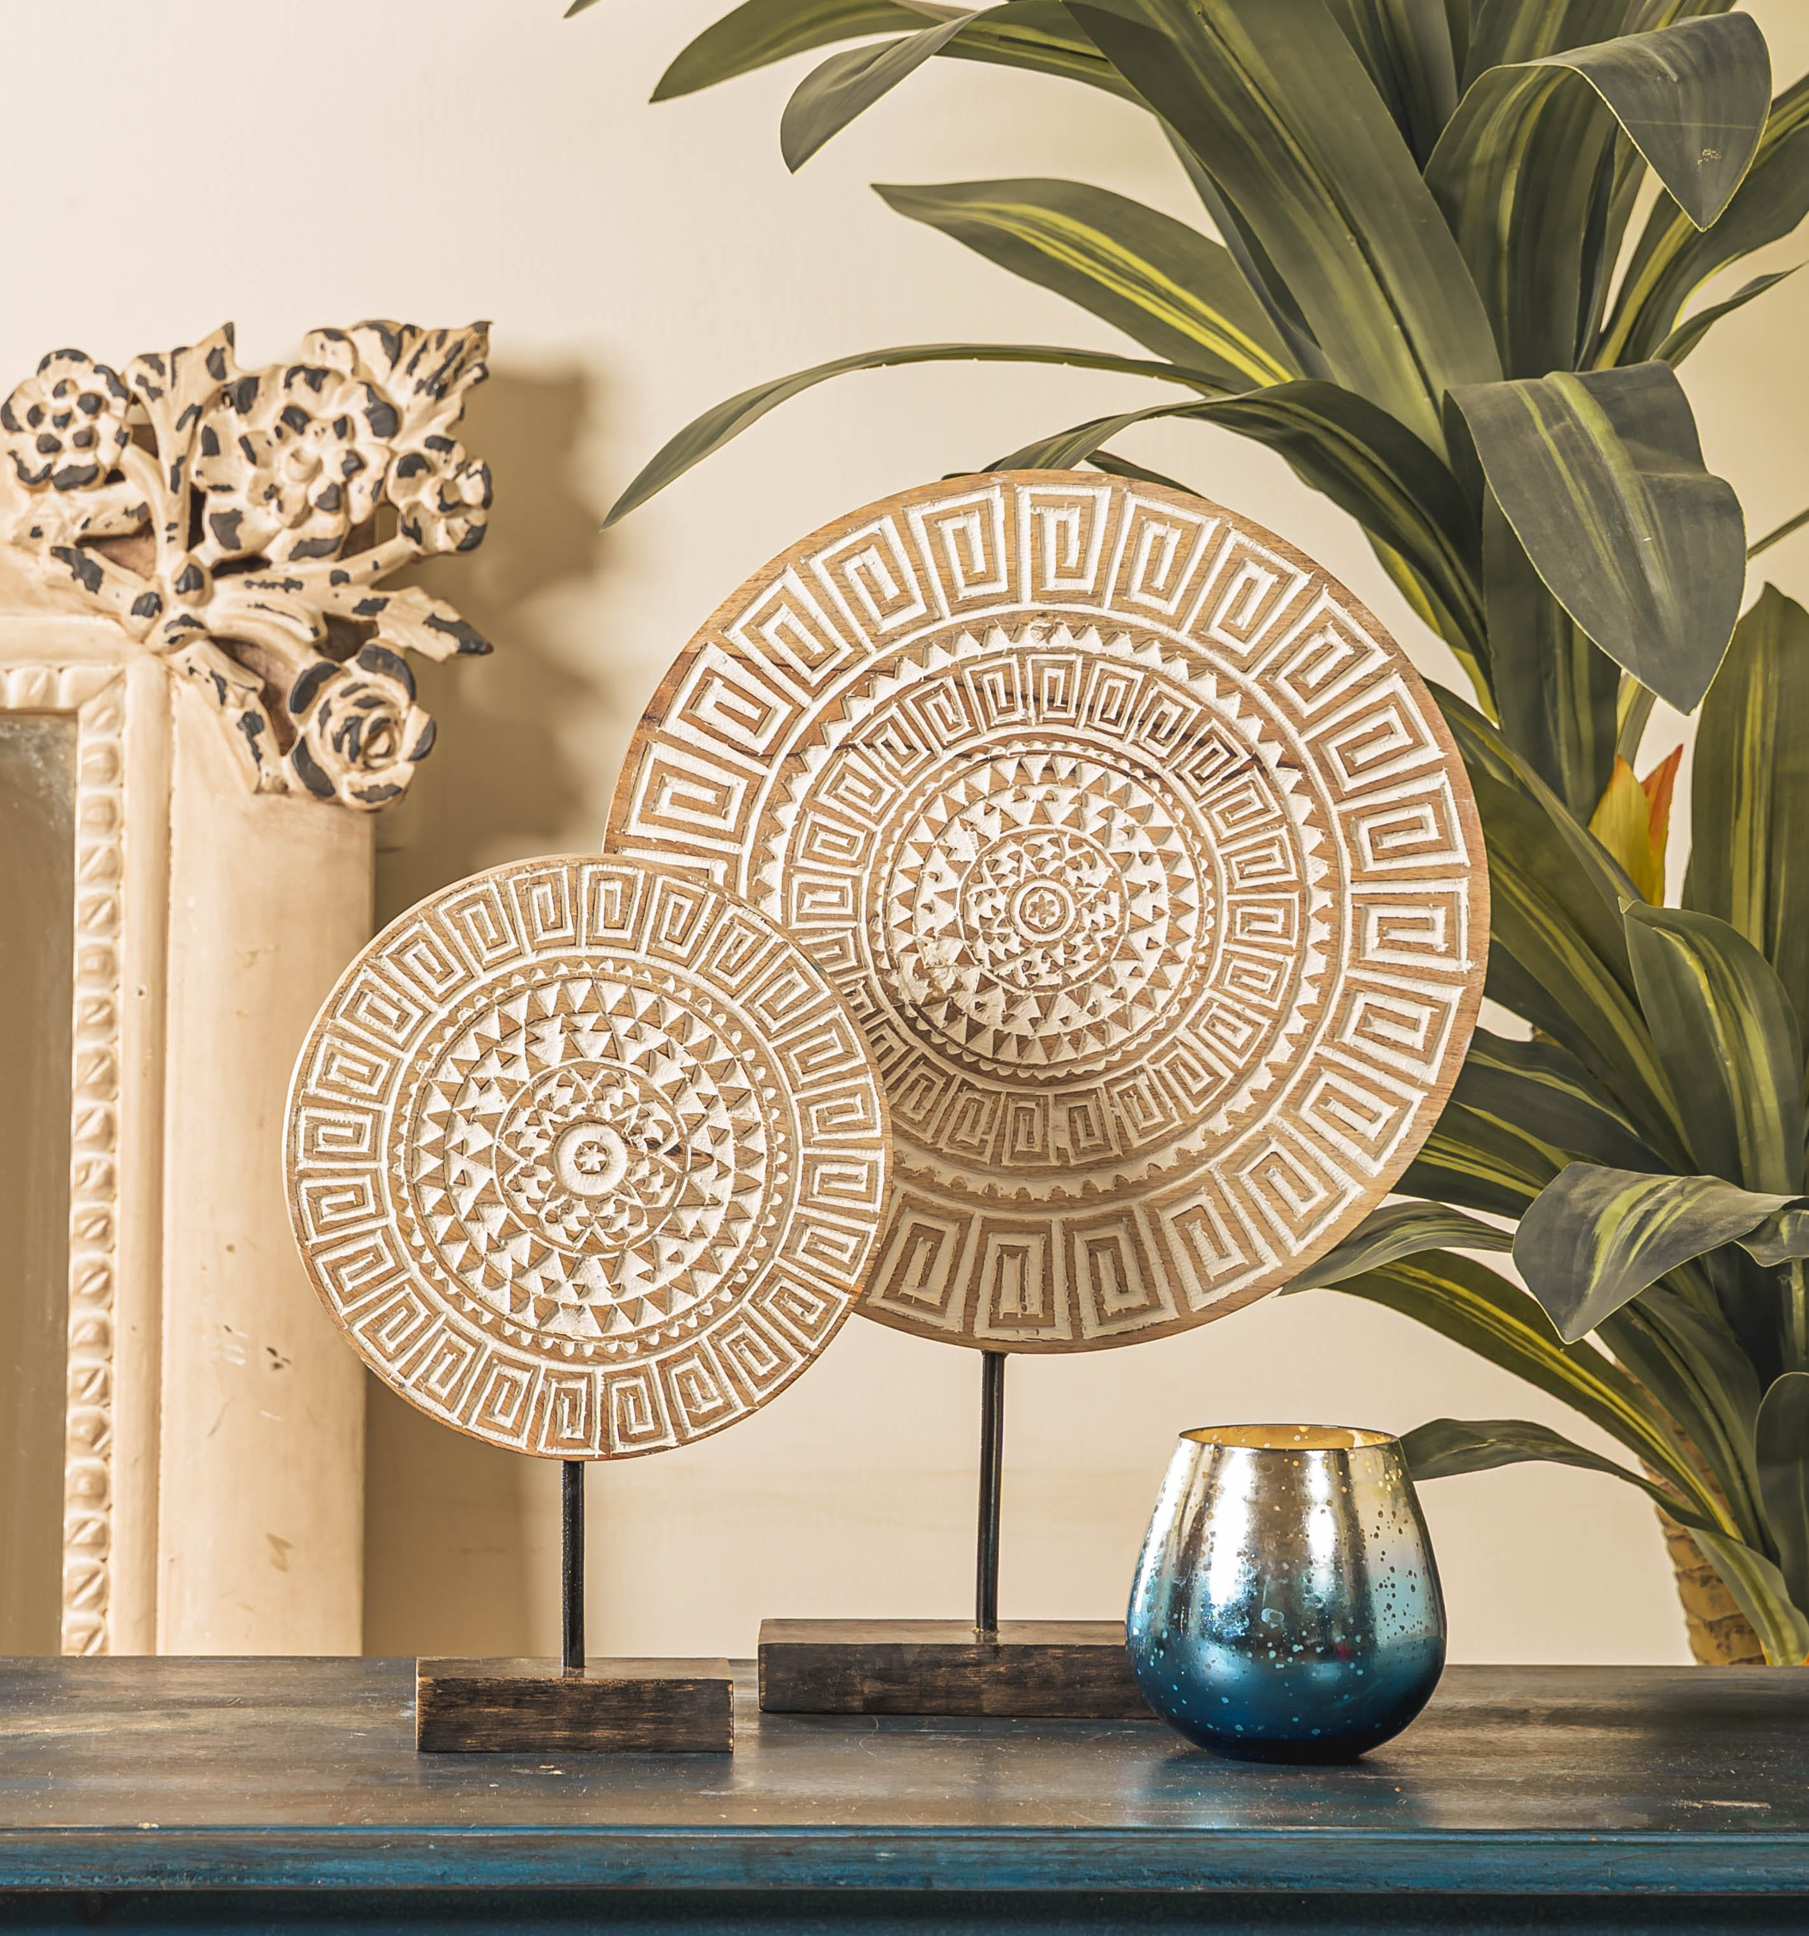
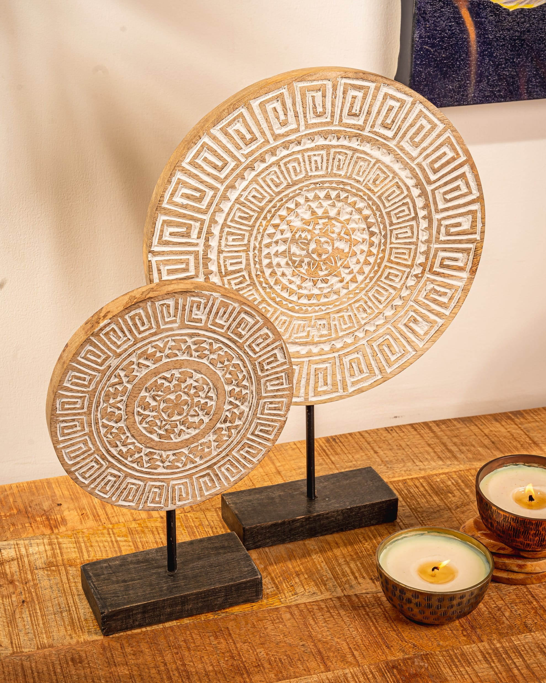
Niran table top décor - set of 2 - INR 3850 for the set
Gifting
https://homevedaa.com/product/niran-decor-set-of-2/

Slide 25
Viking Mug – made in black pottery by famous master artisan Mathew Sasa – Inr 2650
Gifting
https://homevedaa.com/product/viking-mug/

Slide 26
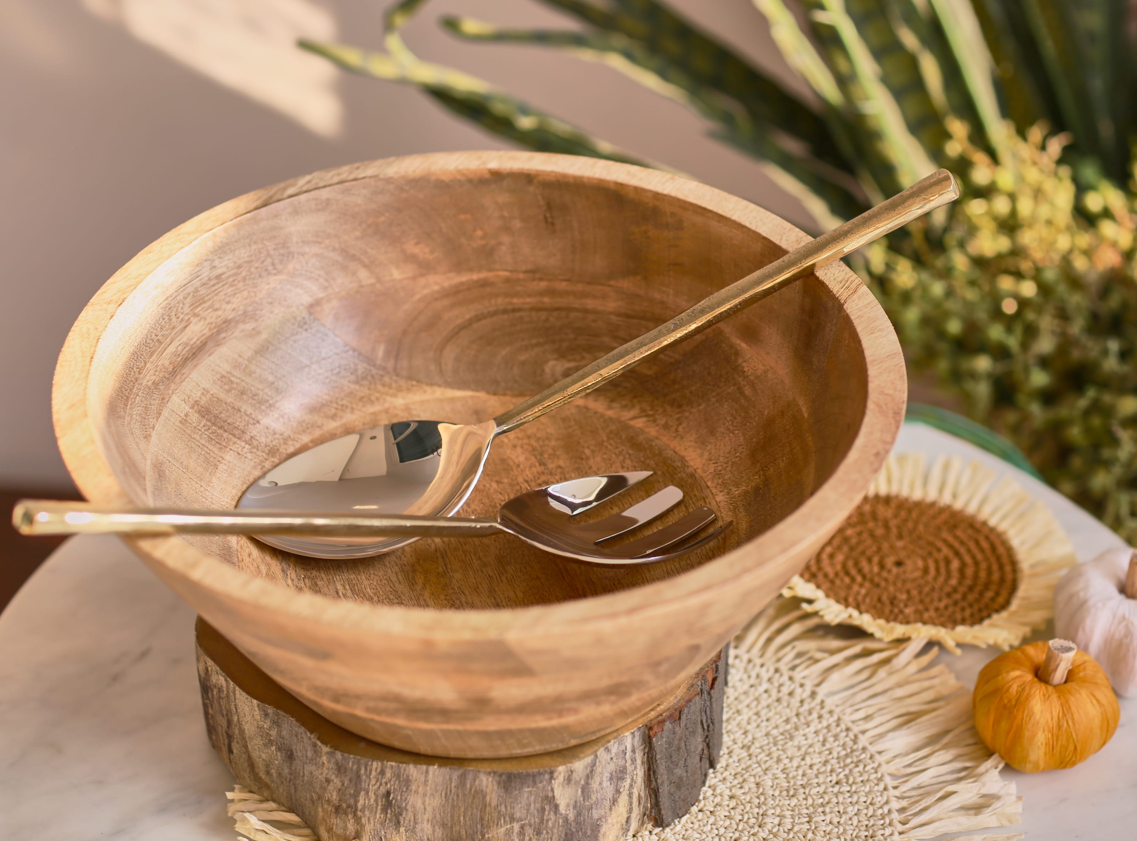
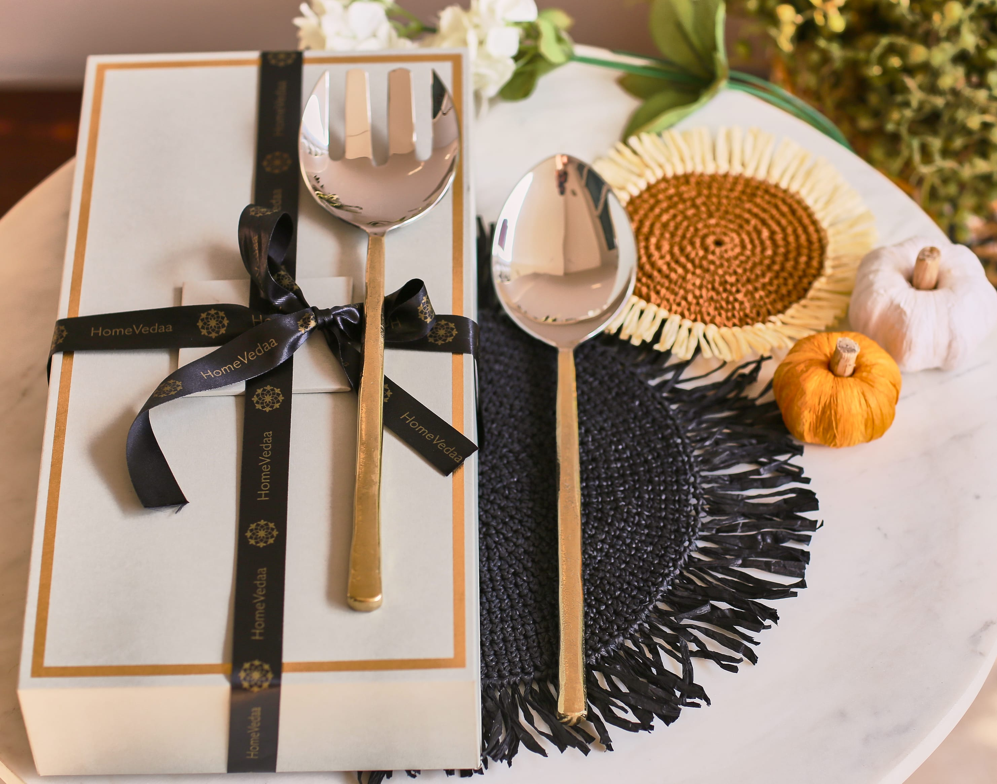
Amaya Salad Server set of 2 – hand forged in Steel and finished with brushed gold color handles – Inr 2250 for set of 2
Gifting
https://homevedaa.com/product/amaya-salad-server-set-of-2/

Slide 27
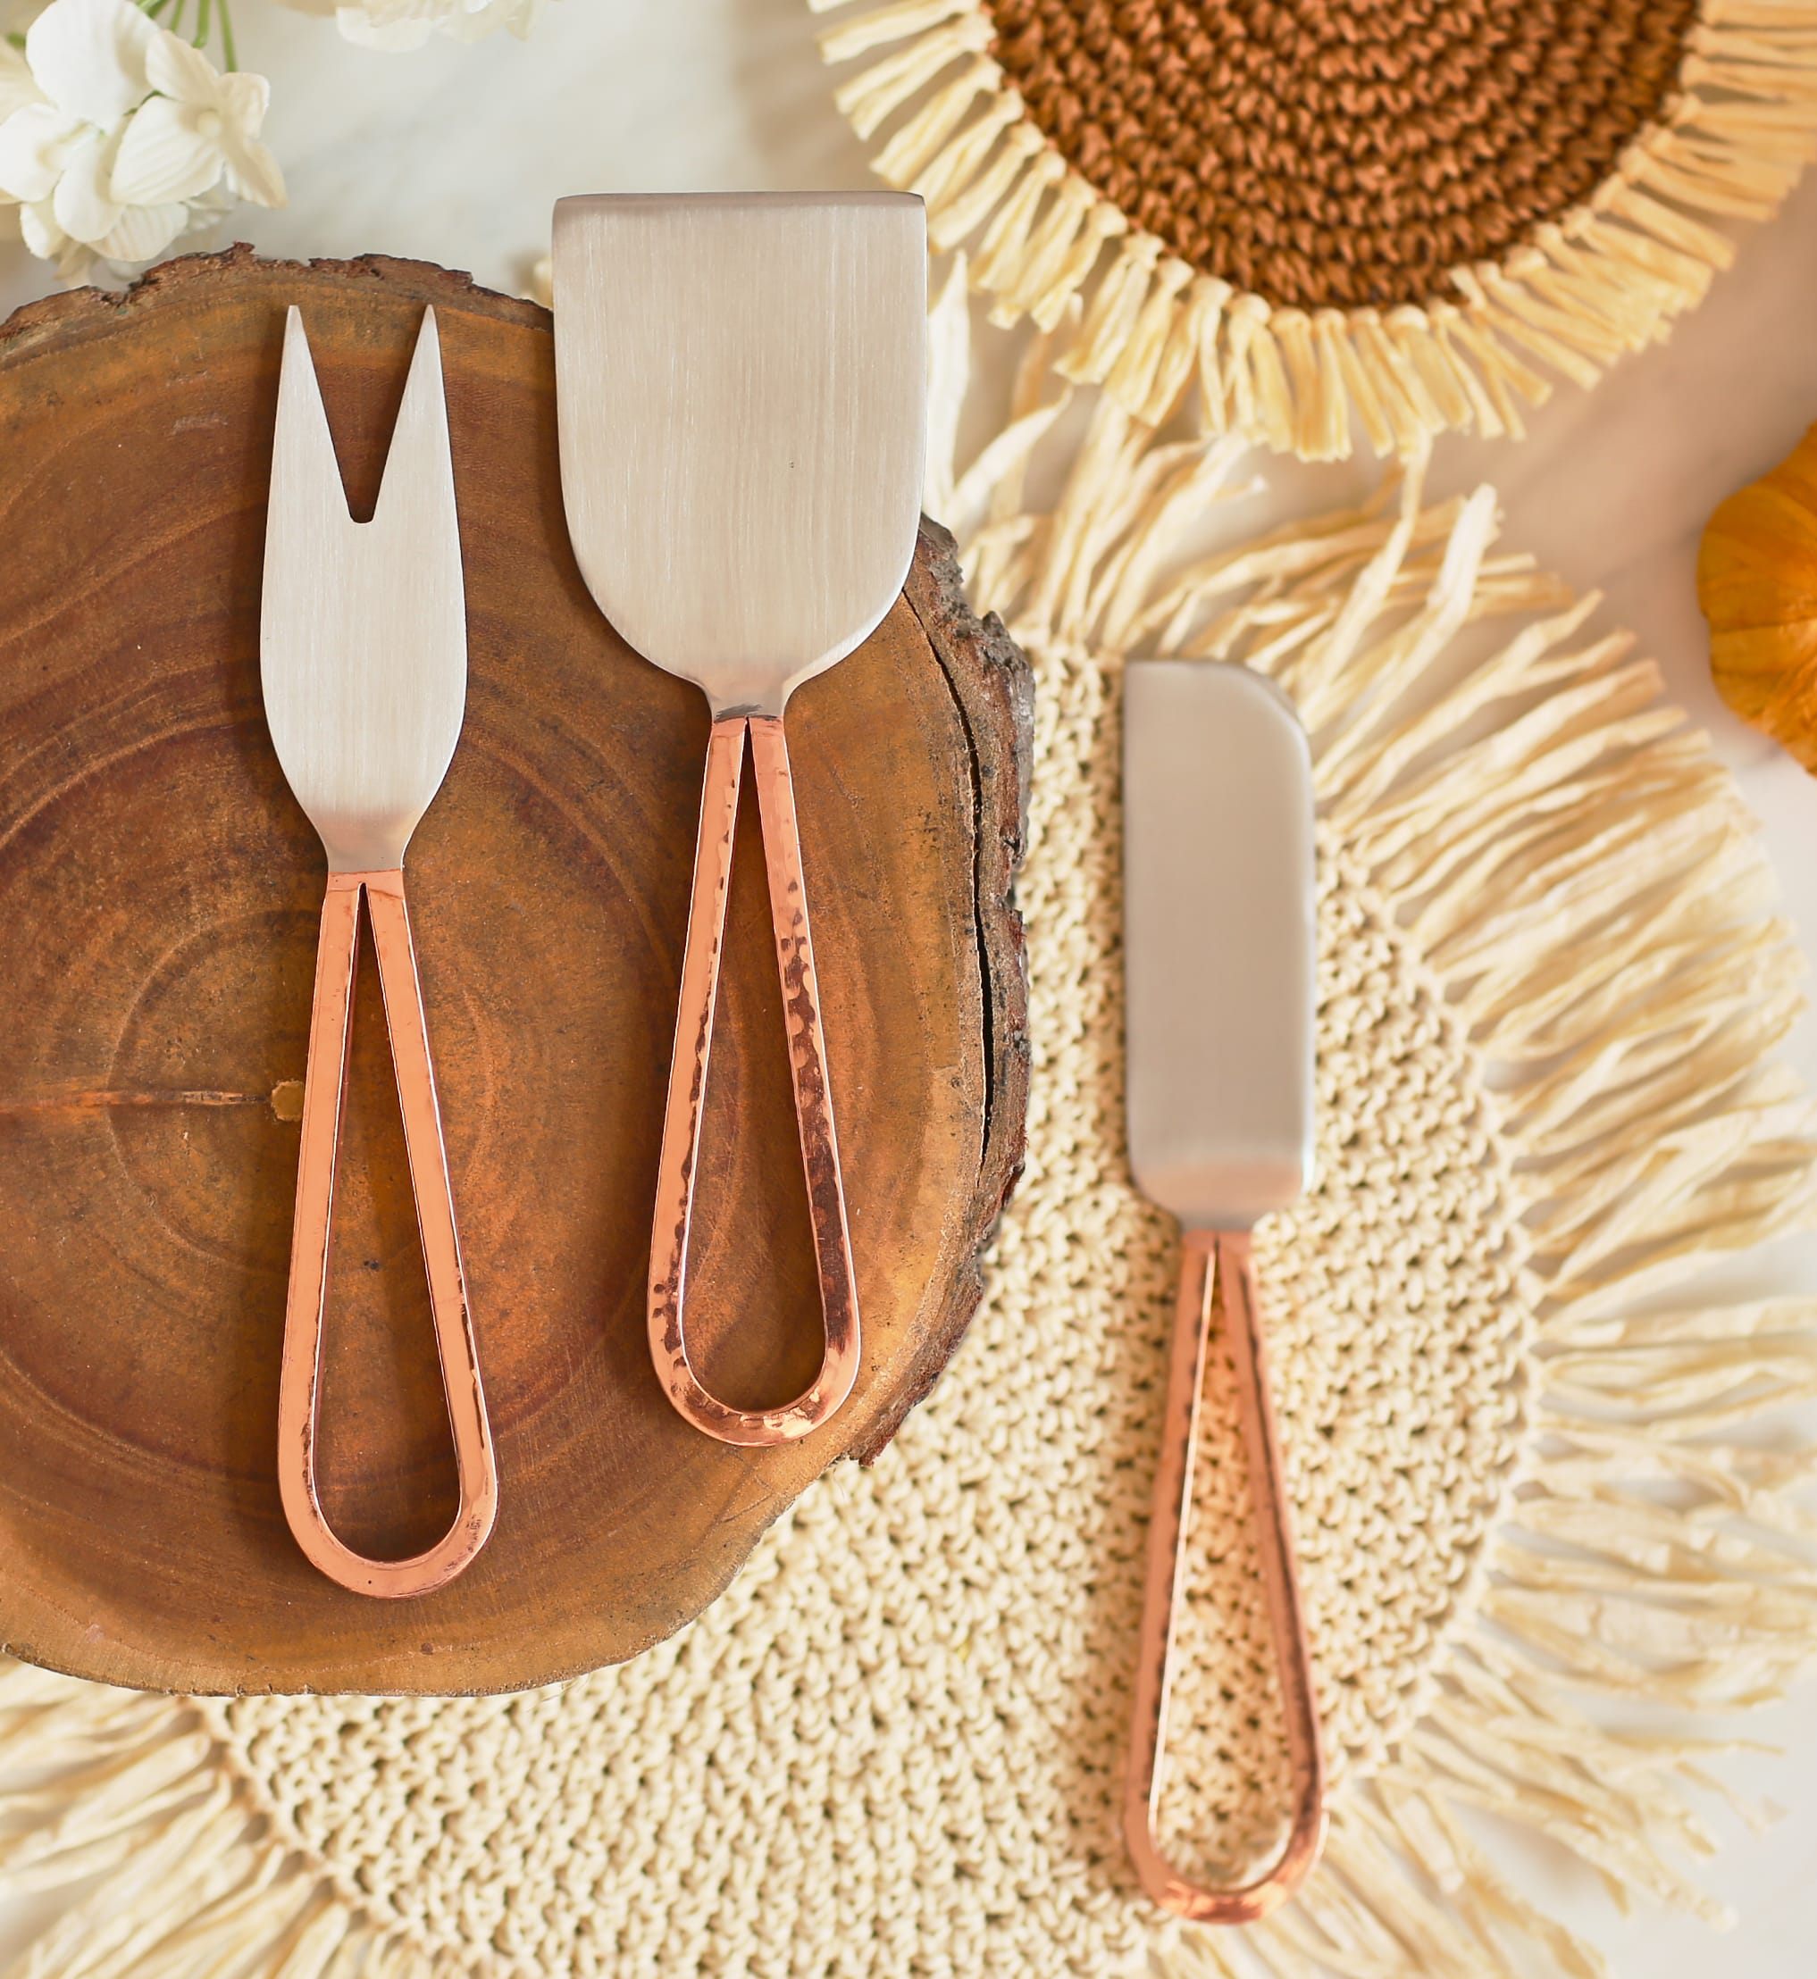
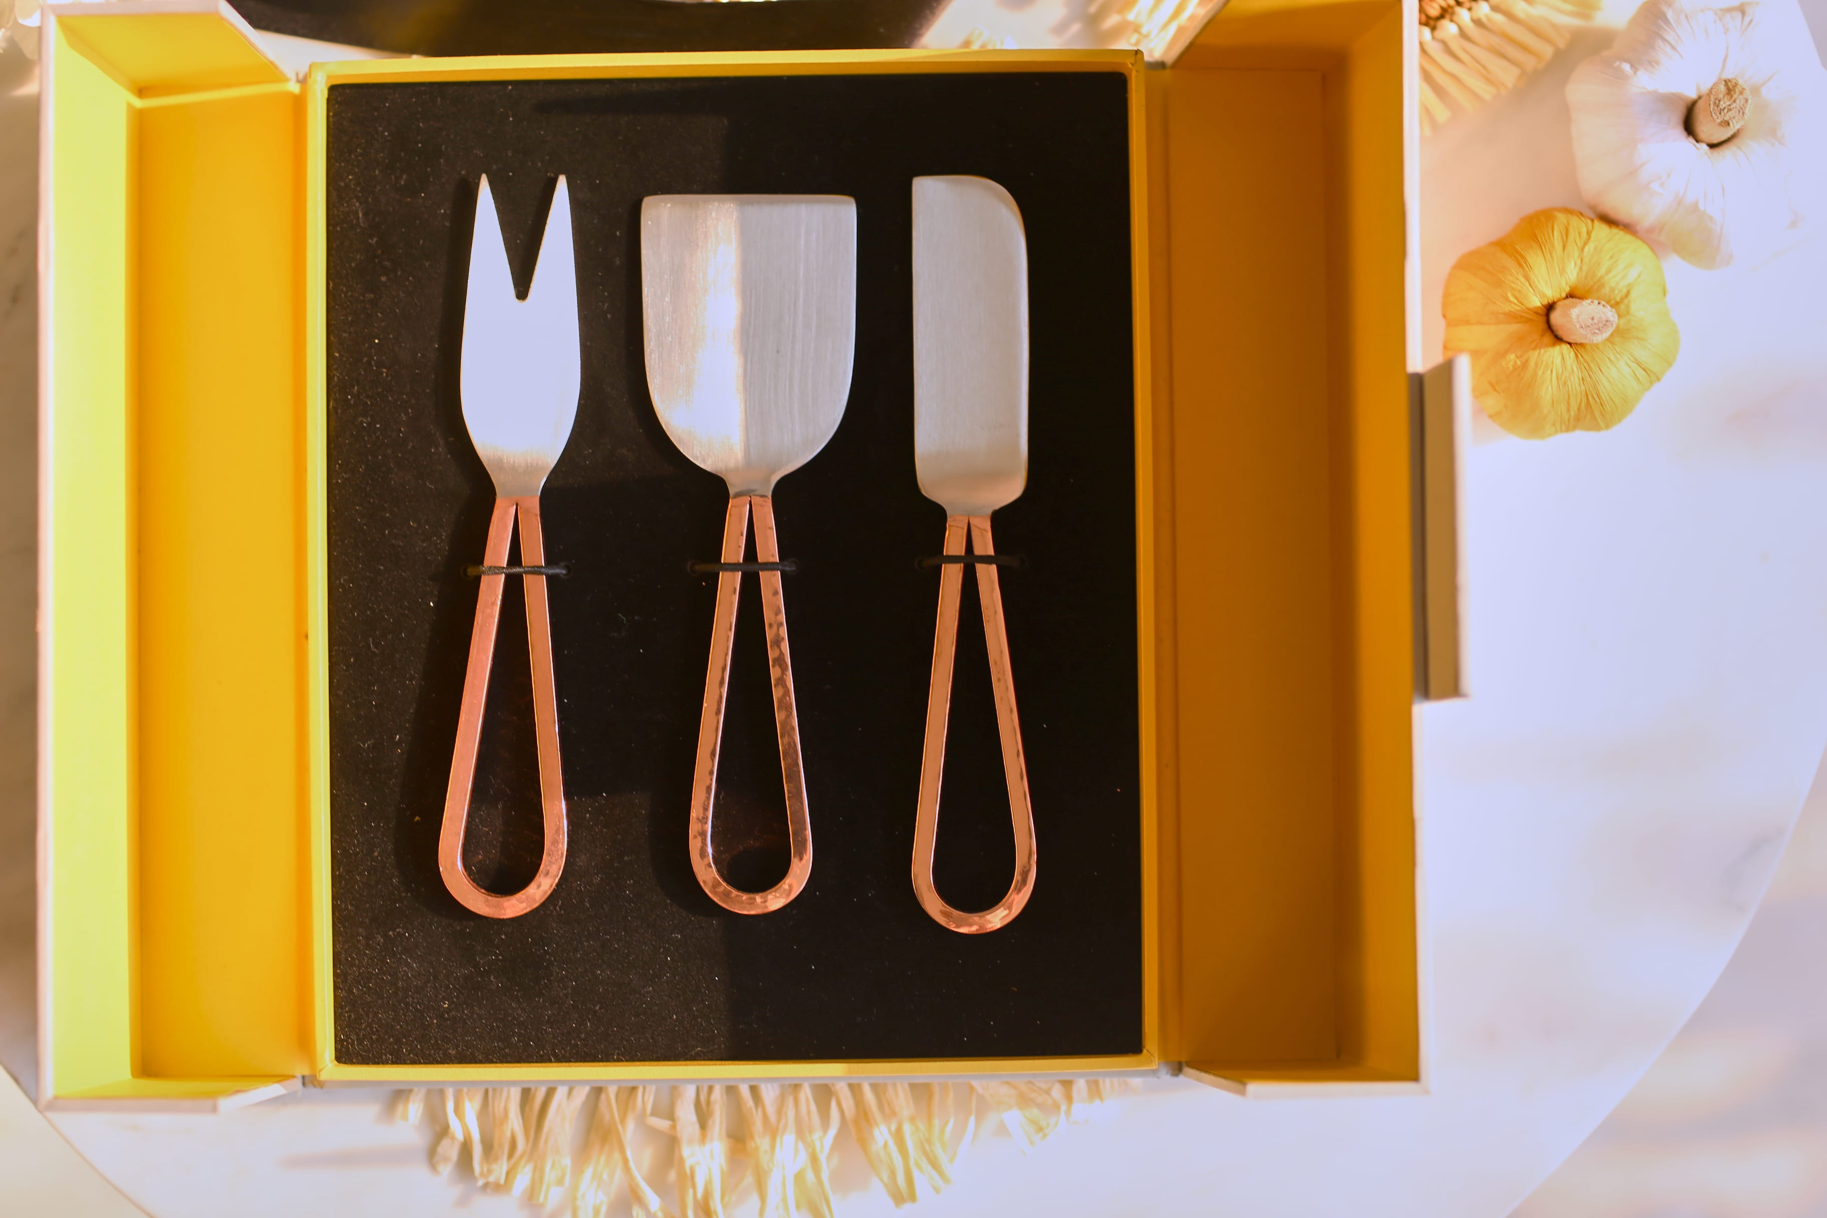
Naira Cheese Knife set of 3 – made in stainless steel with hand forged handles in rose gold color – Inr 2350 for set of 3
Gifting
https://homevedaa.com/product/naira-cheese-knife-set-of-3/

Slide 28
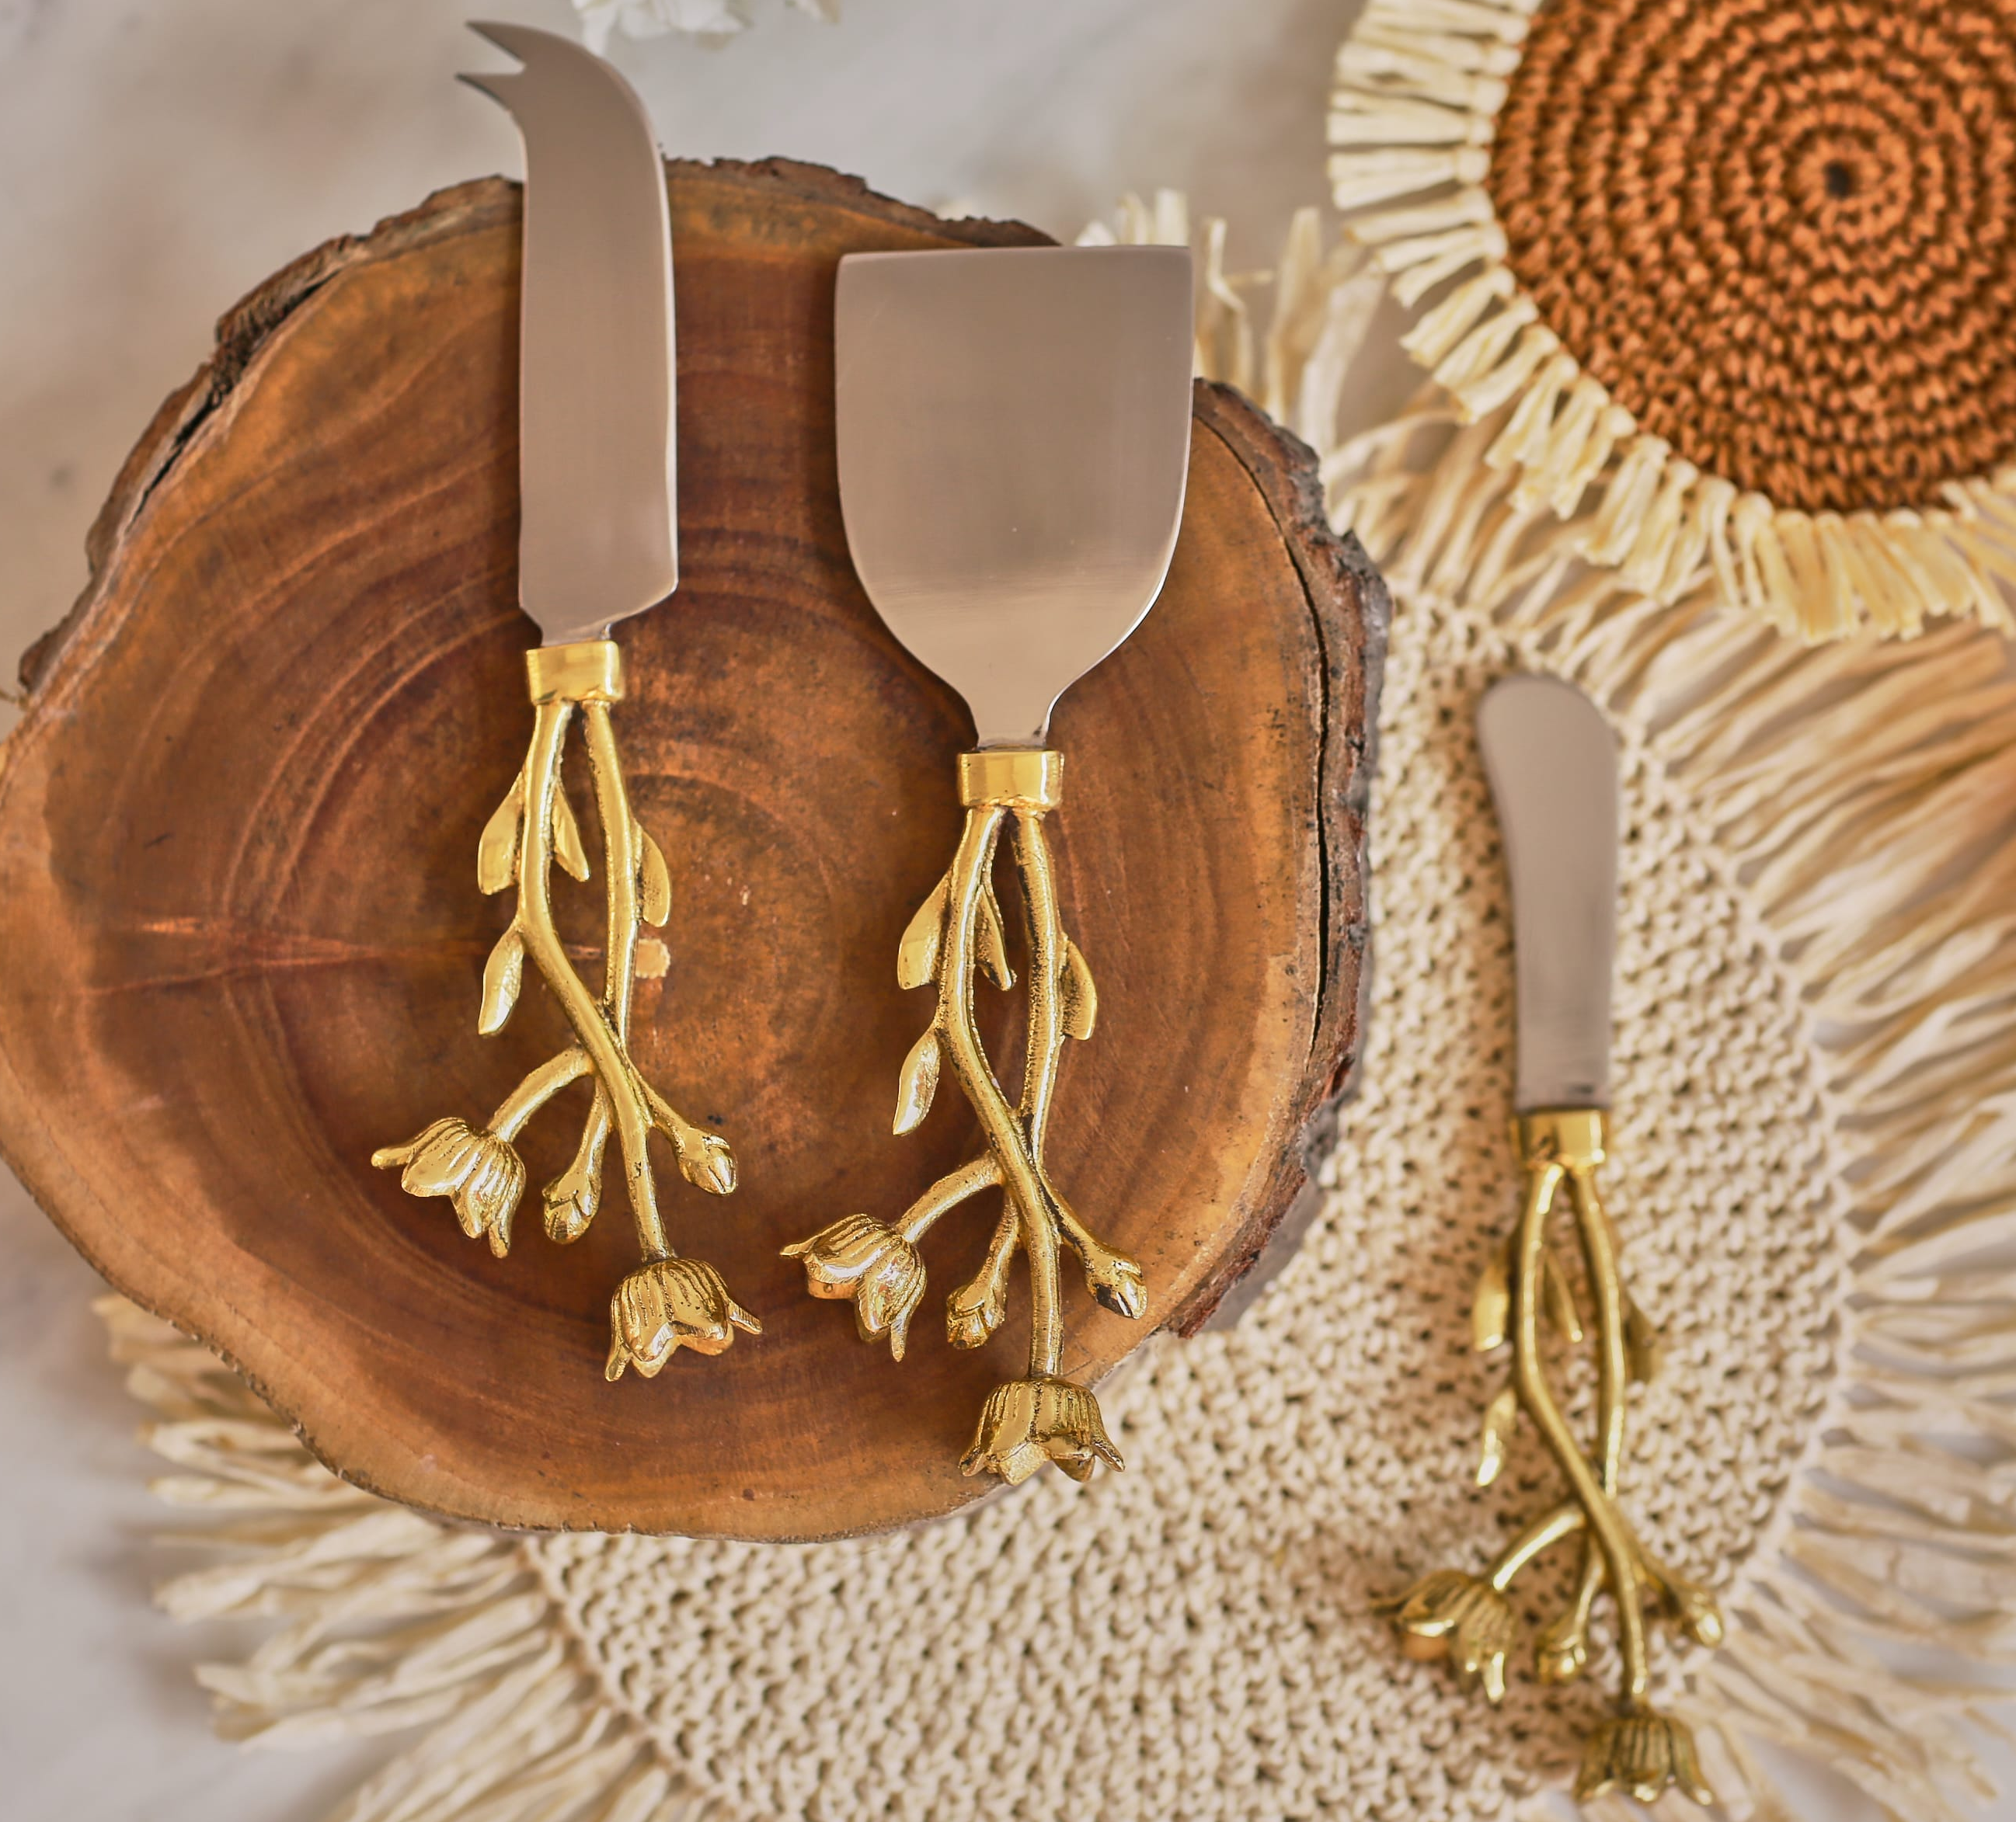
Blossom Cheese Knife set of 3 – made in stainless steel and brass with floral handles in gold color – Inr 2850 for set of 3
Gifting
https://homevedaa.com/product/blossom-cheese-knife-set-of-3/

Slide 29
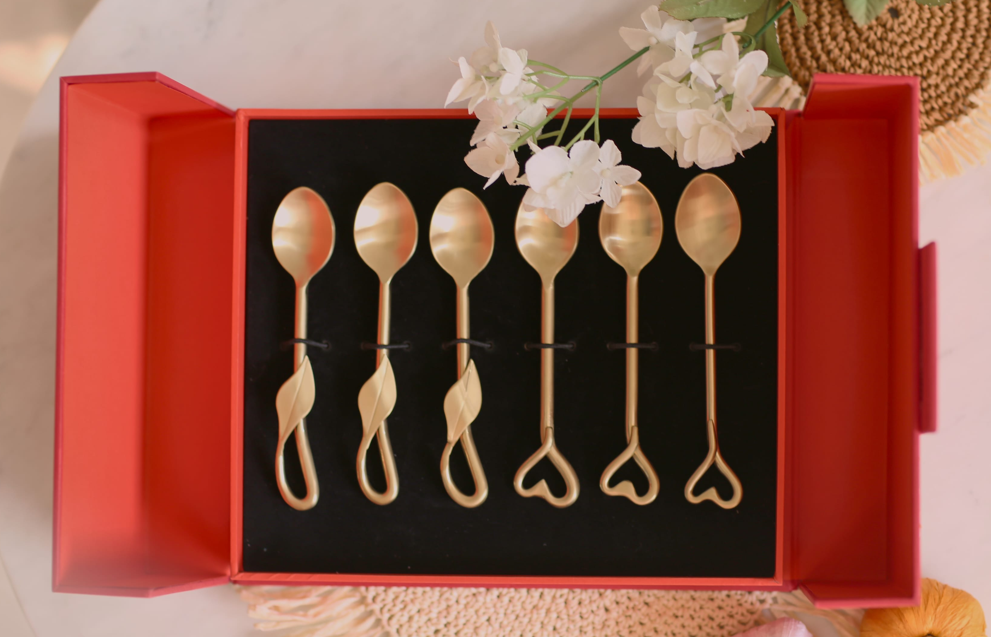
Heart Tea n Coffee spoons set of 6 – made in stainless steel and finished in matt gold color – Inr 2850 for set of 6
Gifting
https://homevedaa.com/product/heart-tea-n-coffee-spoon-set-of-6/

Slide 30
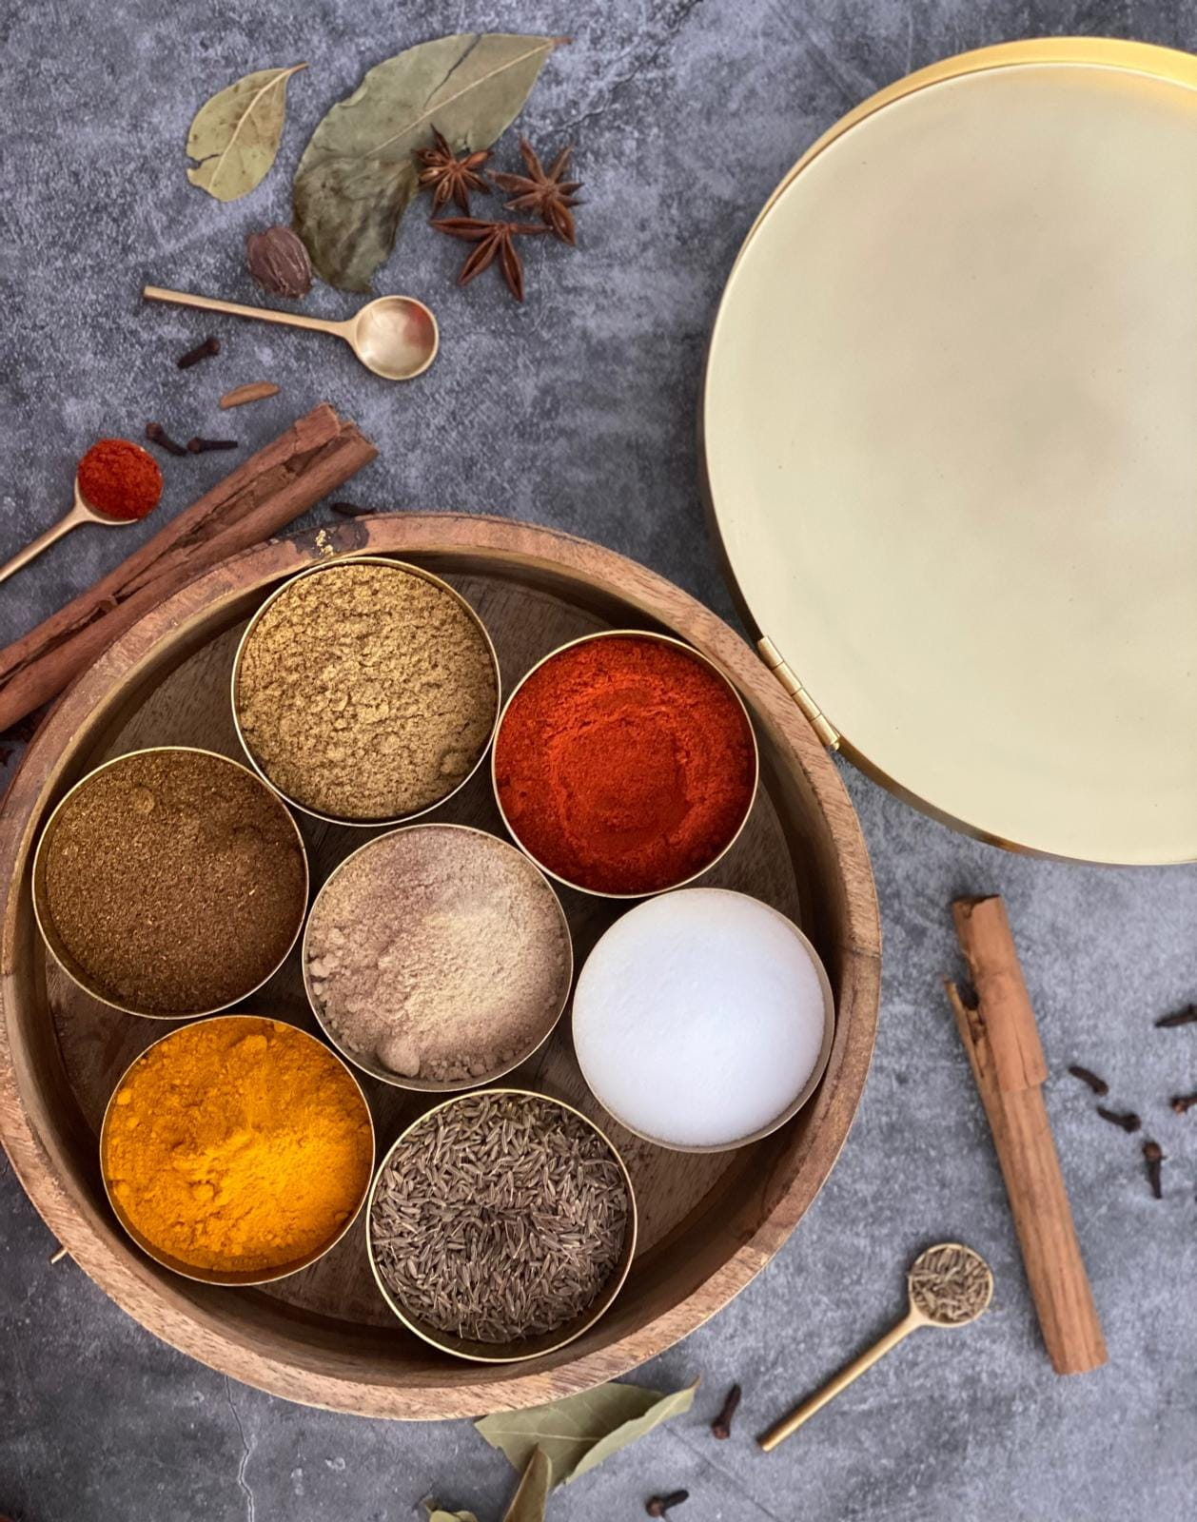
Mehak Spice Box – a lovely twist to the regular spice box! Made in Pure steel with brushed gold finish and mango wood box – Inr 5200
Gifting
https://homevedaa.com/product/mehak-spice-box/

Slide 31
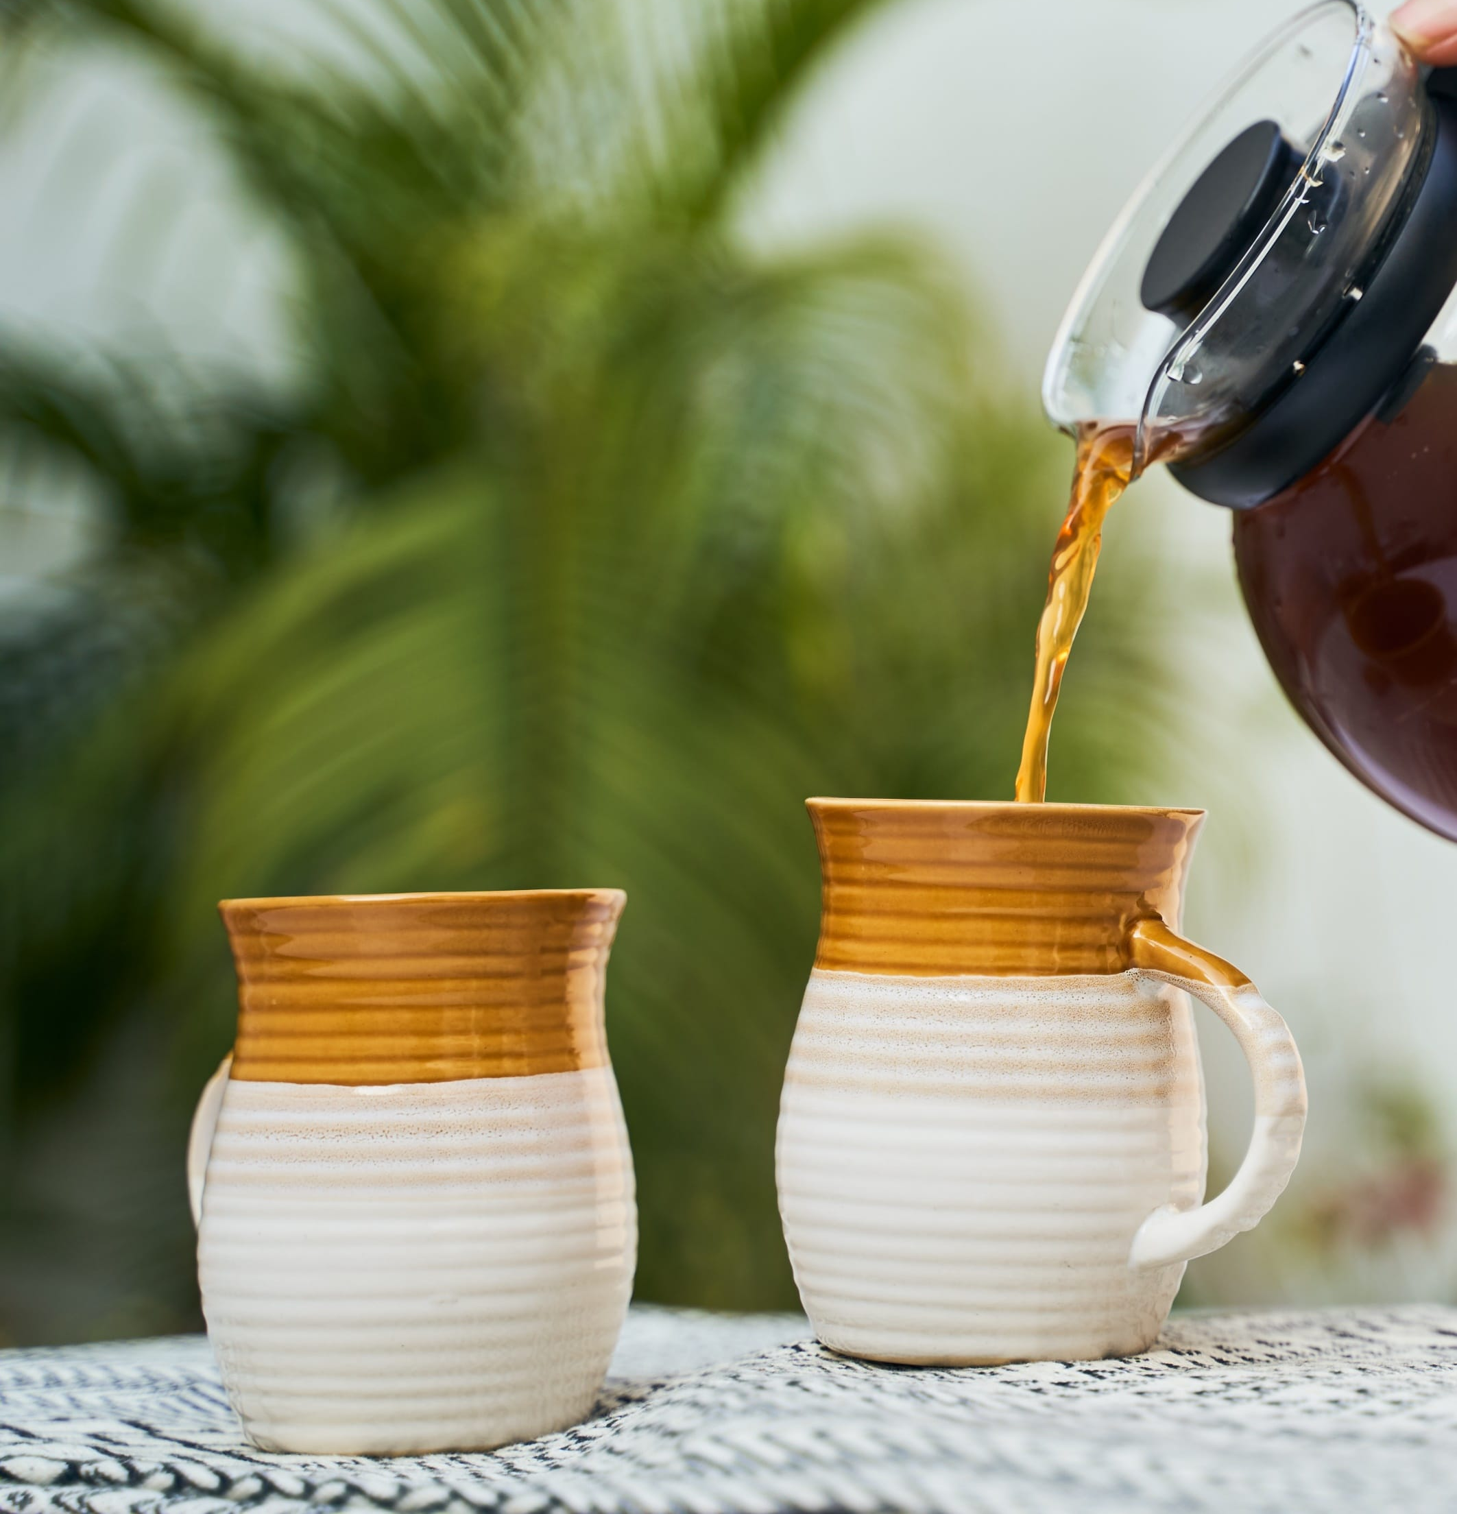
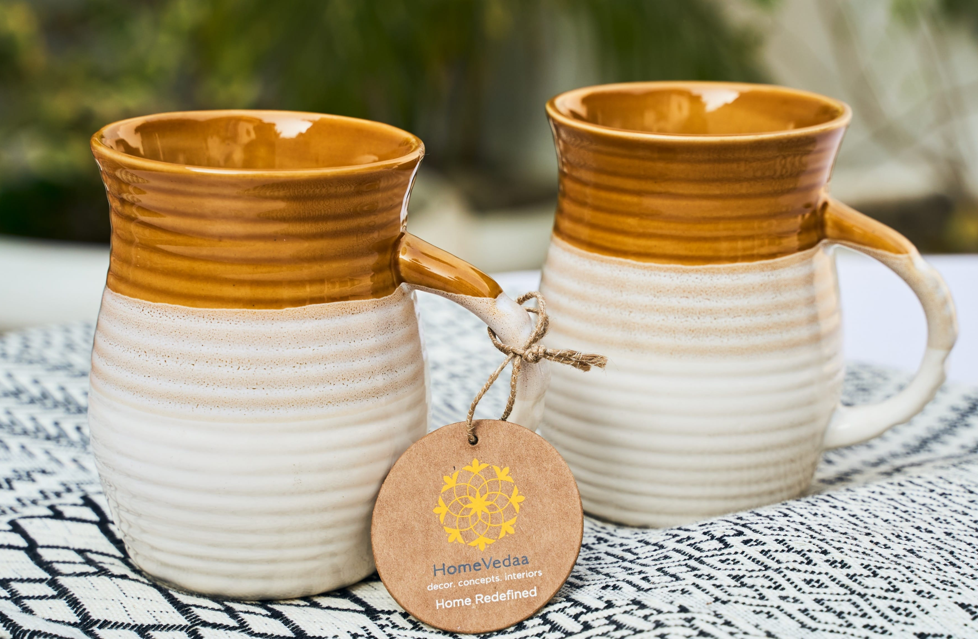
Zina Mug set of 2 – ceramic mugs in warm ochre color – Inr 940 for set of 2
Gifting
https://homevedaa.com/product/zina-mug/

Slide 32
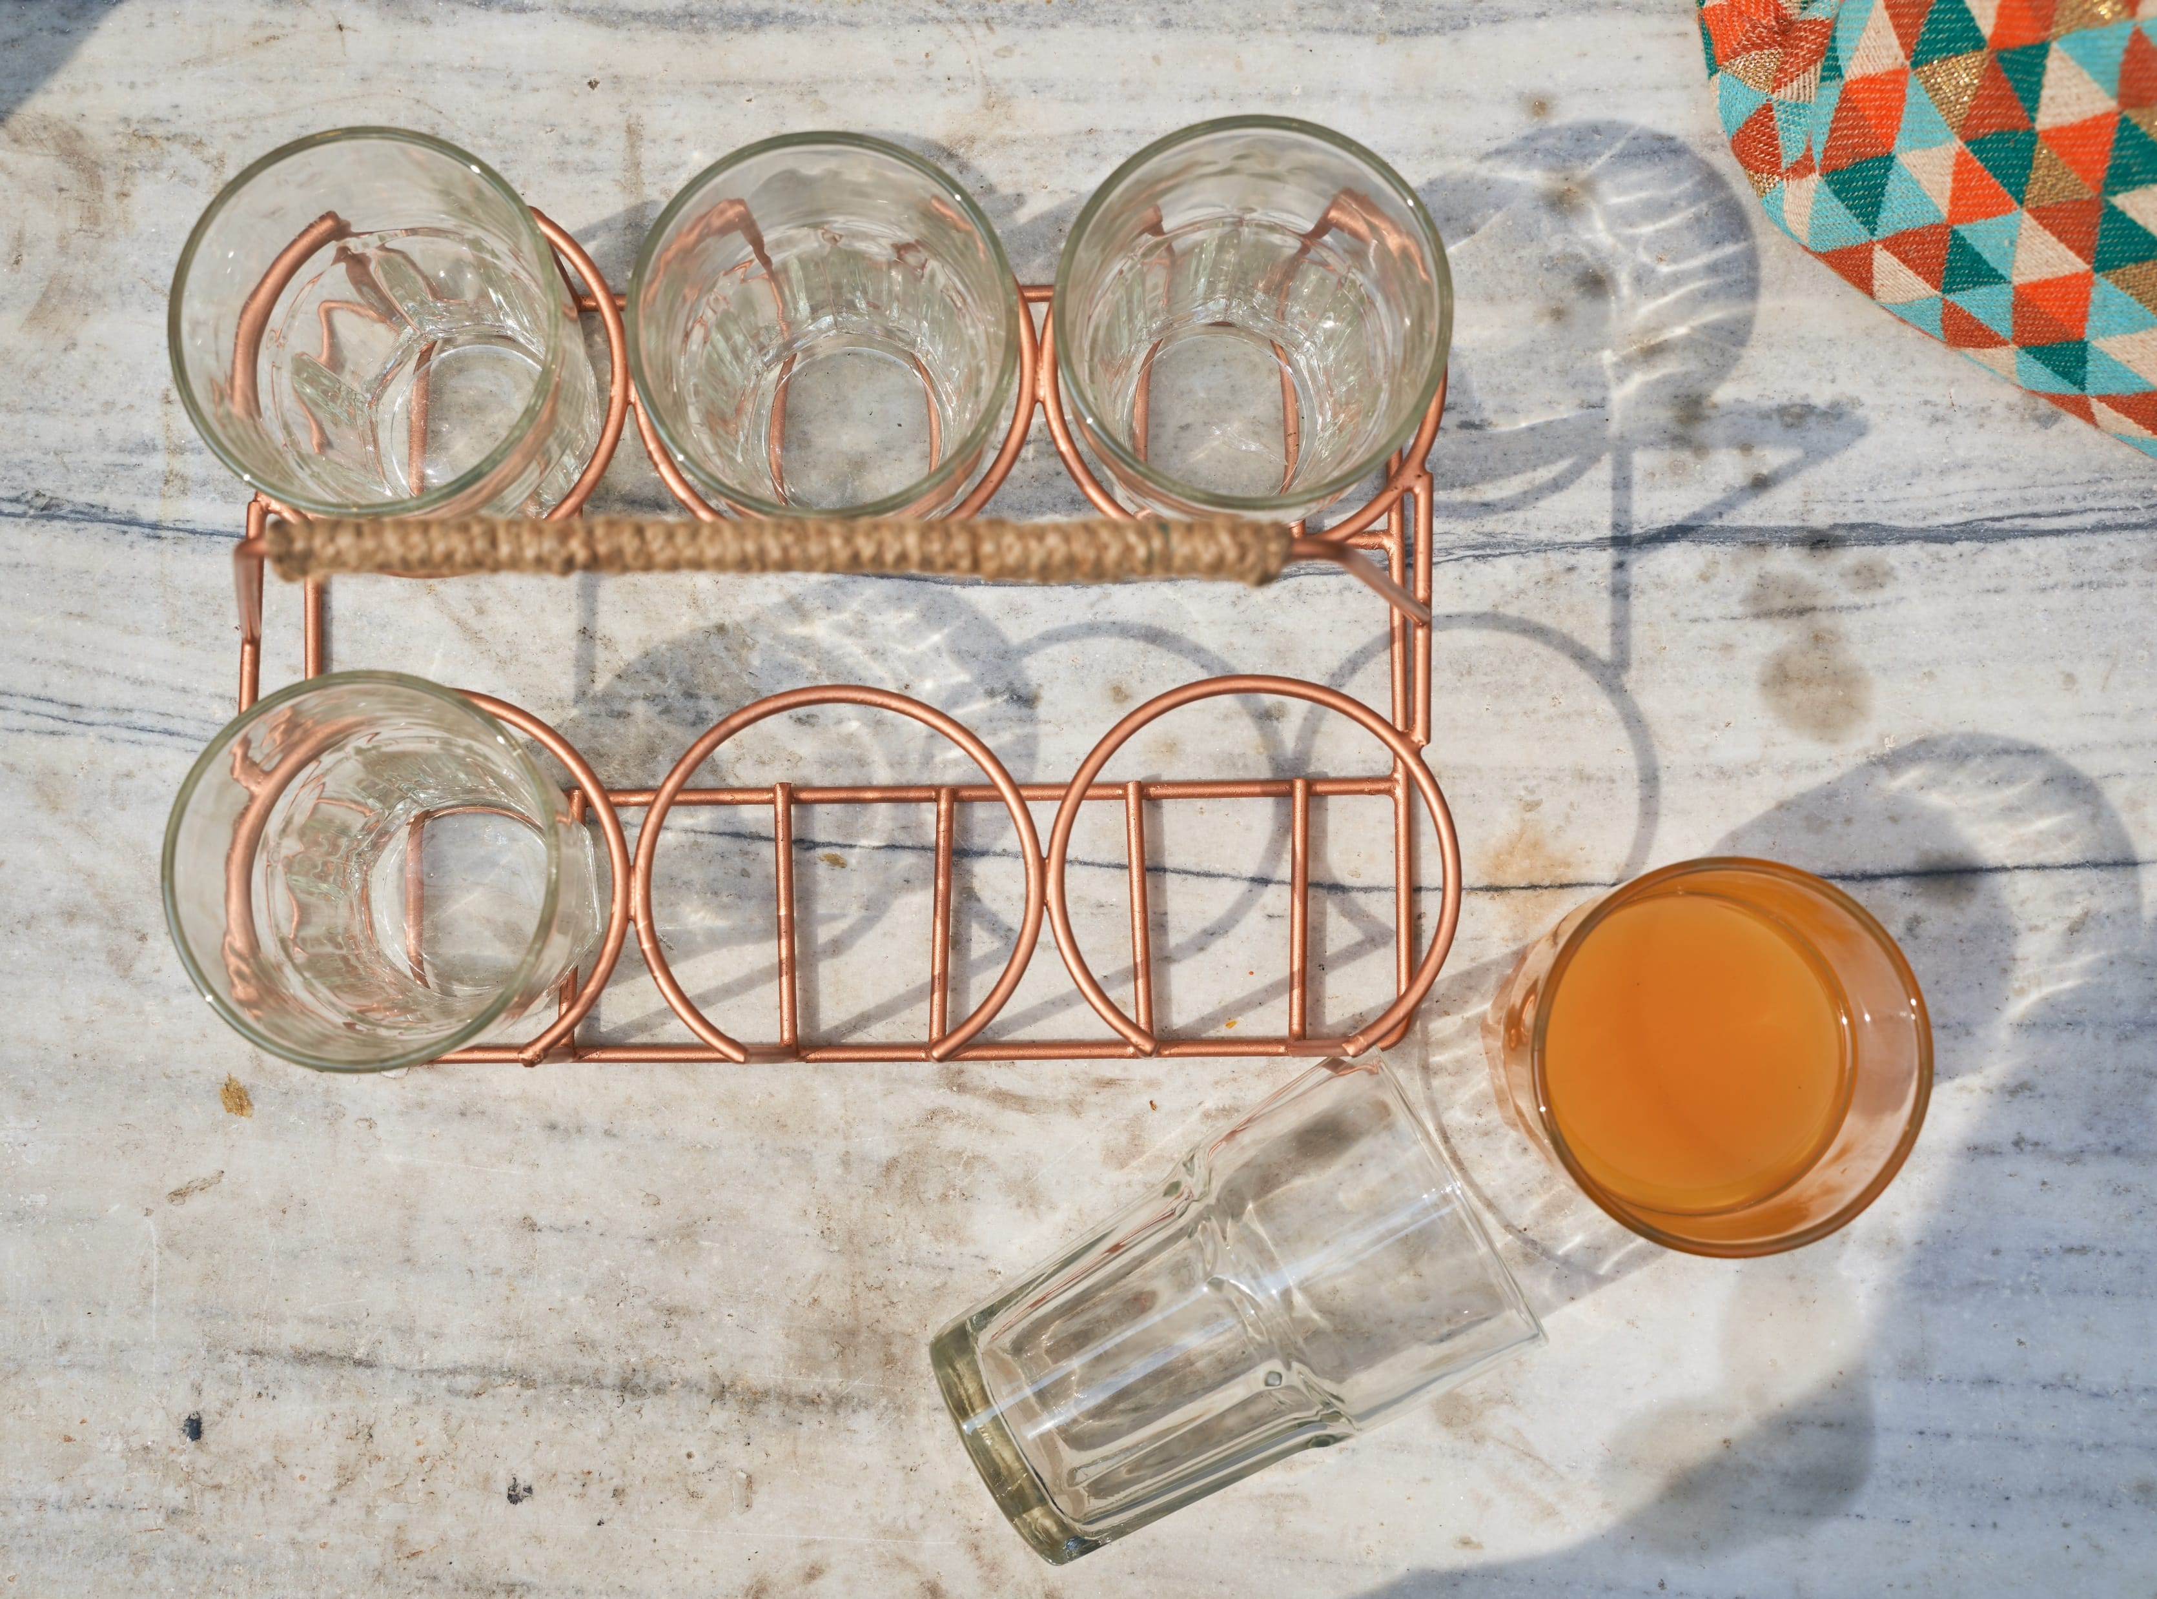
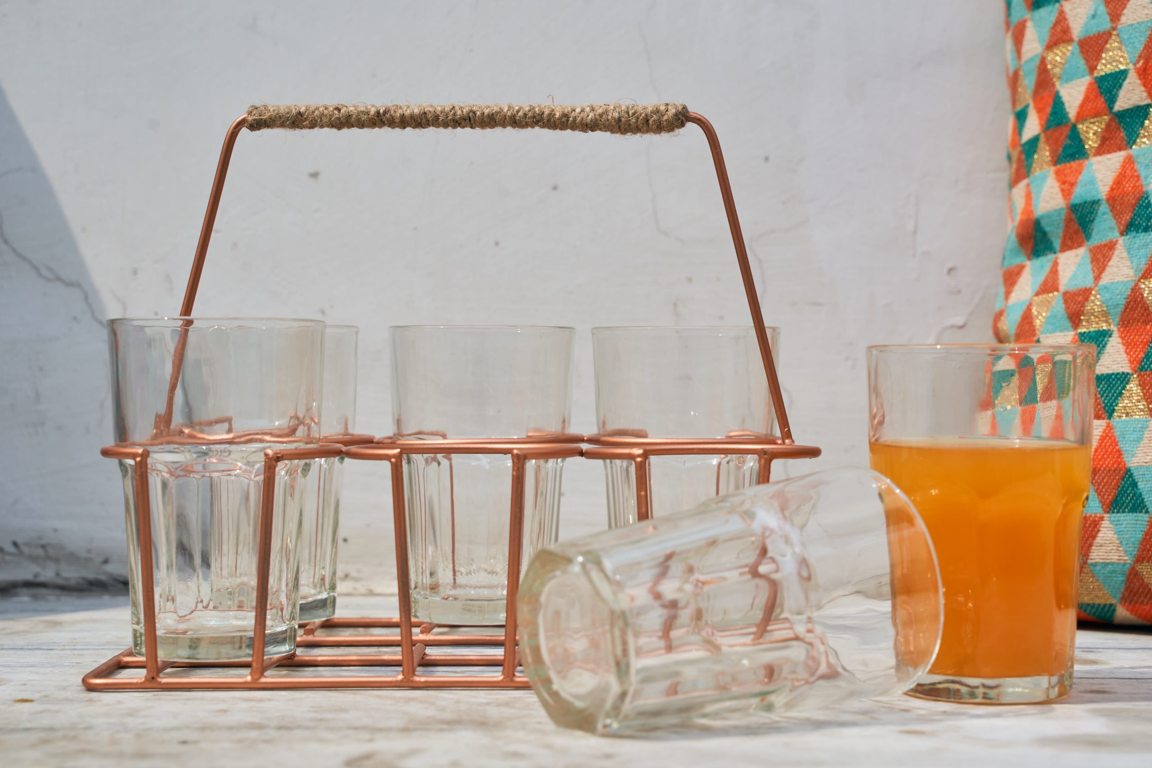
Tamira party Rack with 6 glasses – copper color – Inr 2250 for the set with glasses
Gifting
https://homevedaa.com/product/tamira-rack/

Slide 33
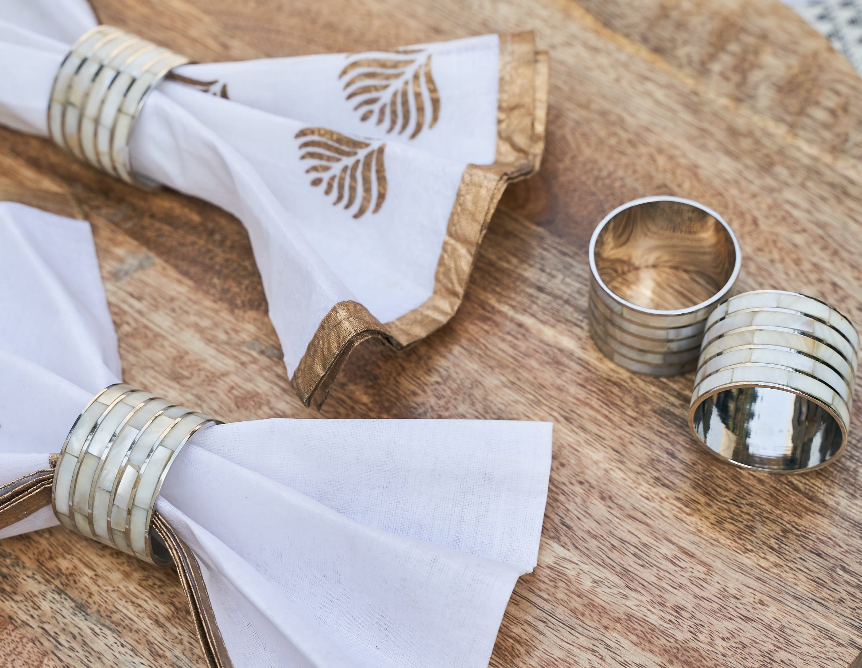
Iris Napkin Rings – made in stainless steel and mother of pearl inlay work.
Set of 6 – INR 1950
Gifting

Slide 34
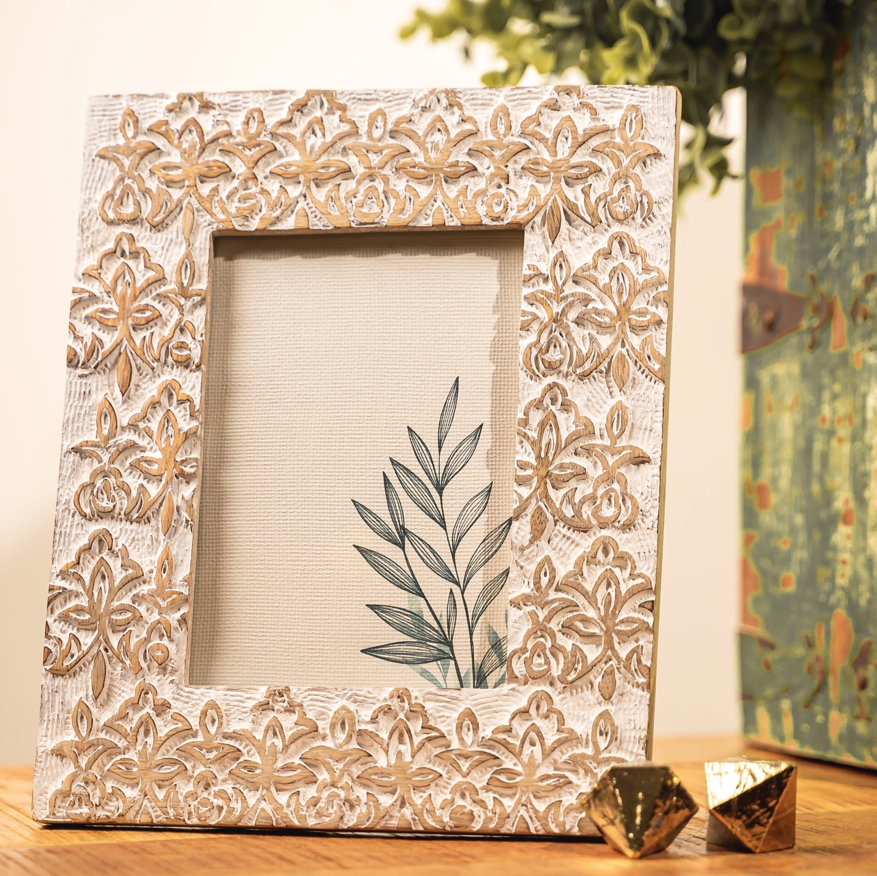
Lotus Photo frame – hand carved in wood in whitewash color – INR 1750
Gifting
https://homevedaa.com/product/lotus-frame/

Slide 35
Magnolia Photo frame – made from mother of pearl in Charcoal color and brass inlay – INR 2100
Gifting
https://homevedaa.com/product/magnolia-frame/

Slide 36
Cypress Photo frame – mango wood – INR 1850
Gifting
https://homevedaa.com/product/cypress-photo-frame/

Slide 37
Terra planter set of 3 - hand hammered metal pots with stands – INR 2950 for the set of 3
Gifting
https://homevedaa.com/product/terra-planter-set-of-3/

Slide 38
Hope Planter – metal in whitewash finish – removeable lid to place pots or any décor piece inside – INR 1950
Gifting
https://homevedaa.com/product/hope-planter/

Slide 39
Dahlia Planter - hand etched metal – INR 2350 ( price does not include flowers)
Gifting
https://homevedaa.com/product/dahlia-planter-coming-soon/

Slide 40
Poppy Hammer Planter – hanging metal planter in whitewash finish – INR 600
Gifting
https://homevedaa.com/product/poppy-hammer-planter/

Slide 41
Marigold Planter – metal planter in antique gold finish - INR 3250 ( price does not include flowers)
Gifting
https://homevedaa.com/product/marigold-planter/

Slide 42
Fern Hanging Planter set of 2 – metal planter in antique gold finish - INR 2850 for the set (price does not include flowers)
Gifting
https://homevedaa.com/product/fern-hanging-planter-set-of-2/

Slide 43
Nirvana by HomeVedaa
Candles n Reed Diffusers
~ Scent is the first thing people notice when they enter a home ~
Gifting

Slide 44
Honeycomb Votive – glass jars with cork lid filled with soy wax in jasmine fragrance – Inr 1250
Gifting
https://homevedaa.com/product/honeycomb-votive/

Slide 45
Shimmer Votive Gold - textured glass jar with cork lids – filled with soy wax in vanilla fragrance – Inr 1400
Gifting
https://homevedaa.com/product/shimmer-votive/

Slide 46
Shimmer Votive Teal - textured glass jar with cork lids – filled with soy wax in vanilla fragrance – Inr 1400
Gifting
https://homevedaa.com/product/shimmer-votive/

Slide 47
Shimmer Votive Confetti Pink - textured glass jar with cork lids – filled with soy wax in vanilla fragrance – Inr 1400
Gifting
https://homevedaa.com/product/shimmer-votive/

Slide 48
Frangipani Incense Holder – handcrafted ceramic incense holder comes with a pack of 30 hand rolled recycled flower incense sticks - Inr 1750 for the complete set
Chemical Free !
Gifting
https://homevedaa.com/product/frangipani-incense-holder-set/

Slide 49
Chandra Incense Holder – handcrafted ceramic incense holder comes with a pack of 30 hand rolled recycled flower incense sticks - Inr 1750 for the complete set
Chemical Free !
Gifting
https://homevedaa.com/product/chandra-incense-holder/

Slide 50
Tulip Reed Diffuser Set – with 6 bamboo reeds. Fragrance – sweet Tonka - Inr 850
https://homevedaa.com/product/tulip-reed-diffuser/

Slide 51
Orchid Reed Diffuser Set – with 6 bamboo reeds. Fragrance – Wild Heather n Ocean - Inr 850
https://homevedaa.com/product/orchid-reed-diffuser/

Slide 52
Heritage Reed Diffuser Set – with 6 bamboo reeds. Fragrance – Sweet Tonka - Inr 750
https://homevedaa.com/product/heritage-reed-diffuser/

Slide 53
Heritage Reed Diffuser Set – with 6 bamboo reeds. Fragrance – Walnut n Vanilla - Inr 750
https://homevedaa.com/product/heritage-reed-diffuser/

Slide 54
Heritage Reed Diffuser Set – with 6 bamboo reeds. Fragrance – Wild Heather n Ocean - Inr 750
https://homevedaa.com/product/heritage-reed-diffuser/

Slide 55
Zen Gold Reed Diffuser Set – with 8 bamboo reeds. Fragrance – Gold Jasmine - Inr 1150
https://homevedaa.com/product/zen-reed-diffuser/

Slide 56
Heritage Candle Votive – soy wax – Inr 350 per piece Good to go as a set of 3 OR pick any one to combine with other gifts.

Slide 57
Heritage Candle Votive – soy wax. Fragrance Sweet Tonka – Inr 350
https://homevedaa.com/product/2928/

Slide 58
Heritage Candle Votive – soy wax. Fragrance Walnut n Vanilla – Inr 350
https://homevedaa.com/product/2928/

Slide 59
Heritage Candle Votive – soy wax. Fragrance Wild Heather n Ocean – Inr 350
https://homevedaa.com/product/2928/

Slide 60
Orchid Candle Votive – soy wax. Fragrance Wild Heather n Ocean – Inr 350
https://homevedaa.com/product/orchid-candle-votive/

Slide 61
Zen Gold Candle – soy wax. Fragrance Oudh – Inr 950
https://homevedaa.com/product/zen-gold-candle/

Slide 62
Celebration Candle – soy wax. Fragrance Casablanca Romance & Night Bazaar– Inr 850
https://homevedaa.com/product/celebration-candle/

Slide 63
Meraki Candle – soy wax. Fragrance Exotic sandalwood with Wild jasmine – Inr 700
https://homevedaa.com/product/meraki-candle/

Slide 64
Isha Throw – 100% Cotton jacquard throw – Inr 2950
Gifting
https://homevedaa.com/product/2887/

Slide 65
Palash Throw – 100% Cotton jacquard throw – Inr 2950
Gifting
https://homevedaa.com/product/palash-cotton-throw/

Slide 66
Sidra Throw – hand made crochet throw – INR 3950
Exclusive – A Team Vedhika Initiative !
Gifting
https://homevedaa.com/product/sidra-crochet-throw/

Slide 67
Garden Cushion Cover – 100% Cotton, printed with hand embroidery – Inr 750
Gifting
https://homevedaa.com/product/garden-cushion-cover/

Slide 68
Geo Me Up Cushion Cover – 100% Cotton jacquard – Inr 550
Gifting
https://homevedaa.com/product/geo-me-up-cushion-cover/

Slide 69
Kantha Cushion Cover – cotton jacquard with subtle kantha work in orange – Inr 650
Gifting
https://homevedaa.com/product/kantha-cushion-cover-description-a-vibrant-cushion-cover-with-yarns-in-orange-highlighting-the-ivory-and-grey-background-its-slubby-yet-soft-feel-is-perfect-to-just-plop-on-with-your-favorite-boo/

Slide 70
Orange Slub cushion cover 100% cotton – Inr 550
Gifting
https://homevedaa.com/product/orange-slub-cushion-cover/

Slide 71
Sitara Cushion Cover-100% cotton enzyme washed with embroidery – Inr 750
Gifting
https://homevedaa.com/product/sitara-cushion-cover/

Slide 72
Tree Bloom Cushion Cover-100% cotton enzyme washed with embroidery – Inr 750
Gifting
https://homevedaa.com/product/tree-bloom-cushion-cover/

Slide 73
. . . and it’s a wrap! Thank you

Slide 74
Reach us at:
Mail : mukta07@homevedaa.com
Website: www.homevedaa.com
Phone: +91 9810740623
Address: C 12, The Pinnacle, DLF Phase 5, Gurgaon, Haryana 122009, India

